Slide 1
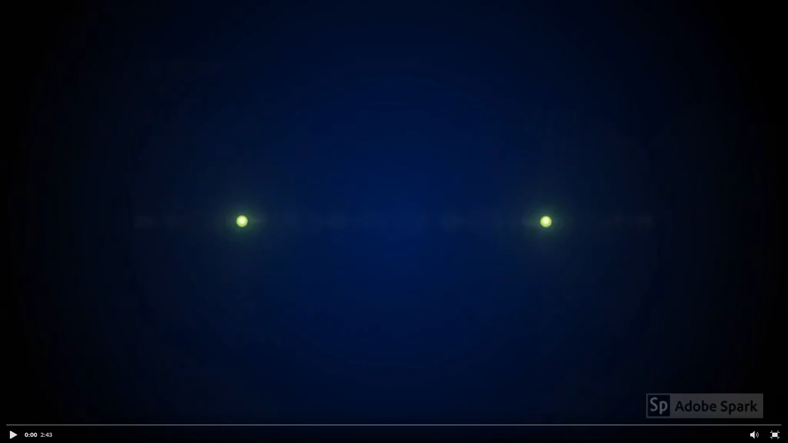


We are proud to present our 5 graduating TAMUCC McNair Scholars and wish them continued success!

Slide 2
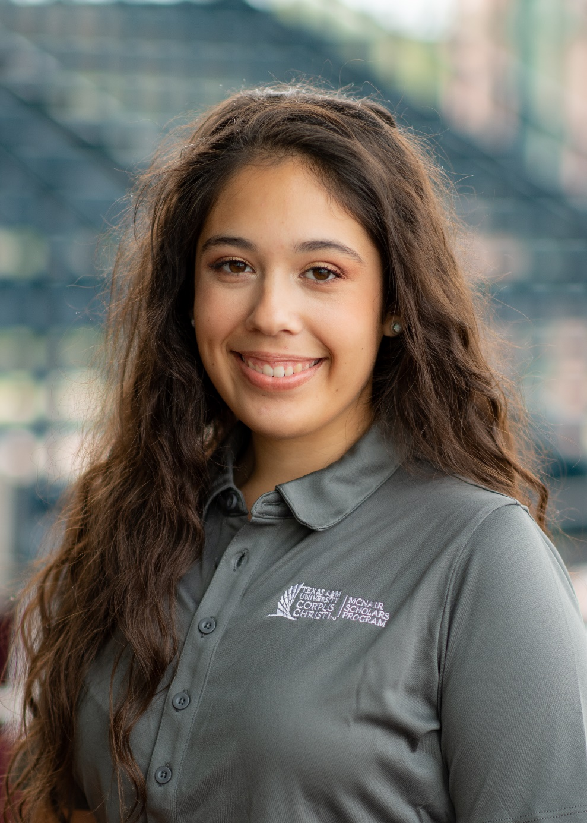

Abigail Champion
Fall 2020
Major: Kinesiology
Mentor: Dr. Heather Webb
Research Title: “Impacts of the Menstrual Cycle Phase on Measures of Body Composition”
Awards, Honors, Etc.: Dean’s List and Summa Cum Laude
Post-Graduation Plans: Has accepted a job offer in her field.

Slide 3
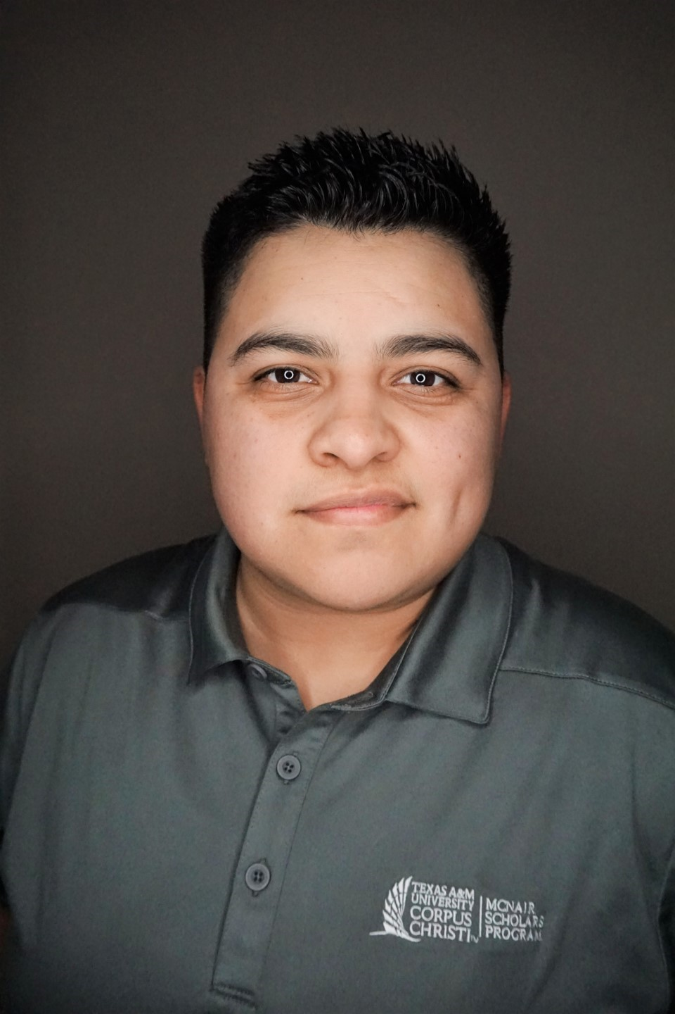
Julie Enriquez
Fall 2020
Major: Engineering
Mentor: Dr. Ruby Mehrubeoglu
Research Title: “Limpet Shell Characterization from 3D Scans”
Post-Graduation Plans: Has accepted a job offer in her field.

Slide 4
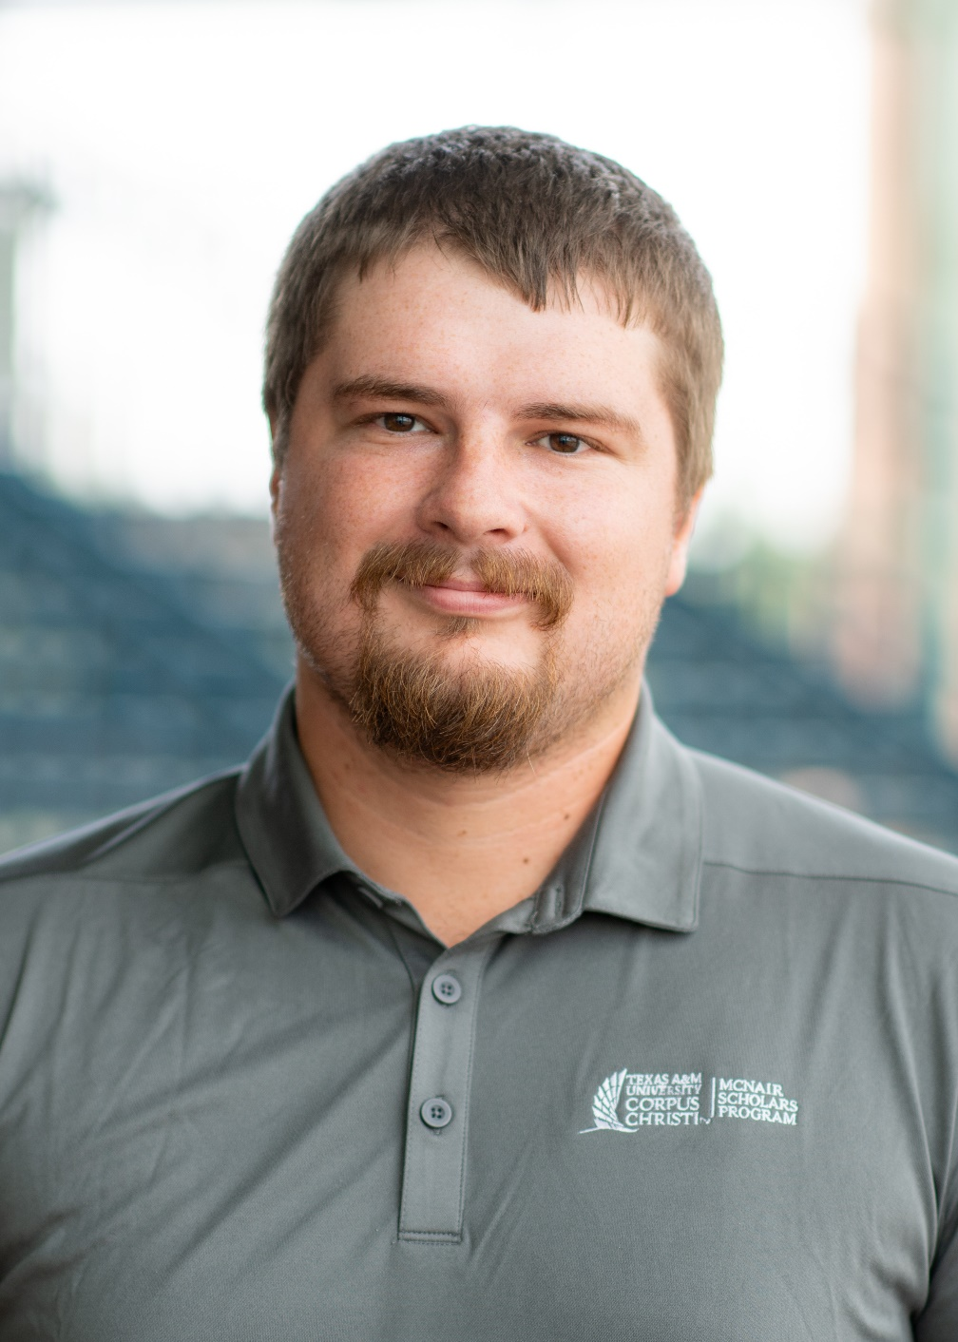
sayge flores fall 2020
Major: Marine Biology
Mentor: Dr. James Hogan
Research Topic: Correlation between the embryonic weight and abundance of live bearing Gambusia affinis and the abundance of predators in Texas coastal streams.
Post-Graduation Plans: Has accepted a job offer in his field.

Slide 5
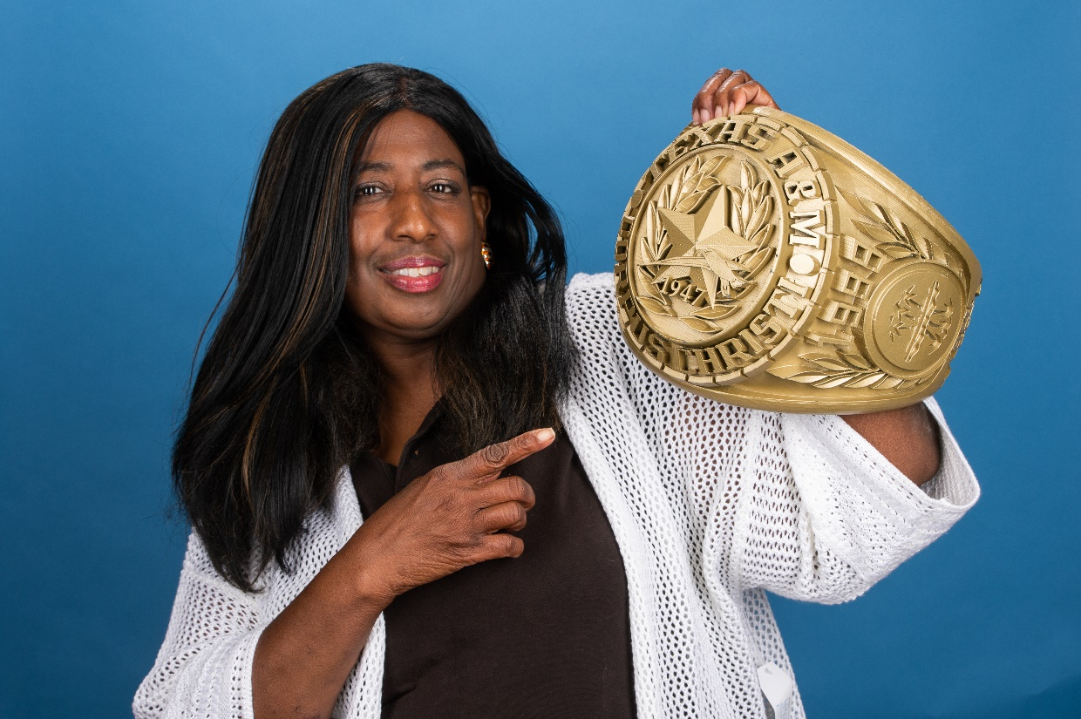
pilar harkless fall 2020
Major: Bio-Medical Science
Post-Graduation Plans: Plans to apply to a post-baccalaureate program at Texas A&M University-Corpus Christi.

Slide 6
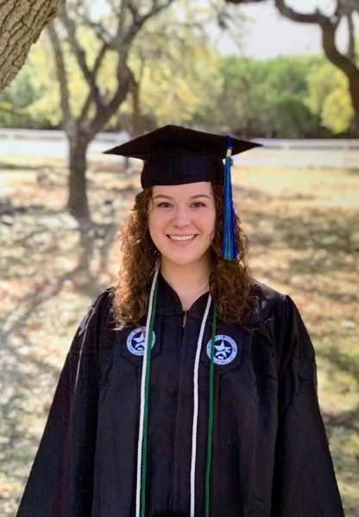
lauren williams fall 2020
Major: Environmental Science
Mentor: Dr. Dorina Murgulet
Research Title: “Geochemical Analysis of Baffin Bay”
Post-Graduation Plans: Plans to apply to a graduate program and enroll by Fall 2021.

Slide 7




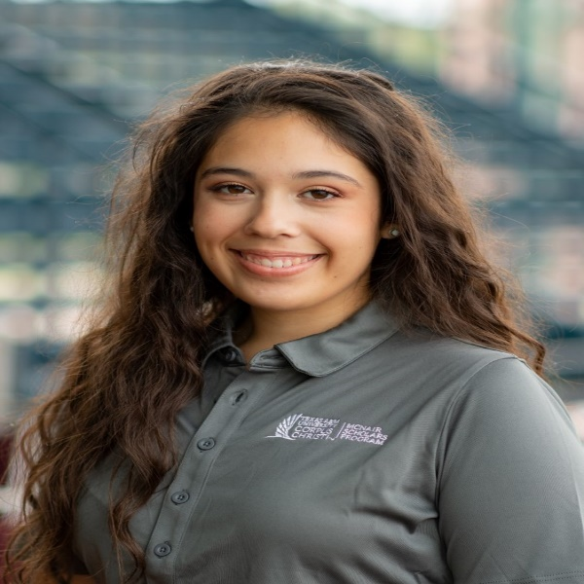

Congratulations to the graduating McNair Scholars of Fall 2020

