Slide 1
Kimberly Hawkenson, C.R.A.
Office of Sponsored Research Administration
October 20, 2022

Slide 2
Overview
OSRA Org. Chart
OSRA Staff
OSRA’s Services
OSRA Policies

Slide 3
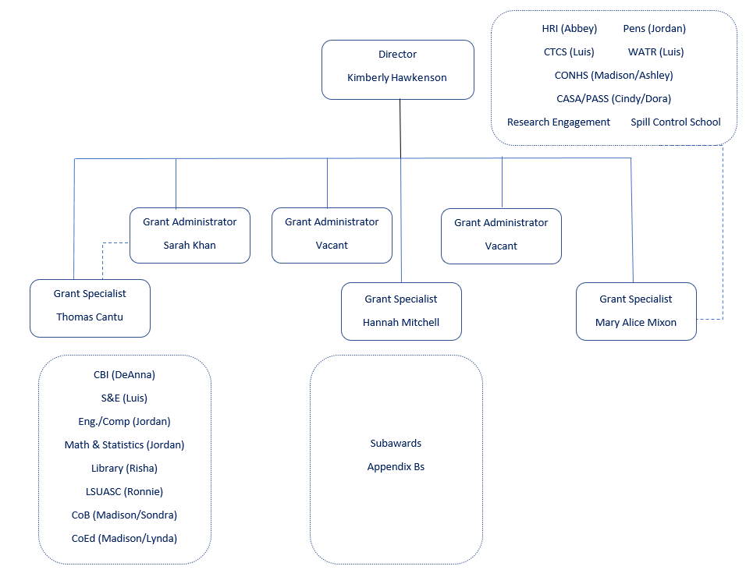
OSRA’s Current Organization Chart
Total Grants 104 49 128

Slide 4
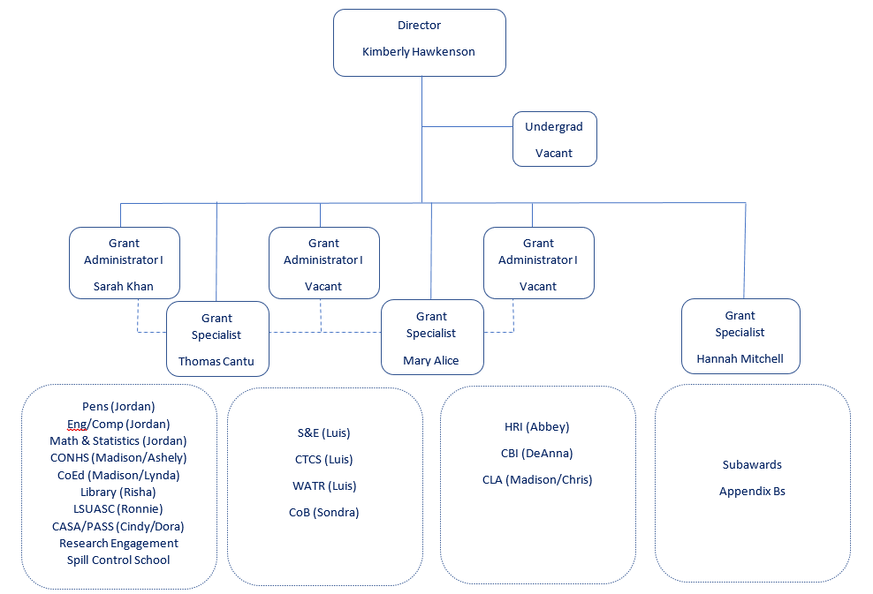
OSRA’s Revised Organization Chart
Total Grants 65 72 95 49

Slide 5
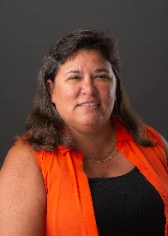
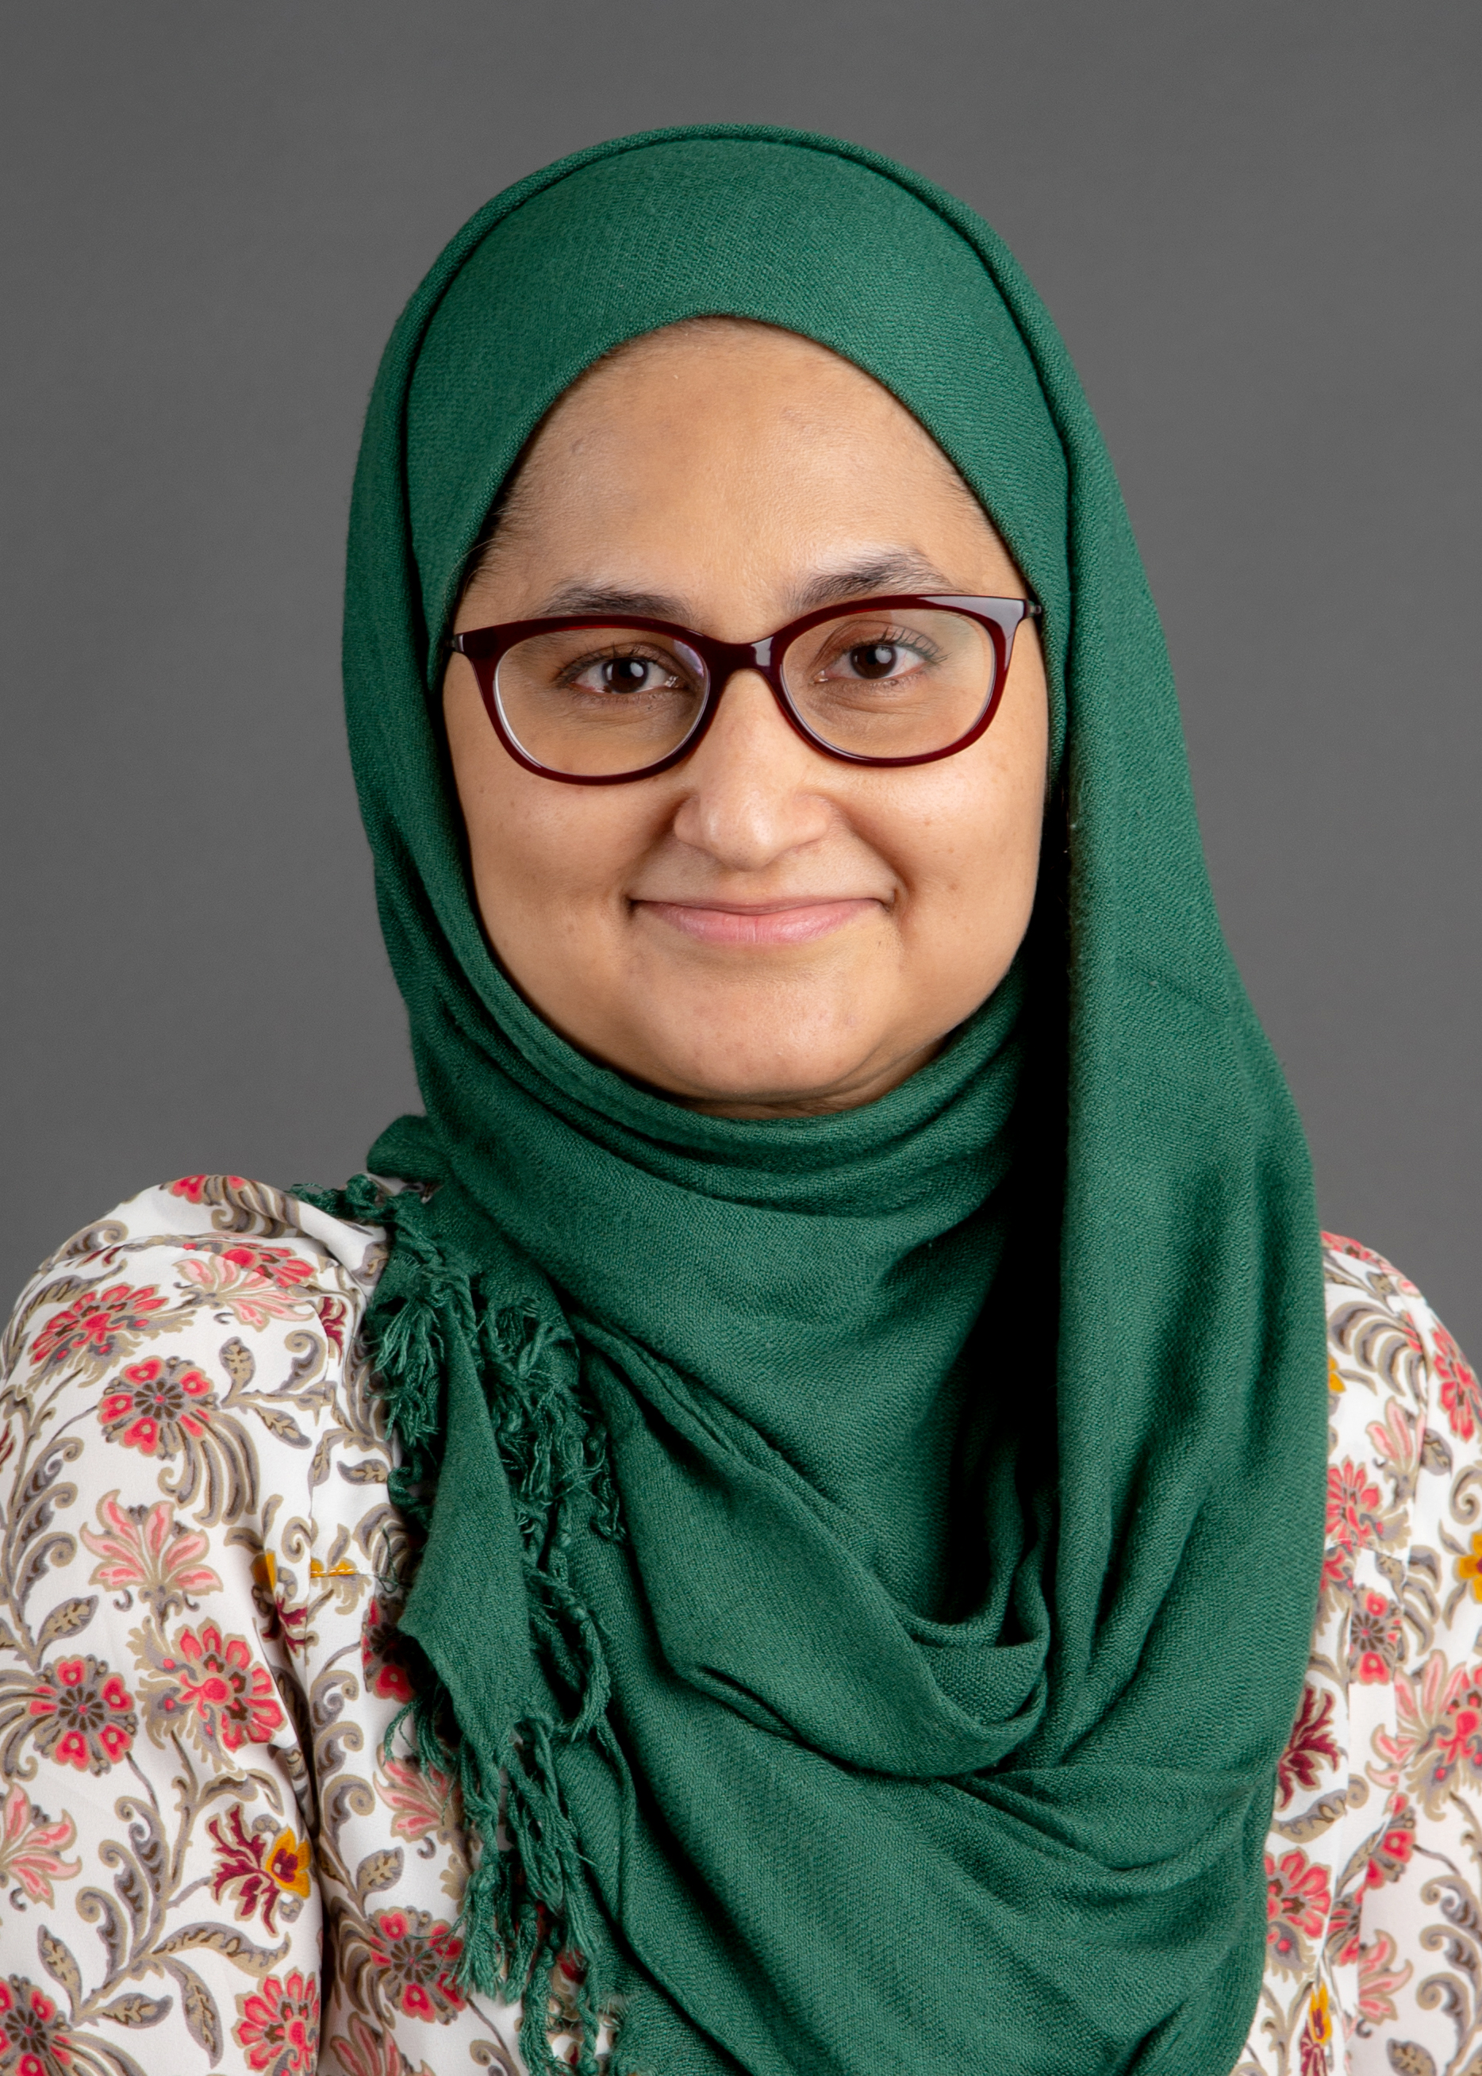
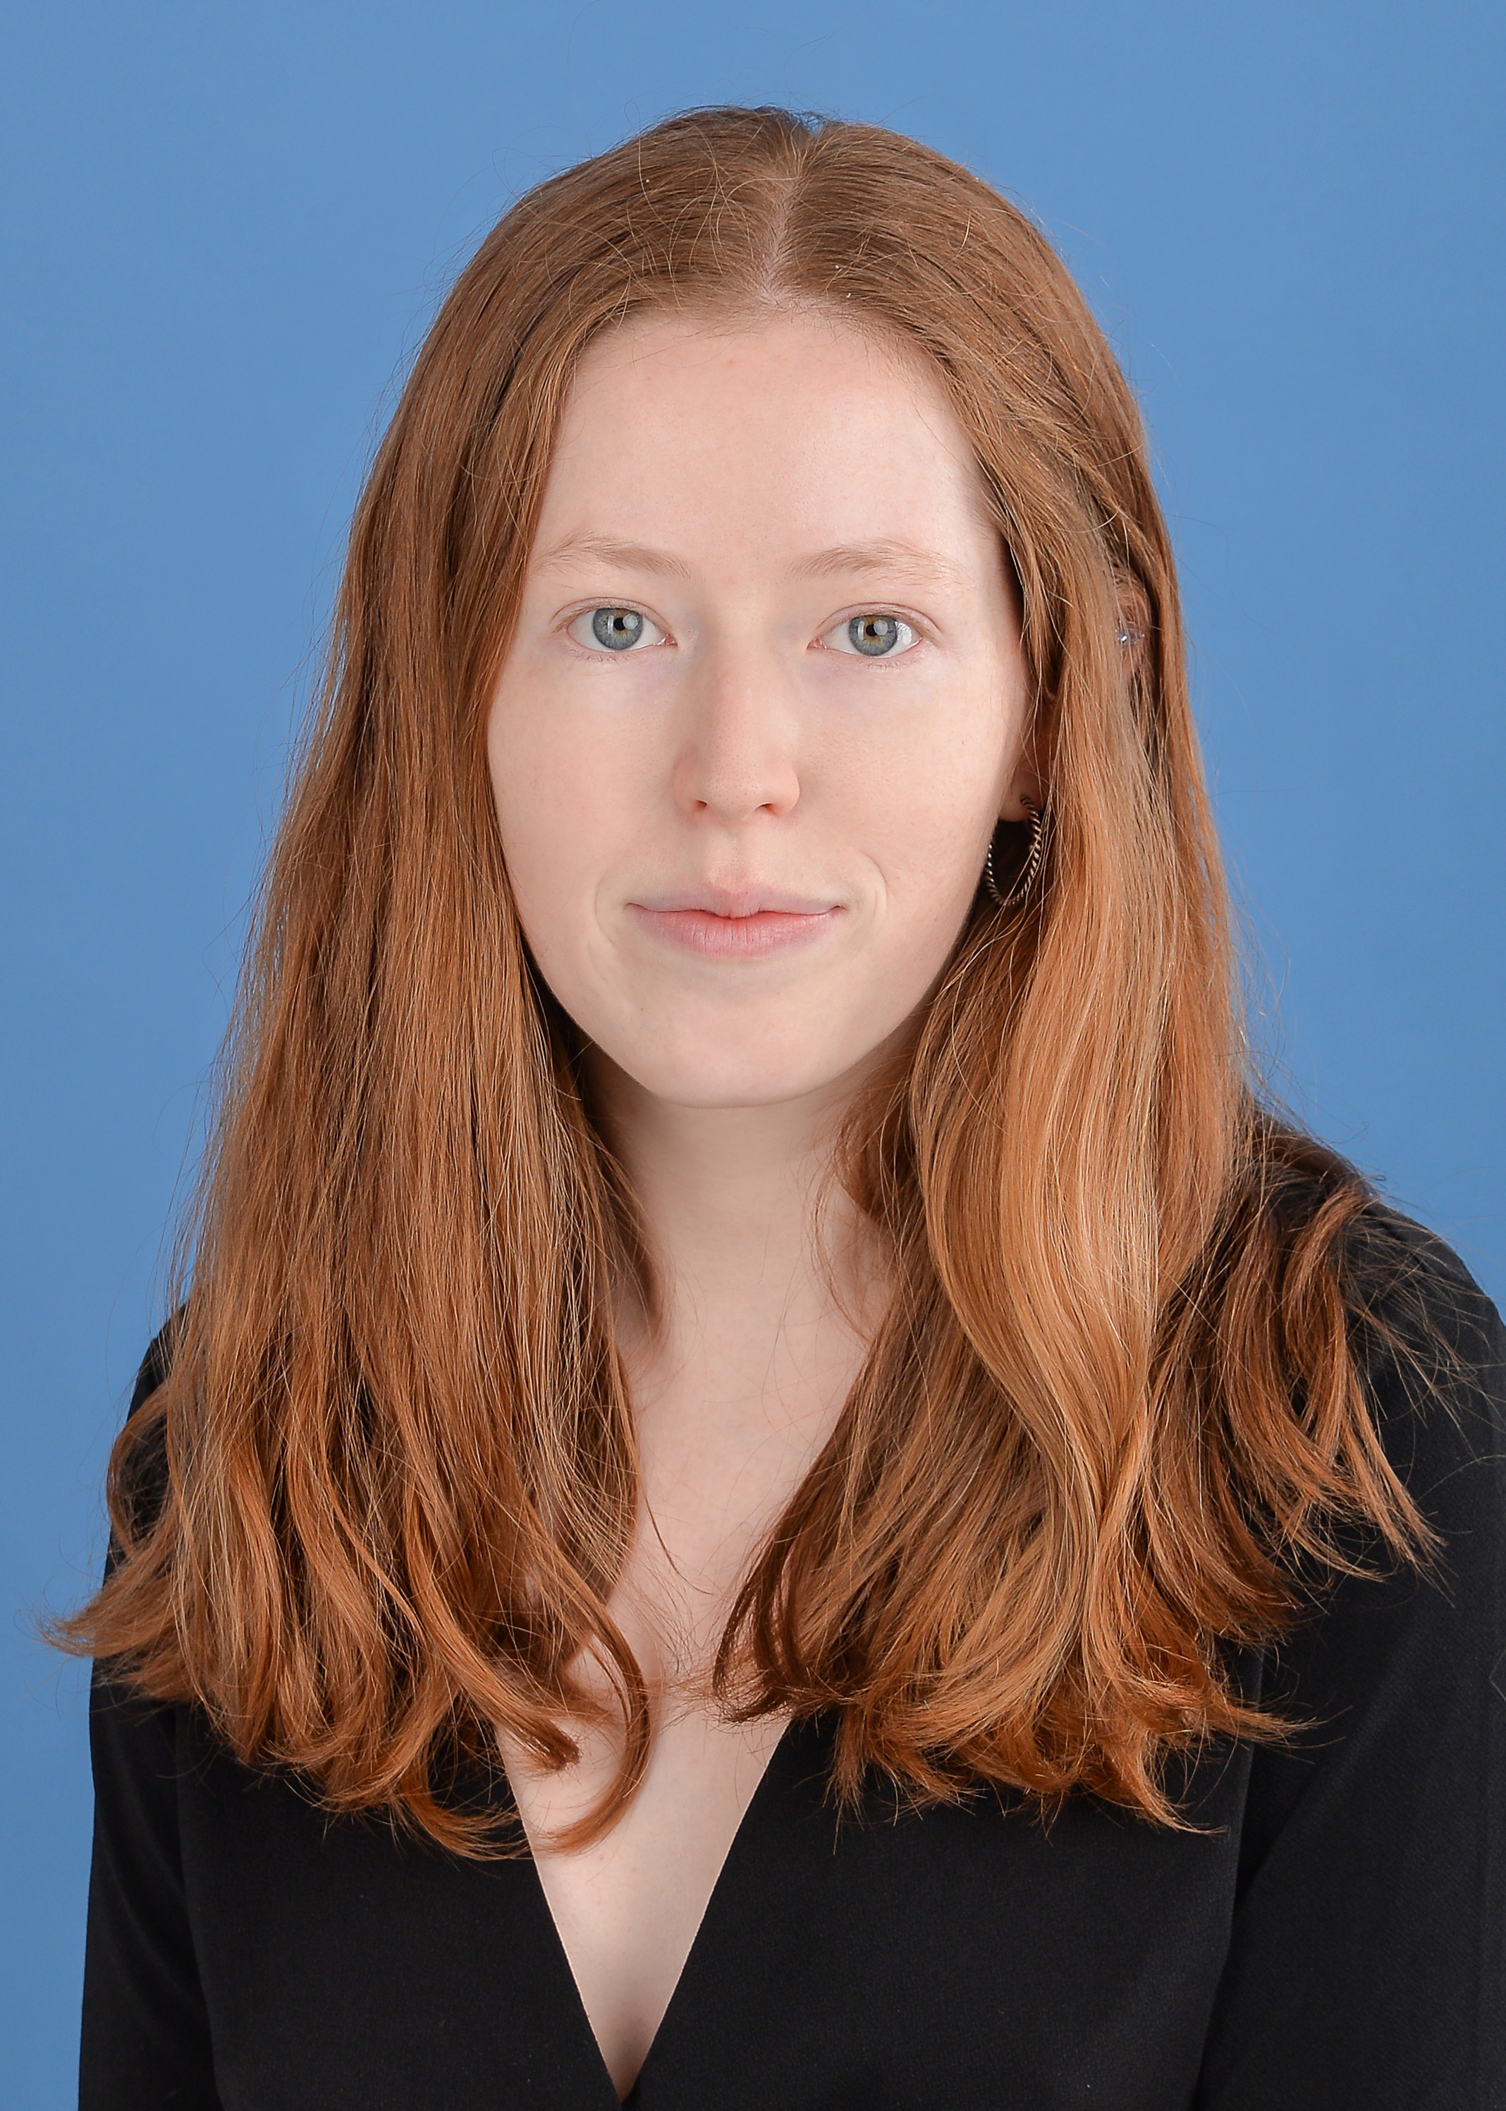
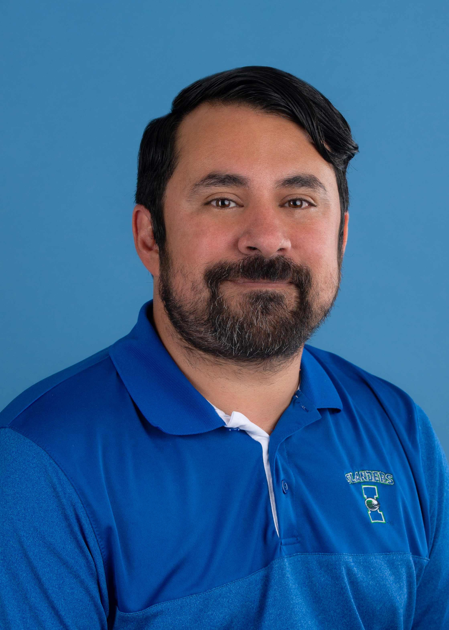
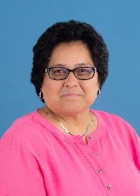
OSRA STAFF
Kimberly Hawkenson
Director of Sponsored Research Administration
(361) 825-2730
kimberly.hawkenson@tamucc.edu
Faculty Center 163
Sarah Khan
Grant Administrator I
(361) 825-3977
sarah.khan@tamucc.edu
Faculty Center 168
Vacant
Grant Administrator I
Vacant
Grant Administrator I
Hannah Mitchell
Grants Specialist: Subawards
(361) 825-3153
hannah.mitchell@tamucc.edu
Faculty Center 170
Thomas Cantu
Grants and Contracts Specialist
(361) 825-3047
thomas.cantu@tamucc.edu
Faculty Center 164
Mary Alice Mixon Grants and Contracts Specialist (361) 825-3885 mary.mixon@tamucc.edu Faculty Center 162

Slide 6
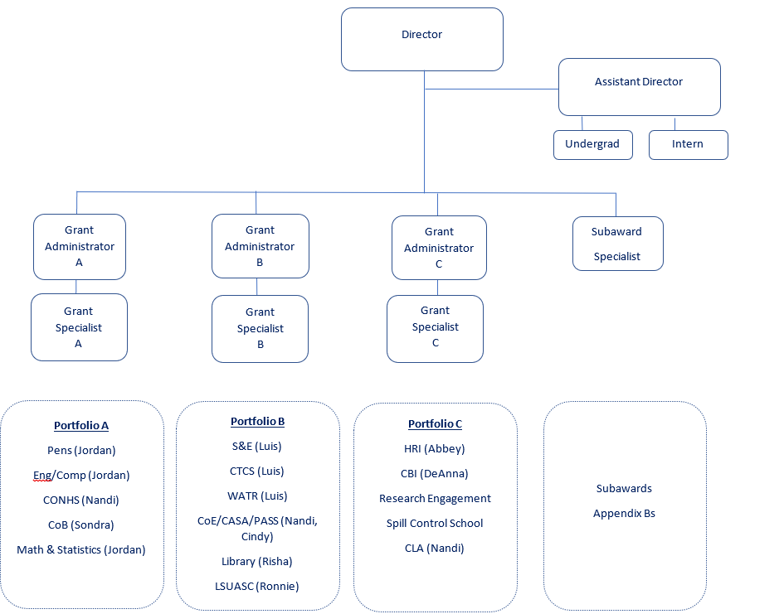
Long Term Vision to Support R1 Portfolio
Total Grants 71 63 98 49

Slide 7
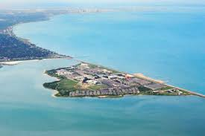
What Does the OSRA Director Do?
Training & Mentorship:
Designs and develops reference materials for research administration team and customers.
Develops and coordinates standardized research administration training programs, including one-on-one mentoring with new research administration staff.
Supports opportunities for professional development and promotion/advancement of team members based on demonstration of competency.
Acts as liaison between senior leadership and team regarding professional development; provides regular updates to and collects feedback.
Pre-Award – Proposal Development and Submission:
Coordinates as appropriate with Sponsored Research Services and The Texas A&M University System.
Facilitates and oversees the application process via proposal review, approval, and submission.
Furnishes advice, guidance and oversight to pre-award team and departmental research administrators.
Negotiate and approve project terms and conditions
Approves and signs extramural proposal applications on behalf of the University.
Post-Award – Award management:
Reviews, approves and signs sponsored projects on behalf of the University.
Develops and implements strategies for communicating and monitoring compliance with University, and other research administration policies.
Ensures understanding of the fiscal performance of research projects and identifies areas of concern that need resolution.
Ensures post-award staff effectively and efficiently manage awards throughout the award lifecycle from project set up to closeout.
Oversees issuance of sub-agreements and their compliance with applicable policies and procedures.
Reviews and negotiates material transfer, confidentiality agreements, data use agreements
Leadership in Research Administration:
Remains current on developments in policies and processes relating to research administration; provides proactive outreach and communication to faculty, staff and administrators on new policies and procedures and updated sponsor guidelines.
Acts as a resource for any compliance questions and issues using existing knowledge, experience and available resources (e.g., sponsor regulations, University policies) for supporting and/or providing guidance within the campus research community.
Serves as the primary point of contact and liaison for sponsored project audits.
Provides oversight for the negotiation and review of agreements, including monetary research agreements and subawards and non-monetary agreements such as memoranda of understanding and data use and confidentiality agreements including ensuring appropriate review of intellectual property rights.
Manages special projects and initiatives as identified by Division and University leadership

Slide 8
MY VISION FOR THE DIRECTOR
Attending as many departmental or College/Center faculty meetings possible to learn what OSRA can do to help administer their sponsored projects and make their jobs easier.
Attending, in person, when possible, any researcher’s presentations to the Coastal Bend community or campus, to learn about their research and build relationships of mutual trust and respect.
Reviewing OSRA’s policy handbook with departmental research administrators and CPIRA to find the most efficient and sensible policies and publishing them so they are available for anyone to access.
Developing training tools & presentations to present to the campus research community.
Reinstating OSRA’s internship program, which has served as an excellent pipeline to create future Research Administrators.

Slide 9
What is the Role of OSRA’s Grant Administrators?
Sponsored Projects Accounting
Assists with opening of Preliminary accounts as needed.
Provides QA/QC of project information in Financial Accounting Management Information Service (FAMIS) including preparing budget entries.
Ensures necessary accounts are set up for cost sharing and monitors and reports cost sharing as required to sponsors.
Prepares financial reports required by our sponsors.
Responsible for Accounts Receivable collections.
Reviews revised budget requests prior to submission and completes sponsor forms as required.
At the end of a project, ensures completion of the close-out module in Maestro. This includes preparing the Facilities & Administrative Costs reconciliation, coordinating with departmental research administrators to ensure encumbrances are cleared and documenting any expenses that post after project end date, and freezing accounts for additional financial activities.
Sponsored Projects Compliance
Reviews and approves Payroll Costing Allocations and Payroll Correction Transaction for accuracy, while monitoring Key Personnel level of effort to ensure compliance with OMB 2 CFR 200.
Ensures that project deliverables are submitted in accordance with sponsor agreements.
Verifies approval of compliance protocols (during award set up).
Verifies compliance with federal regulations regarding financial disclosure of potential conflicts of interest.
Monitors sponsored projects for compliance with University, and other research administration policies and procedures.
Assists with federal and state and TAMU System audits and program reviews related to sponsored projects, including single audit requirements under OMB 2 CFR 200 subpart F.
Sponsored Projects Administration
Provides support, guidance, and expertise to faculty and staff regarding issues related to post-award research administration.
Assists faculty and Departmental Research Administrators with No Cost Extension Requests.
Assists faculty and Departmental Research Administrators with Award Transfers for separating Employees
Provides oversight of sponsored project administration including the review and approval of cost transfers and effort reporting.

Slide 10
What is the Role of OSRA’s Specialists?
Post-Award Specialists
Responsible for Data Entry for new awards and amendments in Maestro.
Reconciles cost-reimbursable invoices to back-up documentation to ensure expenses are reported in compliance with the project budget, with regulations stipulated by the granting agency and in accordance with TAMUS and TAMU-CC's fiscal policies and procedures.
Prepares sponsor required invoice forms as needed.
Reviews and approves financial transactions on sponsored projects to determine if the expenses are allowable, allocable and reasonable. This includes purchase requisitions, travel requests, travel expense reports and PCard purchases. Reviews and approves vendor invoices as needed.
Sub-Award Specialist
Performs Risk Assessments for new subawards and reviews risk assessments annually.
Drafts and negotiates new subawards and subaward amendments.
Maintains documentation to/from subawardees with reliance agreements to verify continuing review of expiring compliance protocols has been completed (if applicable) (R&I input needed).
Reviews subaward invoices for allowability. Obtain approval from PIs or their delegate for payment and submits subaward invoices to Accounts Payable for timely payment.
Prepares monthly FFATA report for Federal reporting and upload to the FFATA subaward reporting system (FSRS) after review by the Director of OSRA.
Enter new subawards and updates project information in MAESTRO sponsored research administration modules.
Track due dates of subaward deliverables required in assigned agreement to ensure compliance with prime sponsor’s regulations i.e., Budget, IRB, IACUCC, IBC, and Export Control.

Slide 11
Compromise
Collaborate
SUCCESS
I NTERPRE T

Slide 12
Policies
Prior to COVID-19 and the loss of staff, the OSRA team was working to devise a Handbook of OSRA’s Policies and Procedures.
I used my time over the Winter Break that year to finish the Handbook.
It was reviewed and approved by CPIRA, but it was never approved by the previous AVP of R&I to be published.
I plan on reviewing again this year and publishing the Handbook on our Postaward website.
New Policies Needed
Compliance with System FCOI Policy.

Slide 13
Excited for the future of our office!
We are entering a new era in our division.
The OSRA staff is fairly new.
We have a new AVP for Research and Innovation.
I am excited to see what the winds of change hold for us.
I am proud to be a part of the leadership team that helps our University Grow to be an R1 Institution.

Slide 14
QUESTIONS?
Kimberly Hawkenson
Kimberly.hawkenson@tamucc.edu
361-825-2730

