Slide 1
Attaching Documents in iRIS
Rebecca Ballard, JD, MA, CIP May 25, 2021
Director, Research Compliance

Slide 2
Welcome!
I’ll be guiding you through today’s course objectives.
How to upload documents in iRIS.

Slide 3
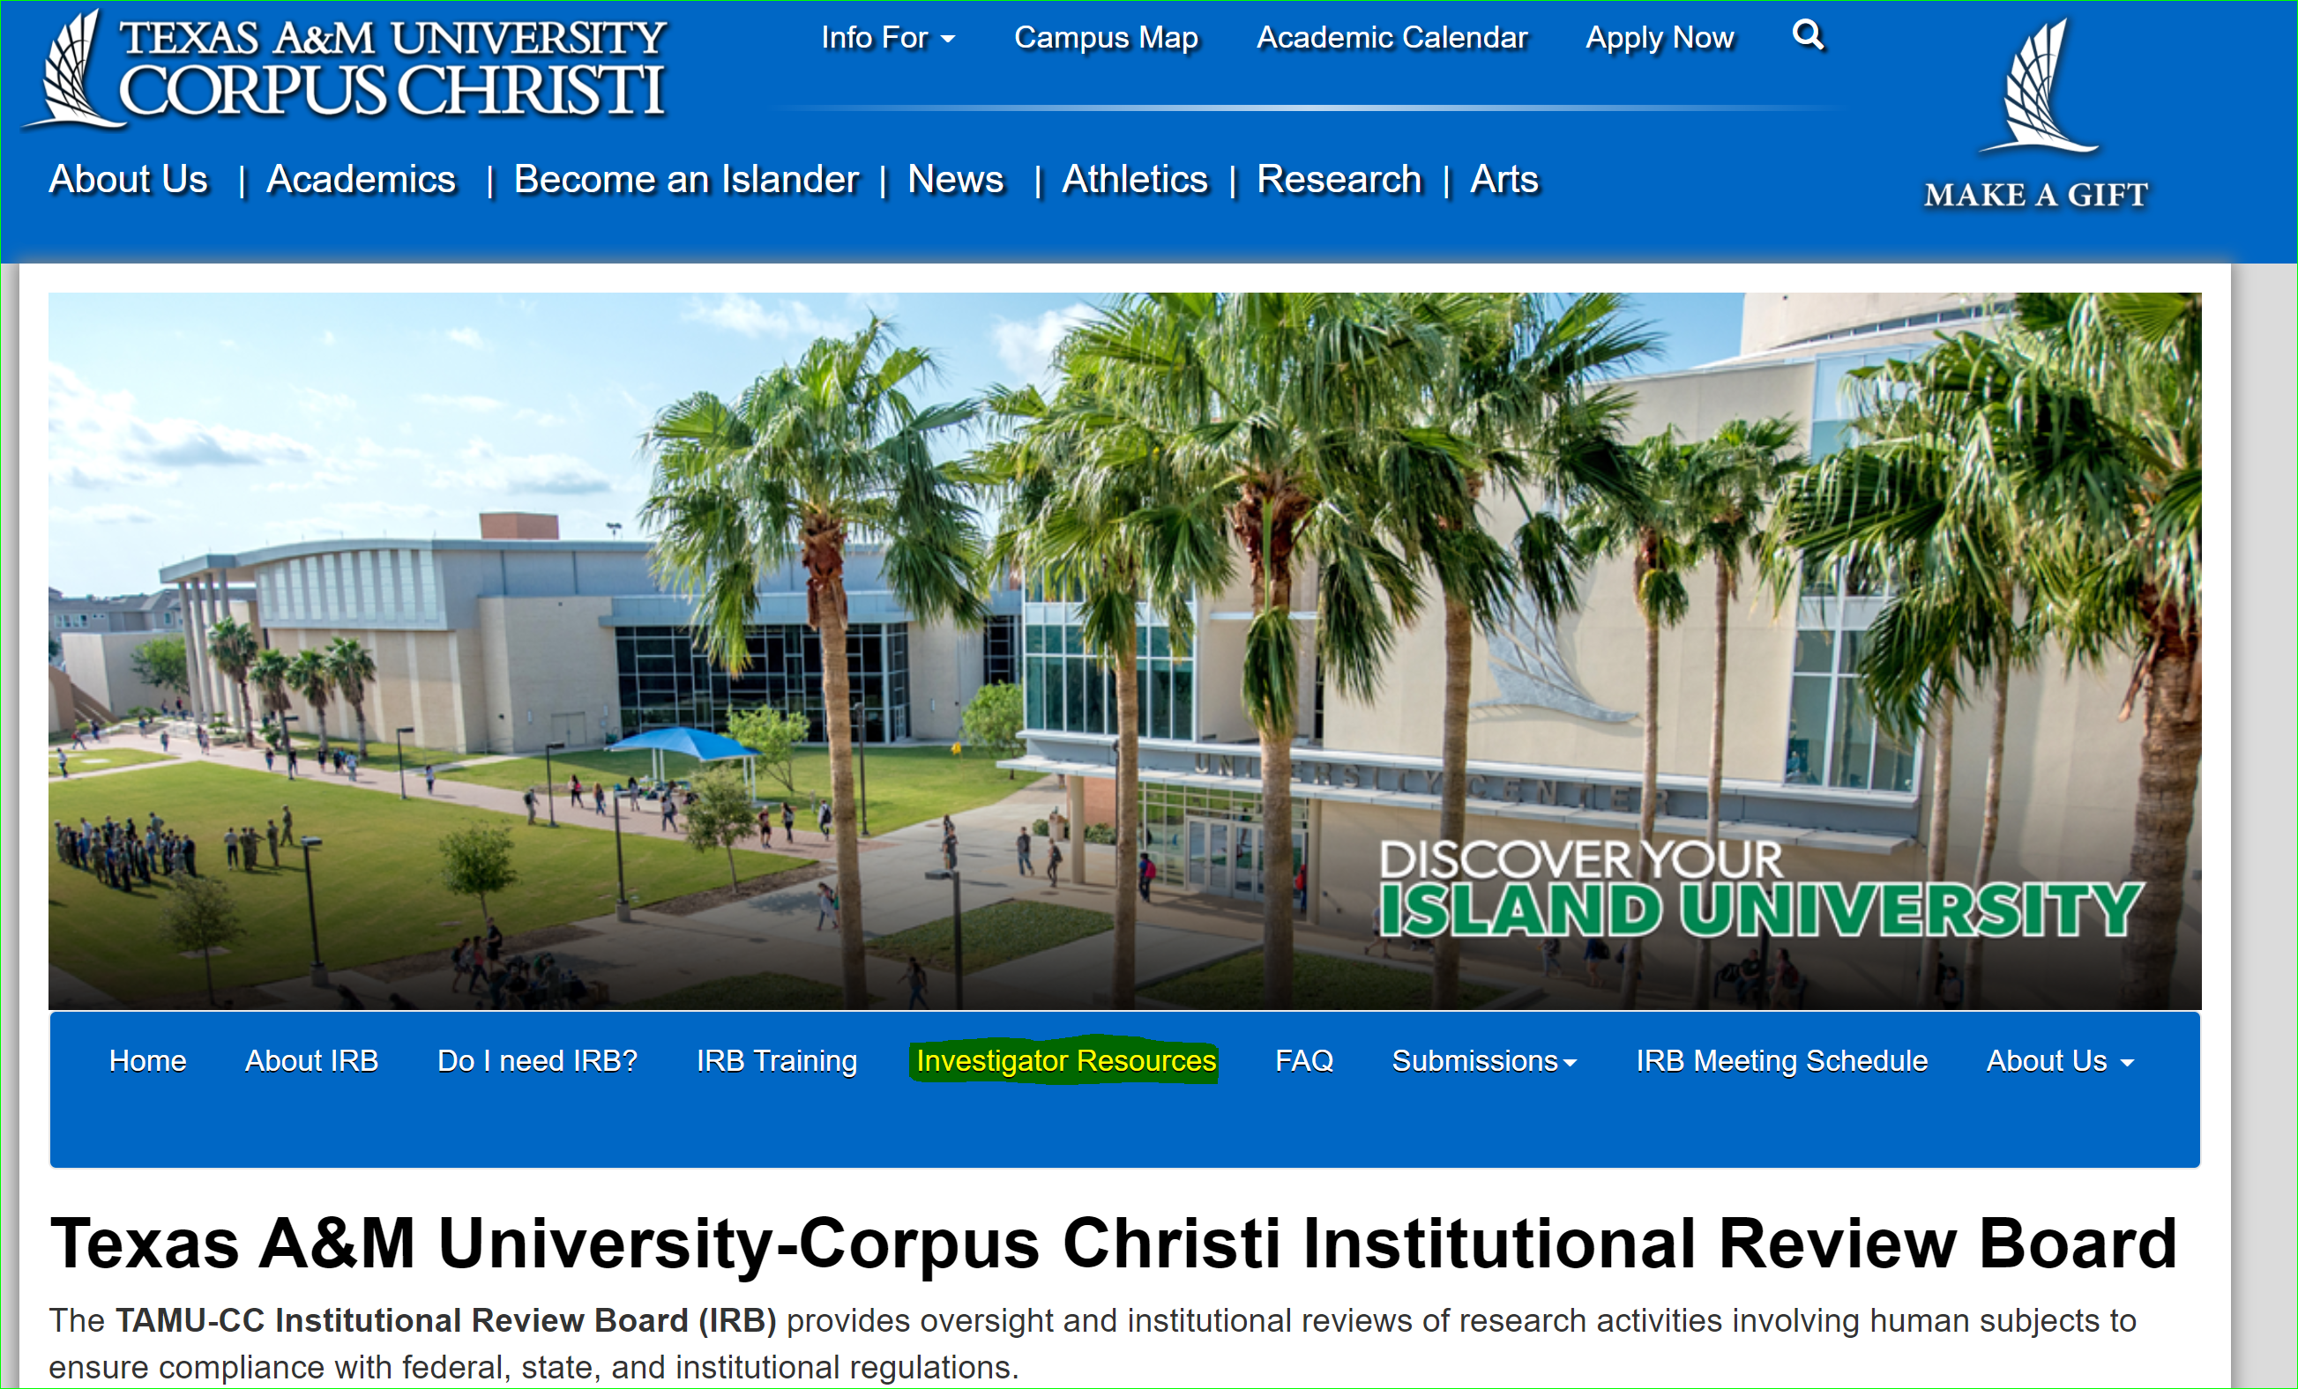
Submission Packet
The completed submission consists of several parts:
You can find templates for study documents on our website under Investigator Resources.
The Study Application
Study Documents
Consent forms
Recruitment Materials
Questionnaires
Interview Questions

Slide 4
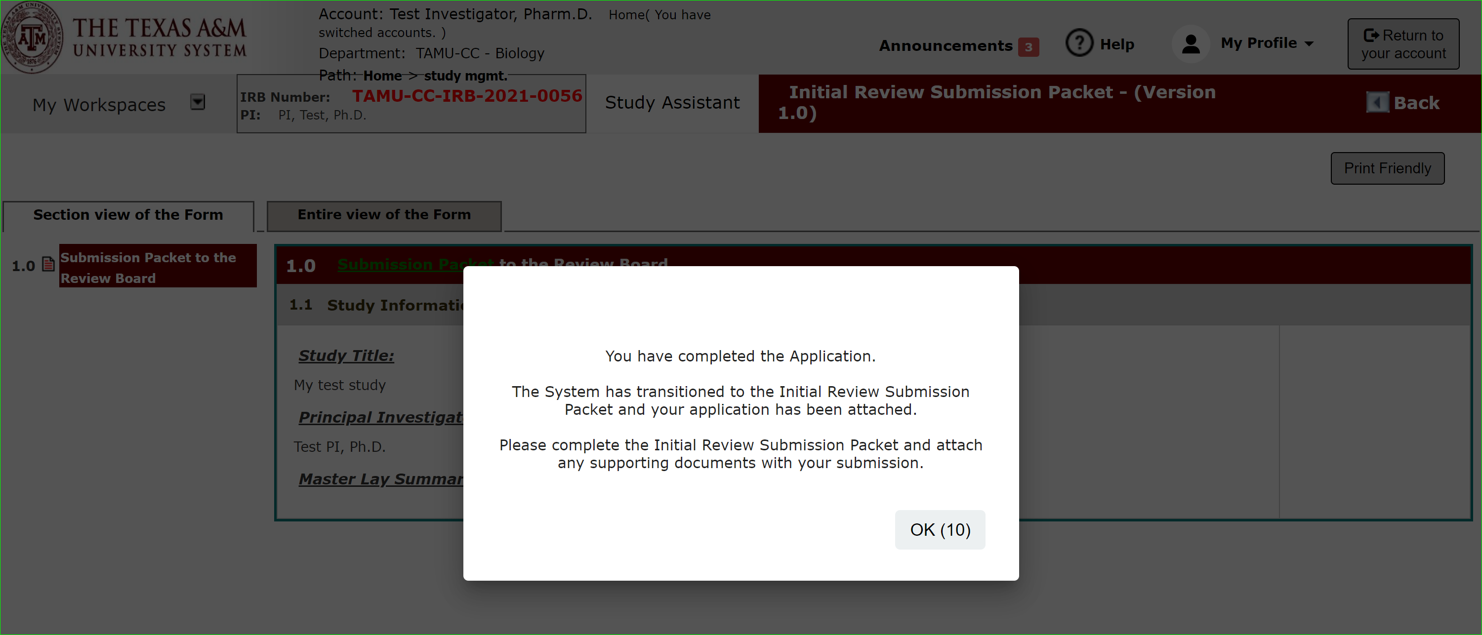
Application Complete
Once you have completed the application portion of the submission packet, you will see this message and be taken to the submission packet.

Slide 5
Submission Packet
You will automatically be taken to the submission packet to upload documents related to your application.

Slide 6
Submission Packet: Upload Supporting Documents
As you progress through the submission packet you will see the IRB Application form you just filled out and then will be prompted to attach various study documents.
"Add a New Consent" in the Informed Consent section.
"Add New Document" or "Add Multiple Documents" in the "Study Documents" section.

Slide 7
Supporting Documents Templates
Supporting Document Templates are available.
Download on the IRB’s website under Investigator Resources: https://irb.tamucc.edu/investigator-resources.html.

Slide 8
Submission Packet: Add a New Consent
The Initial Review Submission Packet select “Add a New consent” in the informed consent section.

Slide 9
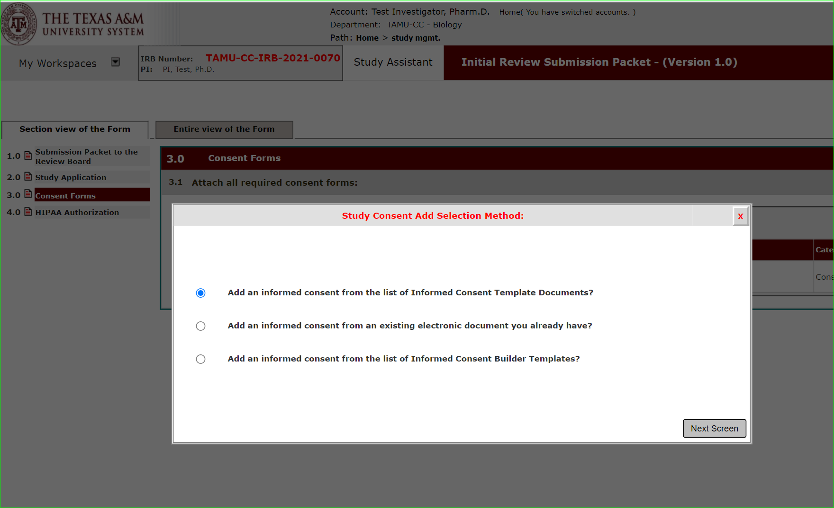
Add a New Consent: Consent Form Templates
There are three methods you can use to get started on your consent form.
Consent Templates
This option allows you to access the consent form templates from within iRIS.
Download. Edit the Document.
Upload final edited version for review.

Slide 10
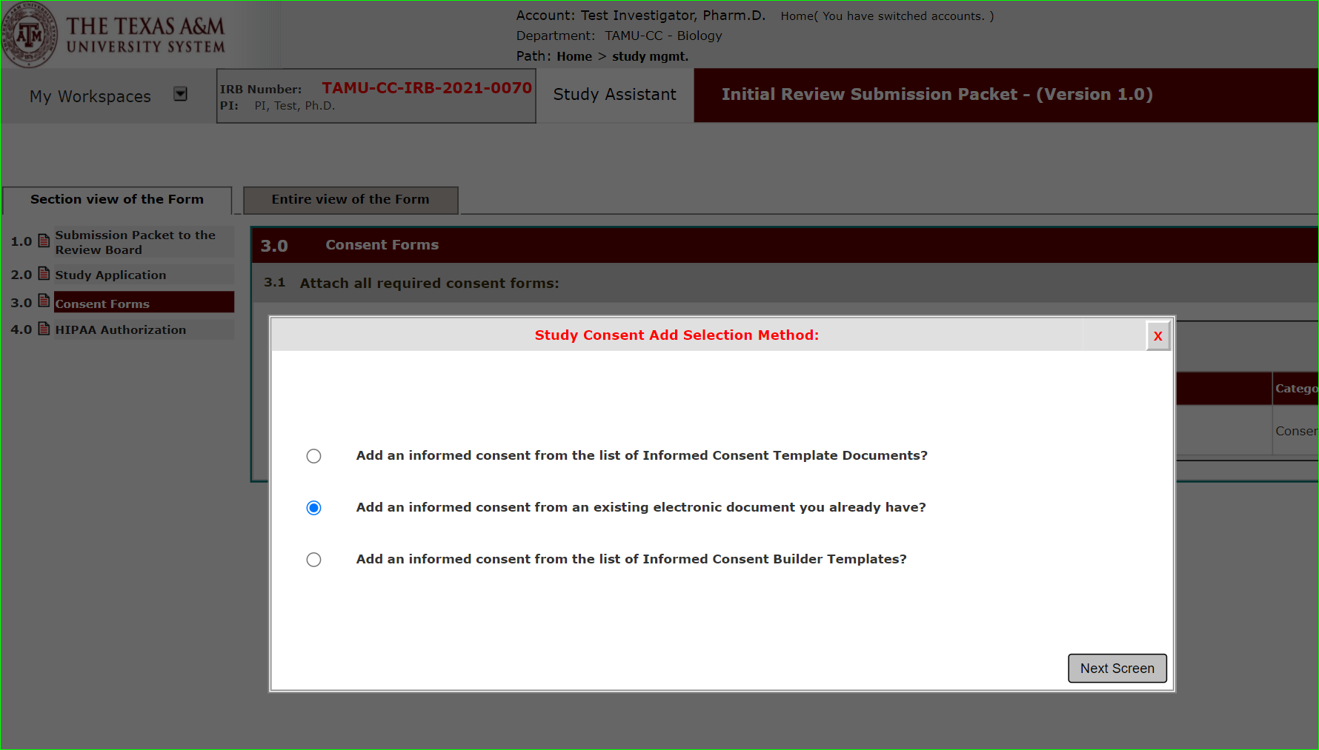
Add a New Consent: Consent Form Templates
There are three methods you can use to get started on your consent form.
Consent Upload
If you already accessed the templates from our website and have a final version ready for upload, this option allows you to upload the consent document.

Slide 11
Add a New Consent: Consent Form Templates
There are three methods you can use to get started on your consent form.
Consent Builder
This option allows you to select a consent template from within iRIS. Using merge code the system will prepopulate items for you, like study title, PI name.
Download. Edit the Document.
Upload final edited version for review.

Slide 12
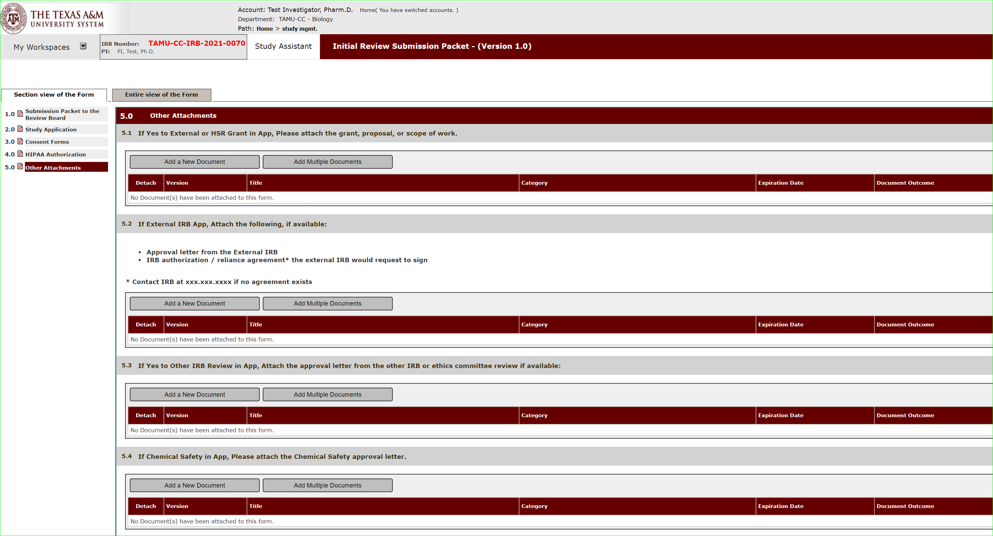
Add Study Documents
Upload supporting documents like surveys, recruitment materials, etc. in Other Attachments.

Slide 13
Add Study Documents
Upload supporting documents like surveys, recruitment materials, etc. in Other Attachments.

Slide 14
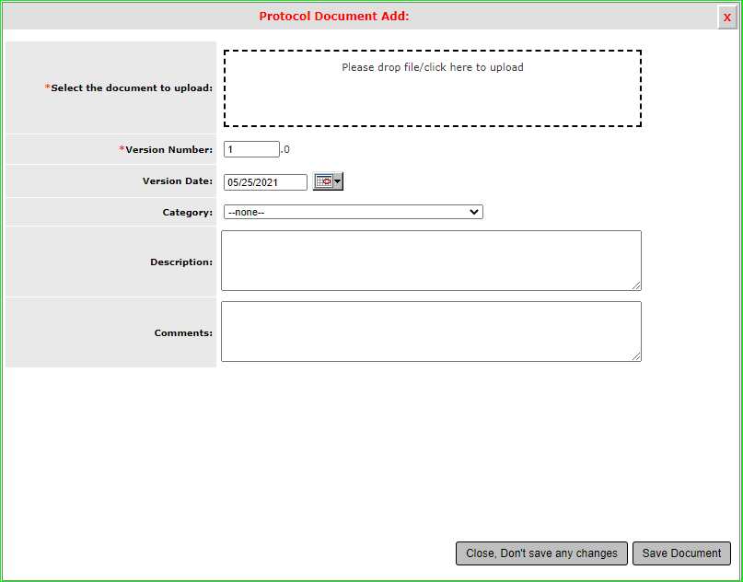
Add Study Documents
Drag and Drop or click to upload the document.

Slide 15
Add Study Documents
Add version number. Version 1 is defaulted.

Slide 16
Add Study Documents
Add version date.

Slide 17
Add Study Documents
Select the document category such as protocol, recruitment material, etc.

Slide 18
Add Study Documents
You can enter any description of the document.

Slide 19
Add Study Documents
You can enter any comments you would like for the document.

