Slide 1
Changes Requested
Rebecca Ballard, JD, MA, CIP February 27, 2023
Director, Research Compliance

Slide 2
Welcome!
I’ll be guiding you through today’s course objectives.
How to review and respond when changes are requested.

Slide 3
How will I know when changes are requested?
iRIS will notify you as soon as review has been completed and changes have been requested on your application.
1
You will receive a notification via email that changes have been requested on your submission.
2
The Protocol Status will also change to “Changes Requested”

Slide 4
Study Team Task
3
The submission will show on your outstanding tasks lists when you login on your dashboard.
Click the paper/pencil icon to open the submission.

Slide 5
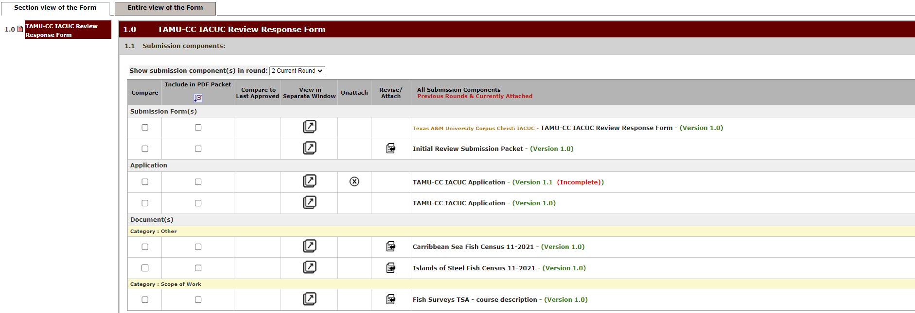
Submission Components
The first thing that will be displayed is the submission components. This includes the application and all attached forms.
If you have created a revised version, the versions for the components will show in the submission component list.

Slide 6
Where do I find what changes need to be addressed?
Scroll down to “Stipulations to address” to view the list of stipulations.
To create a new editable version of the component, click “Revise Existing”.
IACUC Application (version 1.0)

Slide 7
Where do I find what changes need to be addressed?
Under description will describe what needs to be changed.

Slide 8
Where do I make the changes?
The change requested will be linked to the submission components.
Click on the created revised version to open the component to make your changes.

Slide 9
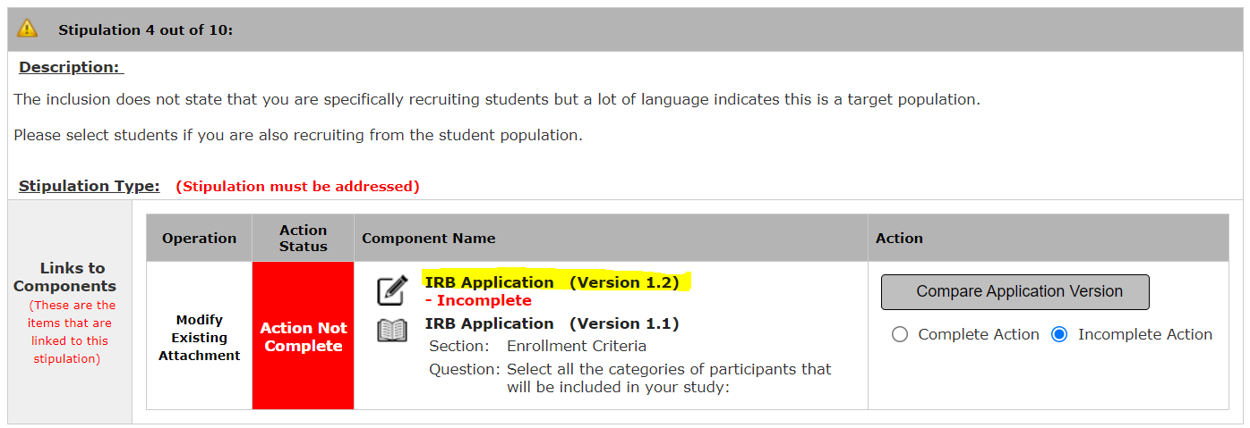
How do I make the changes needed?
This creates a new version that is now editable to make changes.

Slide 10
How do I make the changes needed?
Click the new version to make the changes you need.

Slide 11
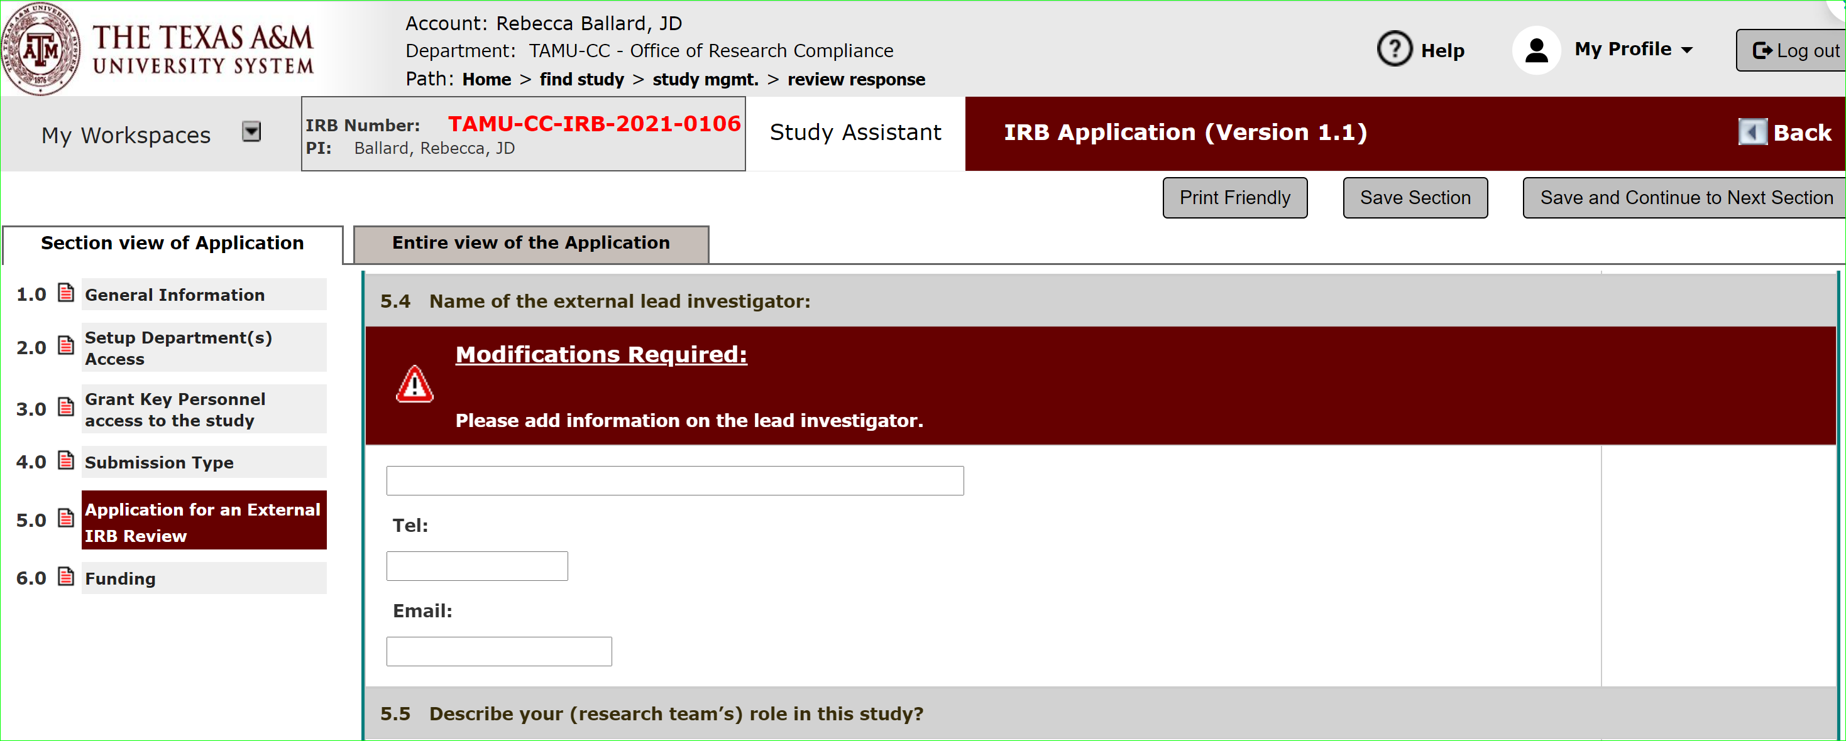
How do I make changes?
Your application will now open and display the stipulation to guide you on what to change.

Slide 12
How do I make changes?
Click back to go to the change requested form to view next stipulation.

Slide 13
What do I do after I’ve revised the application?
Once addressed, mark complete action. The Action status is changed from red to green.
Repeat the process until all stipulations are addressed and marked as “Action Complete”.

Slide 14
Sign-off and Submission
After addressing all stipulations, click Save and Continue to the Next Section to reach the sign-off page.

Slide 15
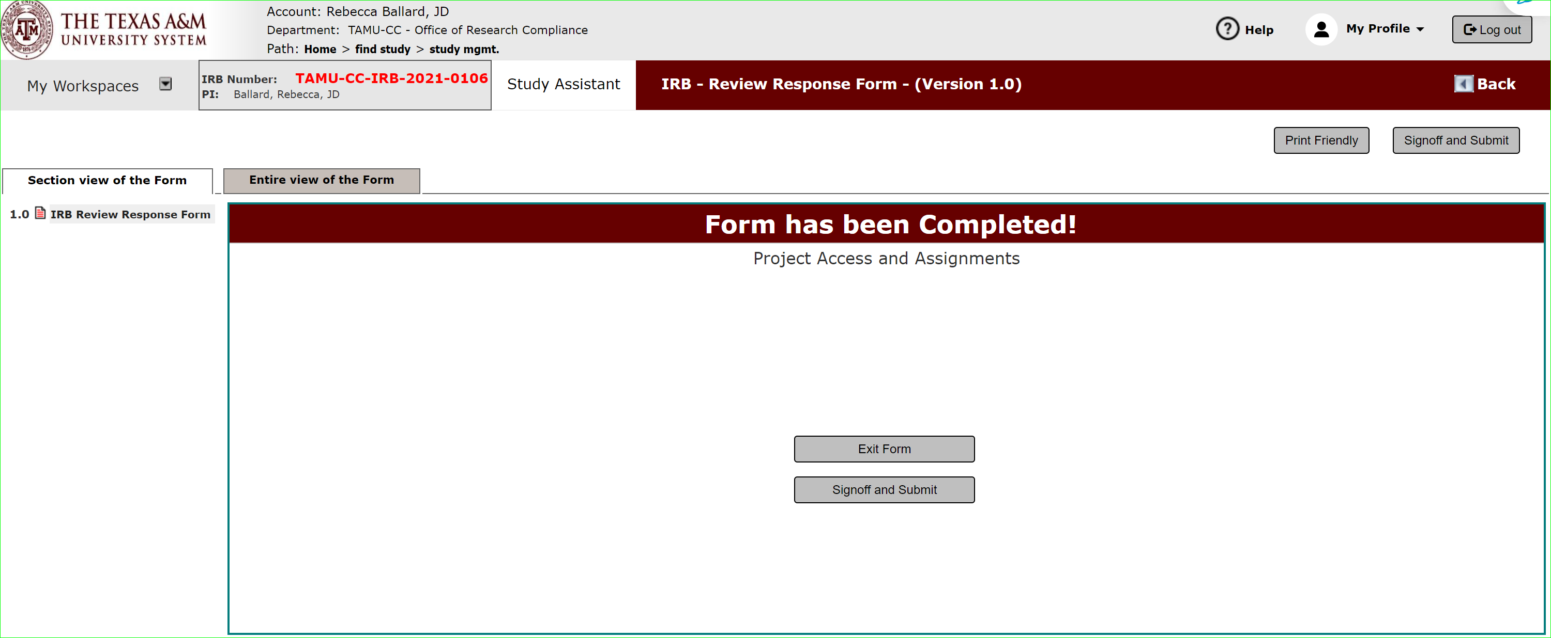
Sign-off and Submission
Click sign-off and submit.
Note: Only the PI can sign-off.

Slide 16
Sign-off and Submission
Click sign-off and submit.
Note: Only the PI can sign-off.

Slide 17
Changes Submitted
Once submitted the application will be routed to the IACUC office for review.
The change requested task will be removed from your task list on the protocol dashboard.

Slide 18
Let’s see these steps in action.

