Slide 1
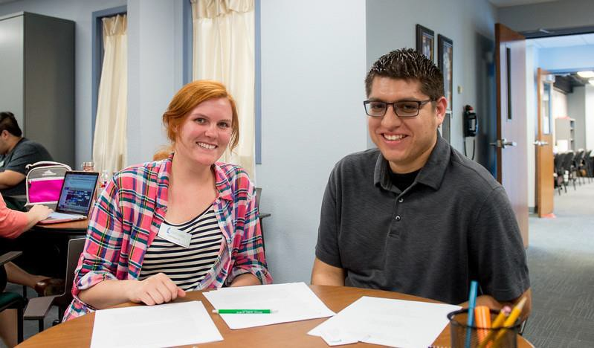



Graduate Academic Writing & Professional Communication

Slide 2

Objectives/Learning Outcomes
Participants will enhance their understanding of writing
expectations at graduate level.
Participants will be able to identify their current writing strategies and be aware of resources for expanding those.
Participants will gain an understanding of professional written communication in the academy.
Participants will be able to identify University resources and strategies to assist them in their writing efforts.

Slide 3

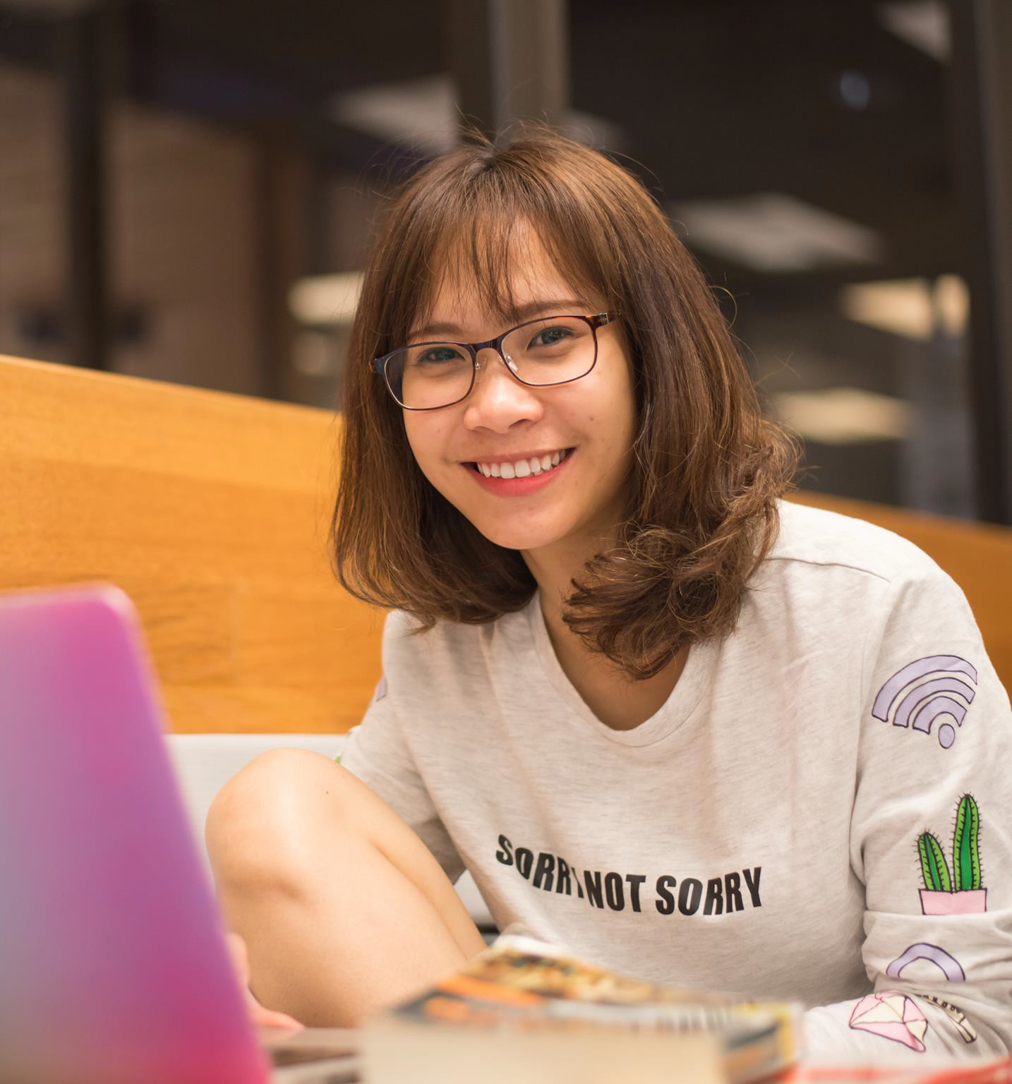
Why it Matters
One of the biggest concerns expressed by graduate students
  Lack of confidence
  Lack of time
  Lack of skill in utilizing scholarly resources
A critical skill in business/industry
Often thought of as a box to check off (e.g., assignment submission, thesis/dissertation completion)
Higher expectations of student writing from professors

Slide 4

Graduate vs. Undergraduate Writing
No official rules
Purpose of writing
  More than writing to fulfill an assignment – striving for broader relevance
Often requires summarizing and synthesizing information (e.g., less reliance on direct quotes, emphasis on showing similarities and differences in the scholarly conversation about a topic)
Vocabulary and formatting specific to the field
Should follow conventions of the discipline
Writing tasks become more complex the farther you go.

Slide 5

Grammar and Mechanics
Reasonable command of both is expected in graduate school.
  Fundamental baseline for most disciplines;
not the essence of academic writing but can
have impact on how your work is viewed
Both matter in academic professional writing.
What’s the difference?
  Grammar: how we put words together to
form sentences and paragraphs –
fundamental structure of language
(thewritepractice.com/grammar-vs- punctuation)
  Mechanics: punctuation, capitalization,
spelling, format
Adequate grammar and mechanics promote clarity in writing.

Slide 6
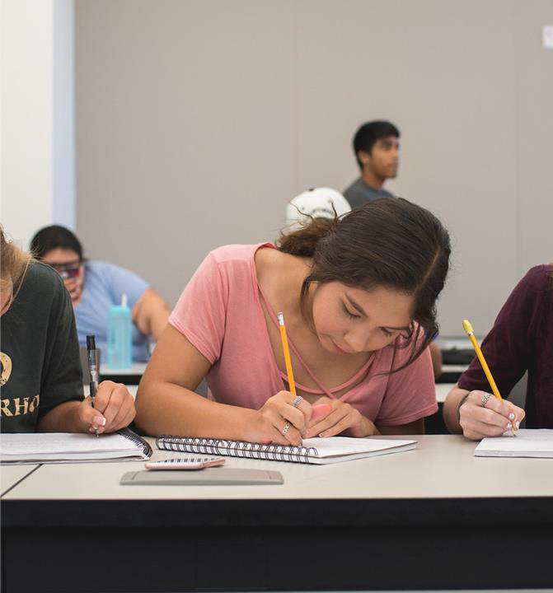
Writing Strategies
Has to do with “how” you write; requires
reflection to improve or expand
  What is your main strategy for writing?
Why?
  Does it vary according to what you are writing?
  What other strategy(ies) have you used?
  What has worked for you?
  What have you tried that did not work for you?
One strategy is not likely to work for everything
or all the time
  Tip: Identify additional strategies early in your program.

Slide 7

General Tips
Read the syllabus instructions for writing assignments as well as any rubrics included.
After reading the instructions, ask questions if you need clarification.
Use required style guide or specific conventions within it for your discipline unless directed to do otherwise (e.g., cover page, heading style, citation style).
Be clear about the kind of writing assigned (e.g., literature review or research paper, reflective paper, demonstration of learning such as exam-style essay). In other words, know the purpose.

Slide 8

Tips, continued
Make writing a routine practice.
  Calendar
Actively seek feedback.
  Peers in your program
  Readers outside your field
  Writing Center
  Faculty advisor/instructor
Finish early enough to proofread and edit more than once.
  Software?
Know that revision is a good thing.
Read – a lot!

Slide 9


Tips for Writing a Paper
Structure your paper so that the flow is organized and clear.
Generally, move from the broad to the specific and detailed ideas or do the opposite. Avoid going back and forth between these two ways of organizing.
Connect ideas throughout the paper.
Define terms and provide sources of information.
Avoid casual language and clichés – use your professional voice.
Cite!
Follow instructions. (Yes, we notice!)

Slide 10

Clarity
Know that writing clearly takes effort.
State the goal and do so early in the paper.
Use concrete examples if appropriate.
Avoid wordiness.
Add structure with headings and subheadings and consistent constructions (e.g., if you indicate you will discuss Blue, Red, and Yellow, then do so in that order.)
Use transitional phrases (e.g., however, in sum, in contrast to), and use them correctly.
Keep sentence construction simple – one or two ideas.
Have someone else read your paper who has not been involved in that work. Then ask them what they understood from reading it.

Slide 11

Professional Communication in Graduate School - Email
It is common for students, including grad students, to email in much the same way they text – brief, informal, casual style.
Many professors approach emails as closer to letters than text messages – more formal, more thorough, more clarity, more adherence to grammar and mechanics of writing.
Both are valid ways of writing. But consider what approach fits the person to whom you are writing and the purpose of your writing. At the University, an approach more like a (short!) letter is the wiser approach unless you know otherwise.
A relational touch is appropriate. We are all human – we do not need to communicate like automatons.

Slide 12

Email, continued
Email
  From your university account to professor’s university
account
  For clarification, request for meeting or letter of recommendation, agreed-upon topics, etc.
  Clear and accurate subject line
  Name of the class if about a specific class
  Your full name
  Reason for email
  Use salutation (example: Dear Dr. Smith,)
  Formal style (e.g., no “text speak” or slang)
  Follow-up if no response, but only after sufficient time

Slide 13
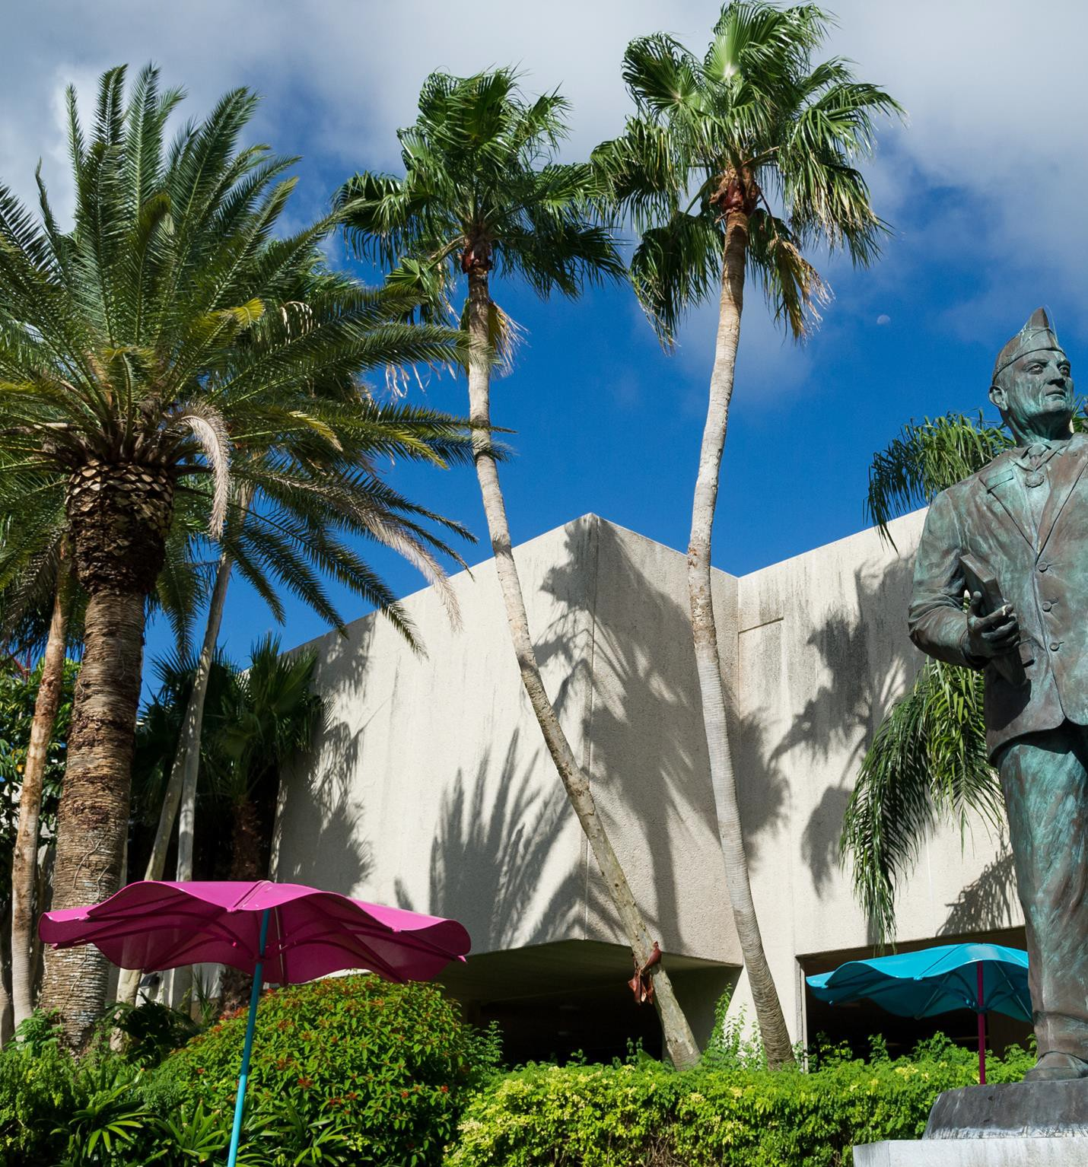
Email, continued
Do not
Ask your professor what course you are taking with
them
Ask for information that is readily available in the syllabus – look first, then ask for clarification
Write an email when you are really angry
Threaten your professor
Write excessively long or complicated emails; consider a phone or face-to-face conversation instead
Assume a more casual or social tone unless that is already negotiated

Slide 14

Professional Communication in Graduate School – Other Formats
While email may be the most common written communication between students and faculty, other formats also exist.
Communication avenues in online course platforms: Tone and content depends on the avenue and the purpose (e.g., group communication for class projects may be less formal than communication with professor).
Memos: Memo formatting is fairly standard. Use professional, more formal tone.
Letters: Business letter format is appropriate, with
professional and formal tone. Letters are sometimes sent as an attachment to an email.

Slide 15
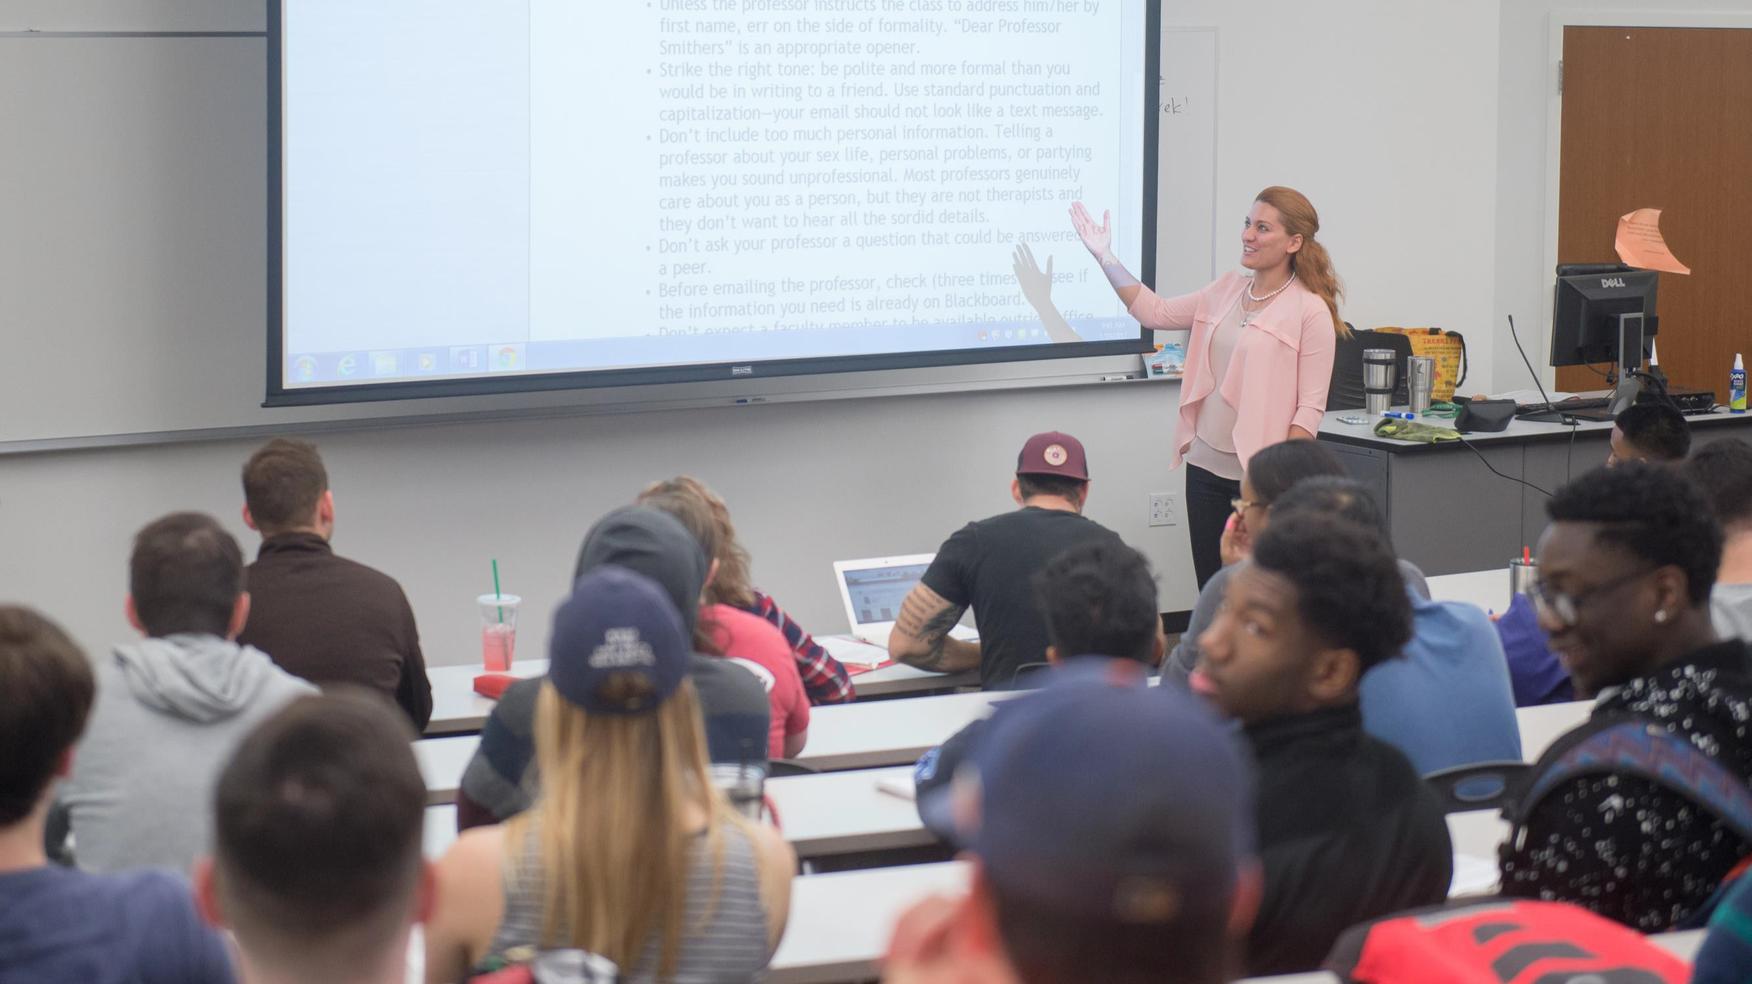
What Faculty Members Expect
Professor/student relationships may be different than your undergraduate program (smaller number of students, mentoring into the discipline); may have more one-to-one or small group interactions.
What you can expect from your graduate instructors may be different from your undergraduate experience.
  Amount of detail and step-by-step instructions
  Amount of feedback
  Expectations that students will correct their own work
Faculty members are all different, even within the same programs. We don’t all run our classrooms alike, emphasize the same things as our colleagues, or communicate in the same ways.

Slide 16
Questions?

