Slide 1

Review, Promotion & Tenure
Candidate

Slide 2
Review, Promotion & Tenure (RPT)
Interfolio Review, Promotion & Tenure is an online platform for carrying out formal faculty reviews in a shared governance context, built to help academic institutions ensure that these processes are transparent, equitable, efficient, and well-documented.

Slide 3
Cases
The lifecycle of a candidate as they progress through a standardized review cycle.
You might think of this as a virtual 3-ring binder used to hold both candidate and committee materials for a review.

Slide 4
Packet
The collection of materials by which a candidate is being reviewed (documents and other files).
The packet is divided into sections which can be worked on and submitted independently of one another.

Slide 5
Information or Action Icons
Menu
SECTIONS
No Action Required
Faculty Action Required

Slide 6
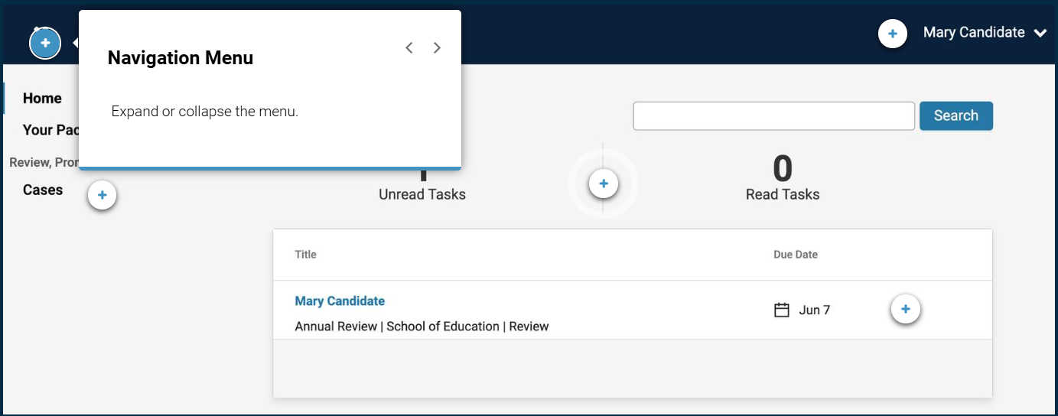
Interfolio Account Dashboard

Slide 7
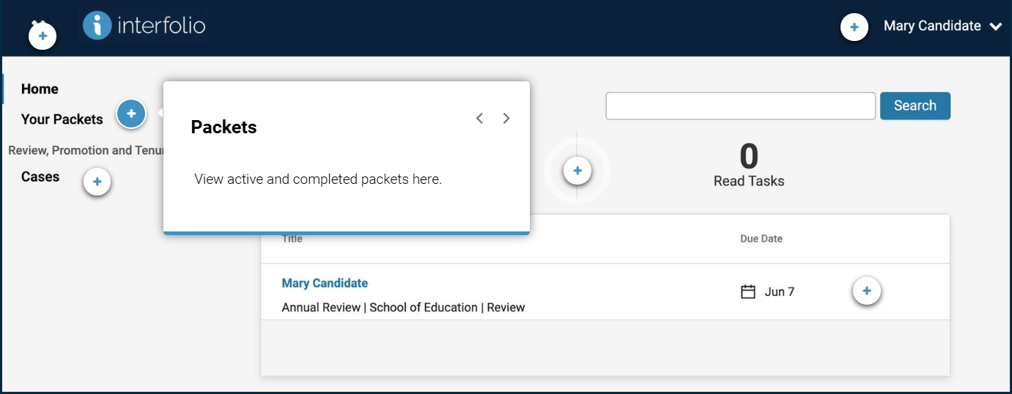
Interfolio Account Dashboard

Slide 8
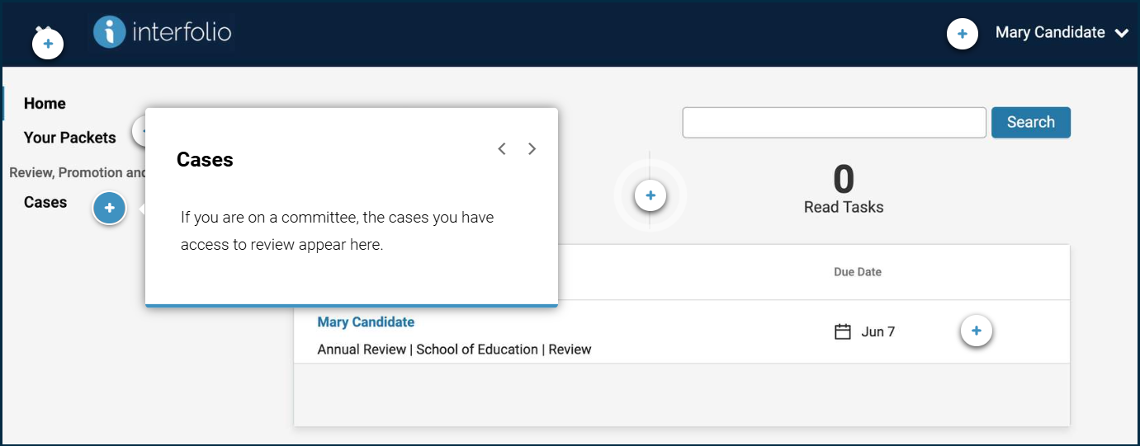
Interfolio Account Dashboard

Slide 9
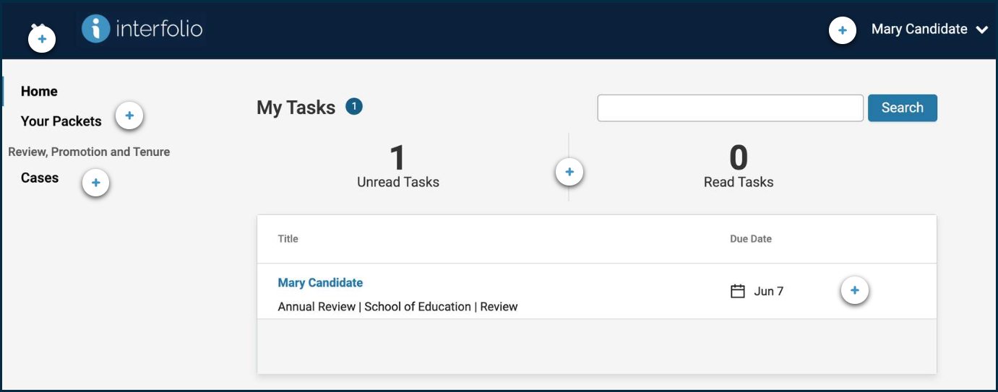
Interfolio Account Dashboard - Case Location
Items that are waiting for your participation will appear here. You will see the number of unread and read tasks above the table. The table will list the tasks with direct hyperlinks as well as the due dates.

Slide 10
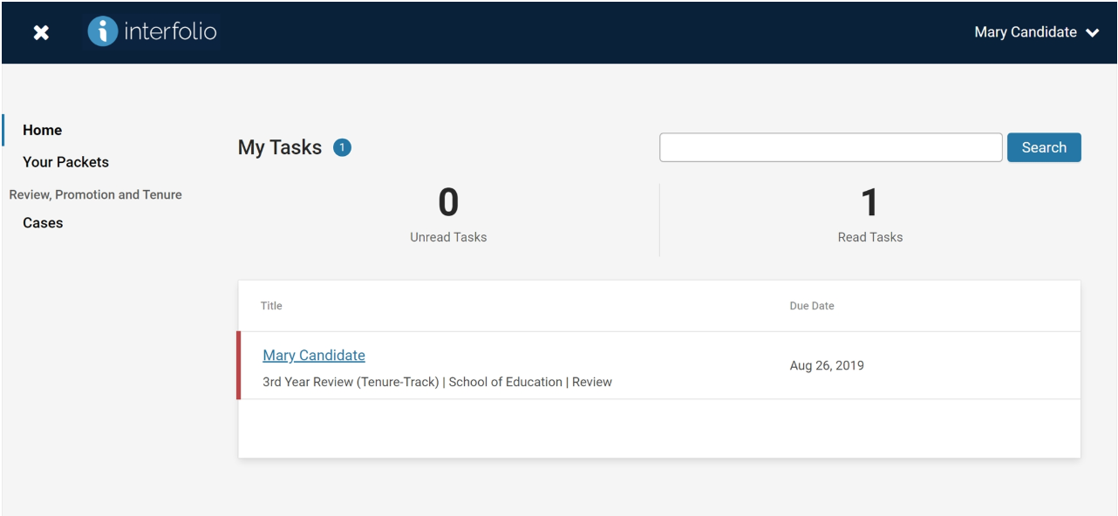
The Candidate Experience - Case Location
1

Slide 11
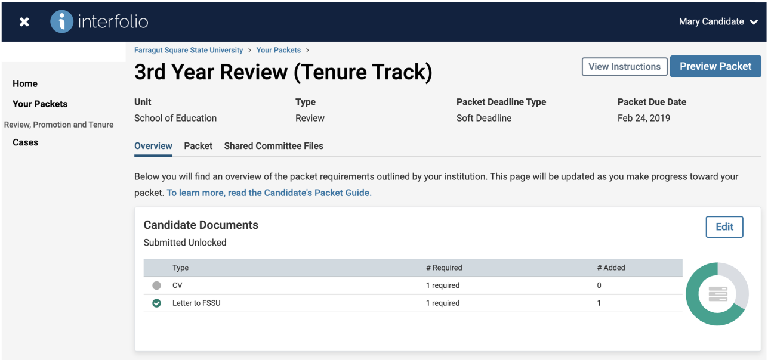
The Candidate Experience - Case Instructions
1

Slide 12
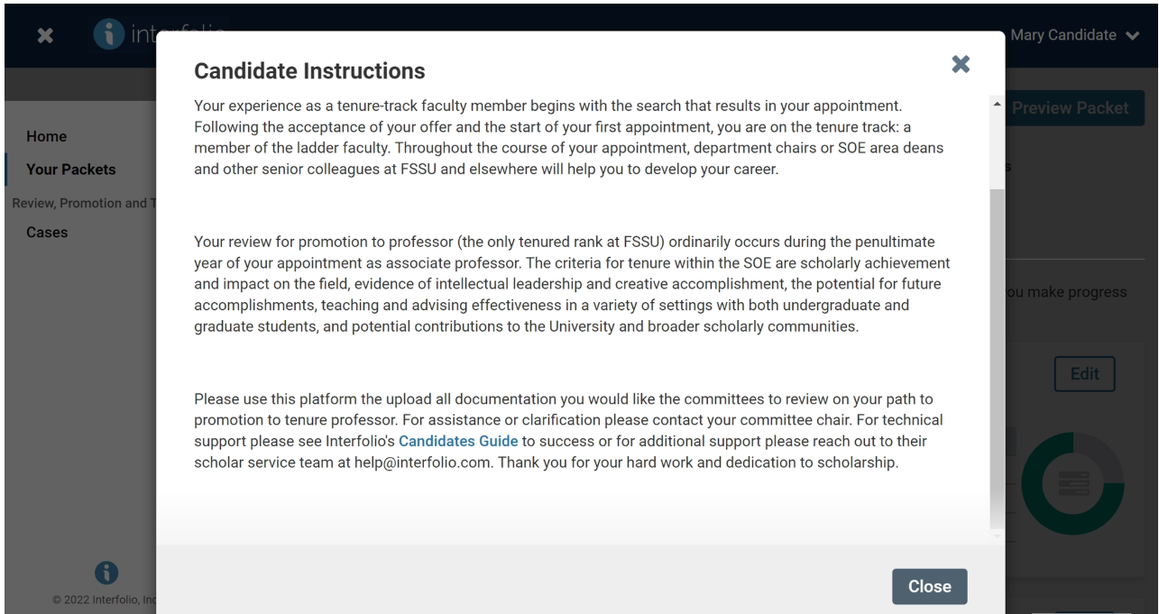
The Candidate Experience - Case Instructions
1

Slide 13
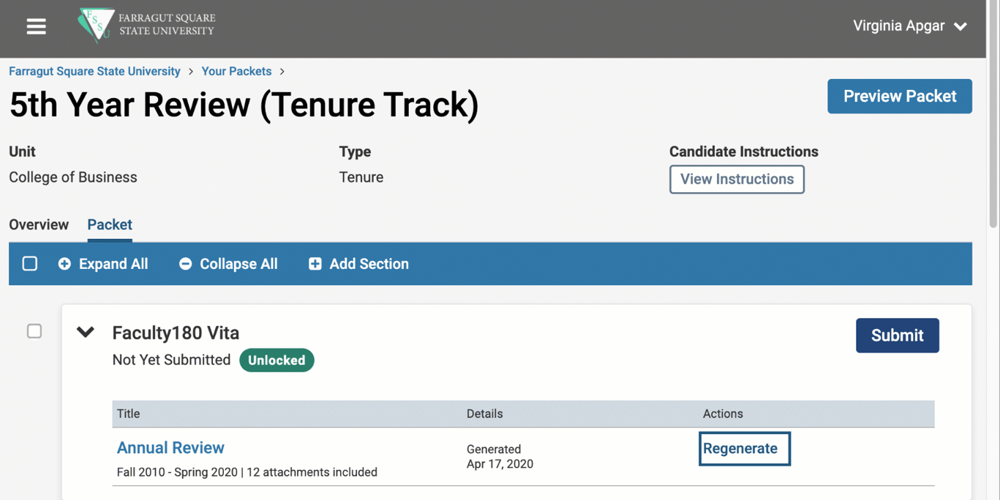
FAR in the Case
The candidate's vita will automatically be pulled into their case materials as soon as the case has been created.
RPT will generate a snapshot of the vita when the case is created and will not automatically update any changes the faculty member makes after the case is created.
If a candidate updates their information in the FAR profile after submitting their case, they must "Regenerate" their FAR for that case.
If the option to regenerate the FAR is locked and the candidate is unable to do so, they should contact an administrator for assistance.

Slide 14
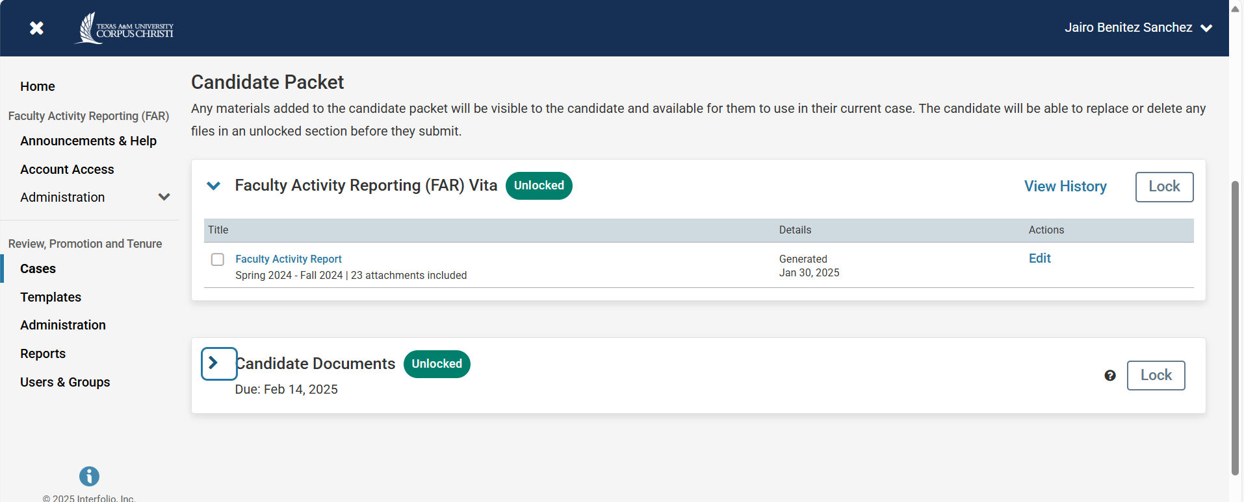
The Candidate Experience - Adding Materials
1

Slide 15
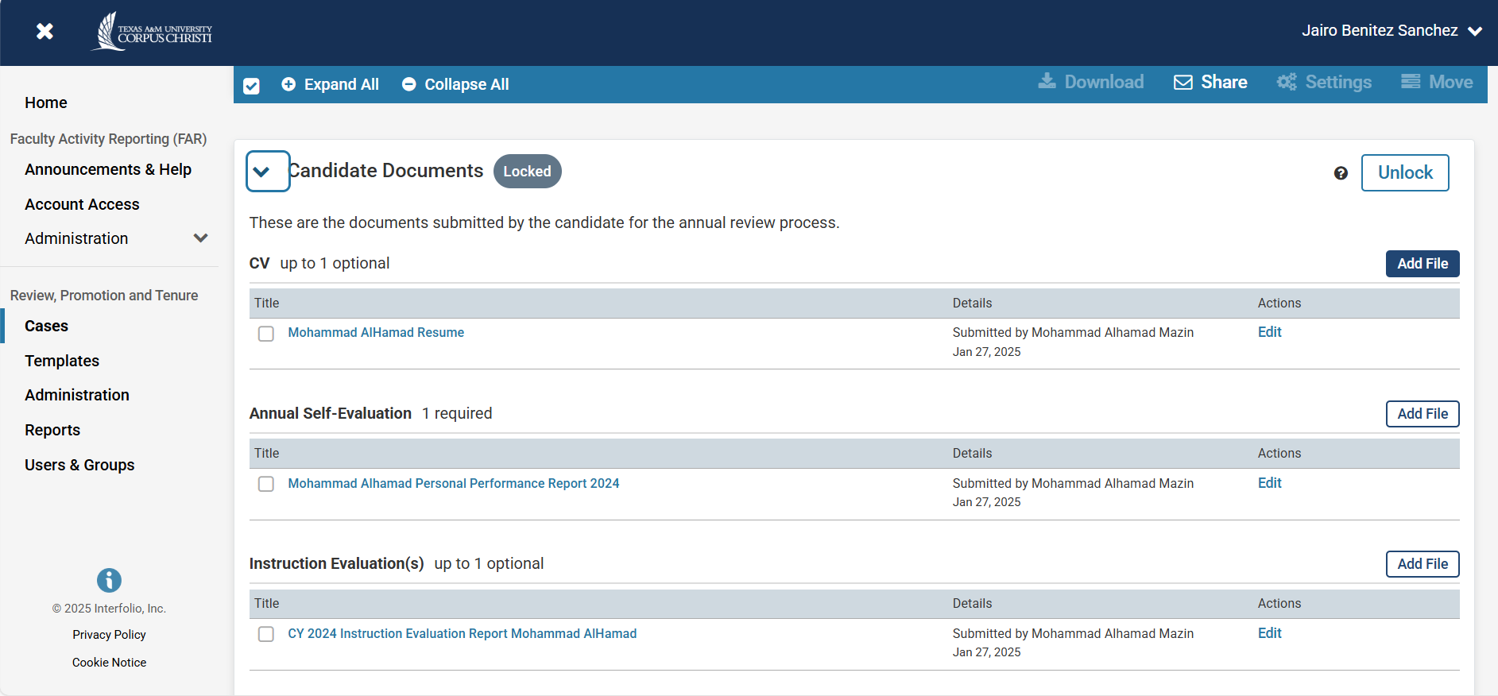
The Candidate Experience - Adding Materials
1
1
1

Slide 16
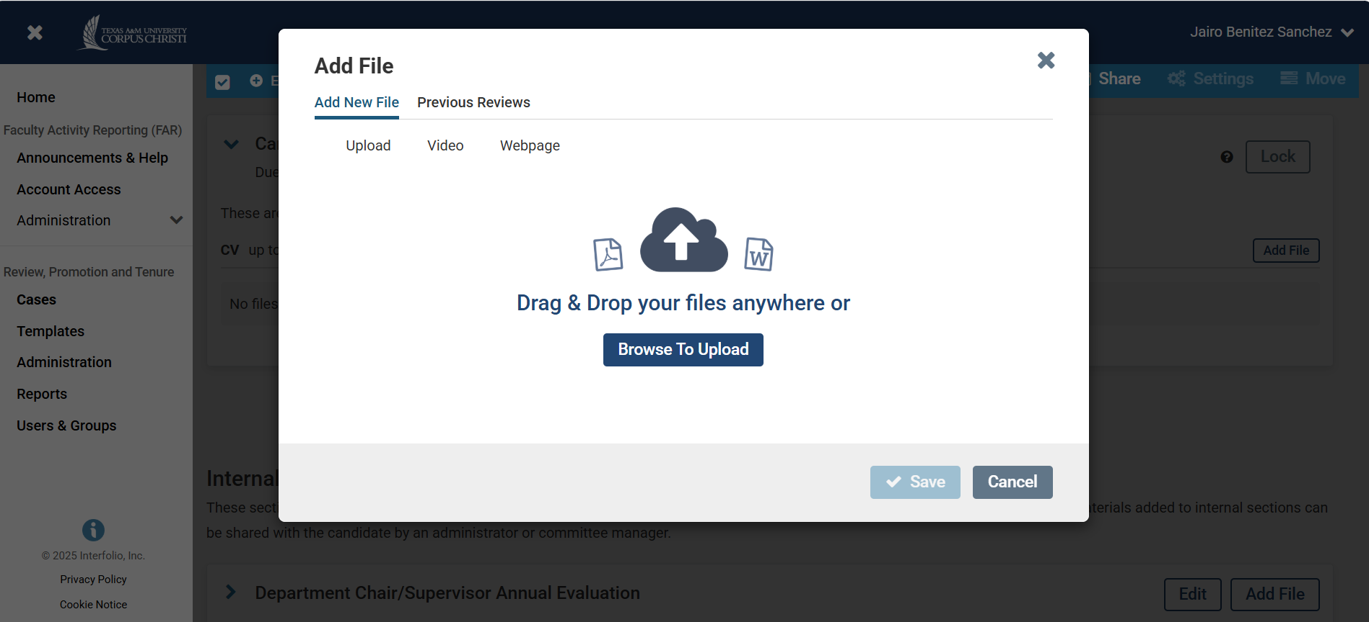
The Candidate Experience - Adding Materials
1
2
3

Slide 17
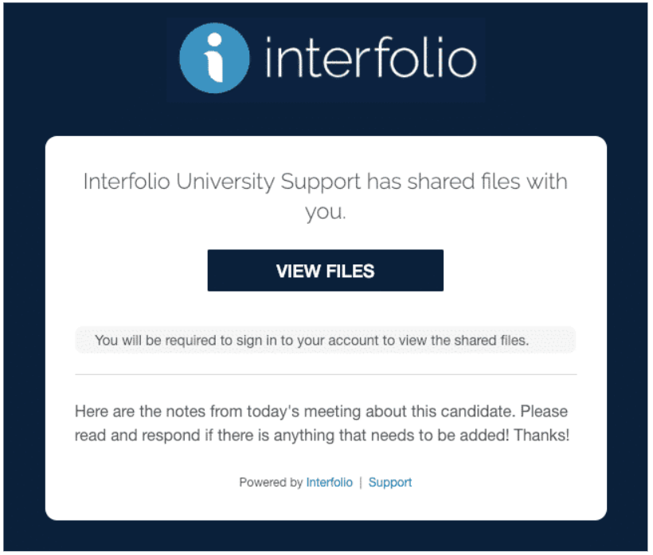
View Shared Files
When files are shared with you, you will receive an email message prompting you to log into your account and view the files.
1

Slide 18
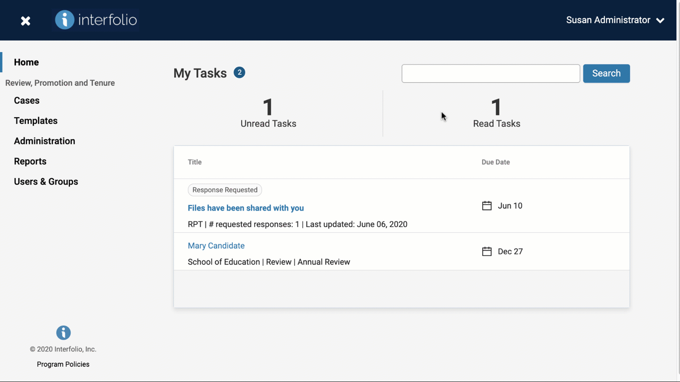
Respond to Shared Files
You will also see a notification in your Action Items when a file has been shared and a response is requested.
To send a response, open the shared file, select "Respond" and upload the file with your response.

Slide 19
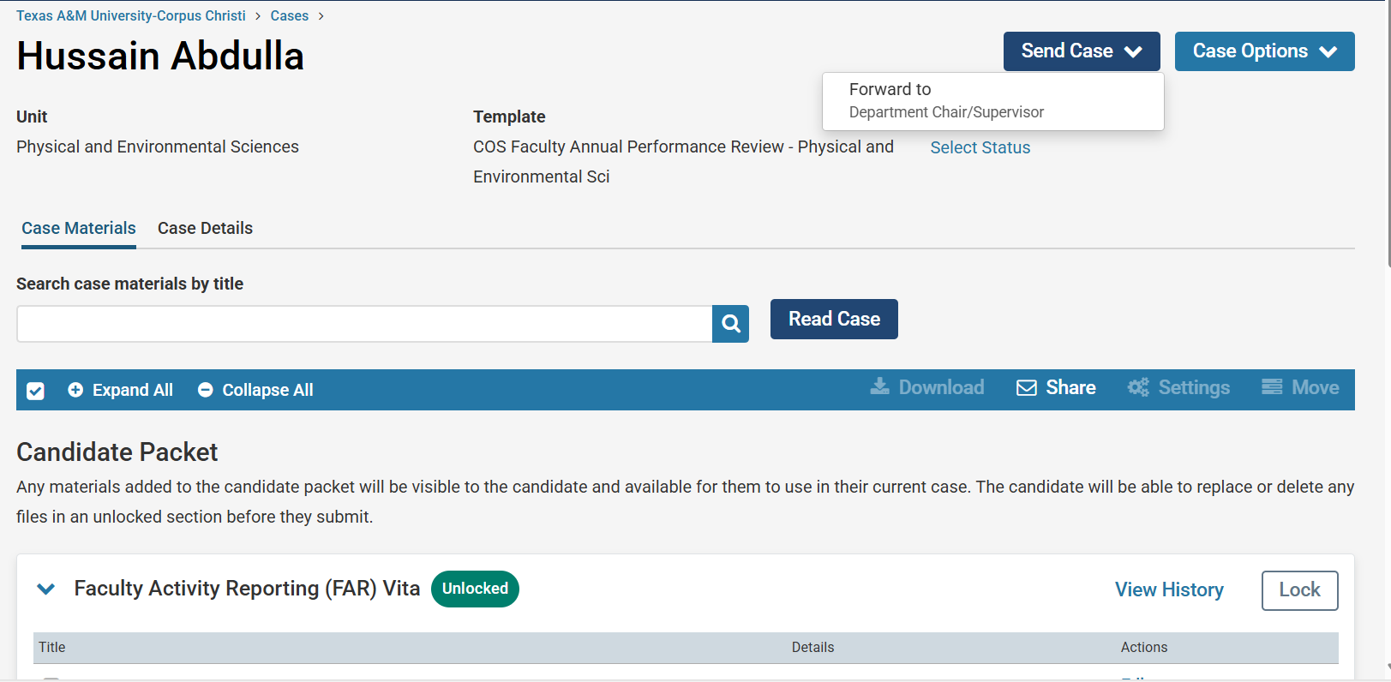
The Candidate Experience – Sending Case Forward
1

Slide 20

If you need any information about Interfolio, please feel free to contact me.
Jairo Benitez.
Continuous Improvement & Credentialing Coordinator
Division of Institutional Excellence
jairo.benitezsanchez@tamucc.edu
Texas A&M University-Corpus Christi
Book time to meet with me

