Slide 1

Faculty Credentialing Process

Slide 2

Learning Objectives:
1. Understand the faculty credentialing process and its importance.
2. Understand how to fill out the faculty credentialing packet.

Slide 3
Why is it Important?
Texas A&M University-Corpus Christi ensures that each instructor of record possesses the academic preparation, training, and experience to teach at the university level and meets or exceeds the minimum requirements established by accrediting bodies and state agencies.
The qualifications of full—and part-time faculty, including tenured, tenure-track, non-tenure-track, adjunct positions, and teaching assistants who are assigned as instructors of record, must be verified prior to the first day of classes.

Slide 4
Why is it Important?
“It is the institution’s obligation to justify and document the qualifications of its faculty. Determining the acceptability of faculty qualifications requires judicious use of professional judgment, especially when persons do not hold degrees in the teaching discipline or are qualified based on criteria other than their academic credentials”.
RESOURCE MANUAL for The Principles of Accreditation: Foundations for Quality Enhancement Fourth Edition Southern Association of Colleges and Schools Commission on Colleges (p. 46). (2024). https://sacscoc.org/app/uploads/2024/02/2024-POA-Resource-Manual.pdf

Slide 5

How does Texas A&M University-Corpus Christi justify and document the qualifications of its faculty?

Slide 6
Faculty Credentialing Process
Faculty Credentialing Packet:
  Memorandum Checklist
  Biographical Data Sheet (Form)
  Certification of Credentials (Form)
    Justification of Credentials (Letter)
  Curriculum Vitae
  Official Transcripts
Department Chair’s Office
(Fill, Review & Sign)
Dean’s Office
(Review & Sign)
Office of University Accreditation and Assessment
(Review & Activate)
Provost’s Office
(Review & Sign)
Activation in Banner
Confirmation email
Notes:
The faculty credentialing process consists of a package.

Slide 7
Related Processes
Some other processes and data-related reports are initiated using the information in the faculty credentialing packet. These processes include:
  Interfolio
    Educational field & CIP code field.
  Reports:
    Texas State Faculty Report with official highest degree earned & teaching field.
    Texas Higher Education Coordinating Board - Formula Founding Report.
    CUPA-HR Report.
    SACSCOC Faculty Roster Report.

Slide 8

How do you prepare a faculty credentialing packet?

Slide 9
Begin preparing your credentialing packet by gathering the official transcripts, as they serve as a key source of information for various forms.
The primary indicator used to determine instructors’ qualifications to teach is a terminal degree in the discipline of instruction.
With the official transcripts, you can quickly determine whether the instructor meets the SACSCOC requirements and university expectations.

Slide 10
SACSCOC Requirements and University Expectations
In its Faculty Credentials Guidelines, the Southern Association of College and Schools Commission on Colleges (SACSCOC) provides the following guidance regarding the qualifications of individuals serving as instructors of record:

Slide 11
SACSCOC standards on faculty qualifications also state:
“Persons holding a degree at the same or lower level than the level at which the course is taught require additional qualifications and the application of professional judgment. Additional justification is needed for these cases as compared to cases where the academic credentials are a ‘perfect match’ for the teaching assignments.“
RESOURCE MANUAL for The Principles of Accreditation: Foundations for Quality Enhancement Fourth Edition Southern Association of Colleges and Schools Commission on Colleges (p. 45). (2024). https://sacscoc.org/app/uploads/2024/02/2024-POA-Resource-Manual.pdf

Slide 12
Justification of Qualifications (Credentials)
In some cases, faculty members are considered qualified for instruction based on factors other than an in-discipline terminal degree, such as:
  Terminal degree in a closely related field.
  A master’s degree or at least 18 semester credit hours of graduate-level coursework in the same or a closely related field.
  Professional licensure or certification in a related field or profession.
  Significant professional, research, or teaching experience in the same or closely related field.
  Continuous documented excellence in teaching.
  Or other demonstrated competencies and achievements that contribute to effective teaching and student learning outcomes.

Slide 13
Justification of Qualifications (Credentials)
Suppose any of the previously mentioned bulleted items apply. In that case, the department head is responsible for providing a detailed description of the qualifications of each instructor of record in the Certification of Credentials Form or an attached letter.
Please note that simply stating the length of experience is insufficient justification; a comprehensive description of qualifications is required.
General justifications such as "The individual has a degree in the field" or "The individual taught this course previously" are not acceptable.
We will review examples of Justification of Qualification letters later in the process.

Slide 14

Official Transcripts

Slide 15
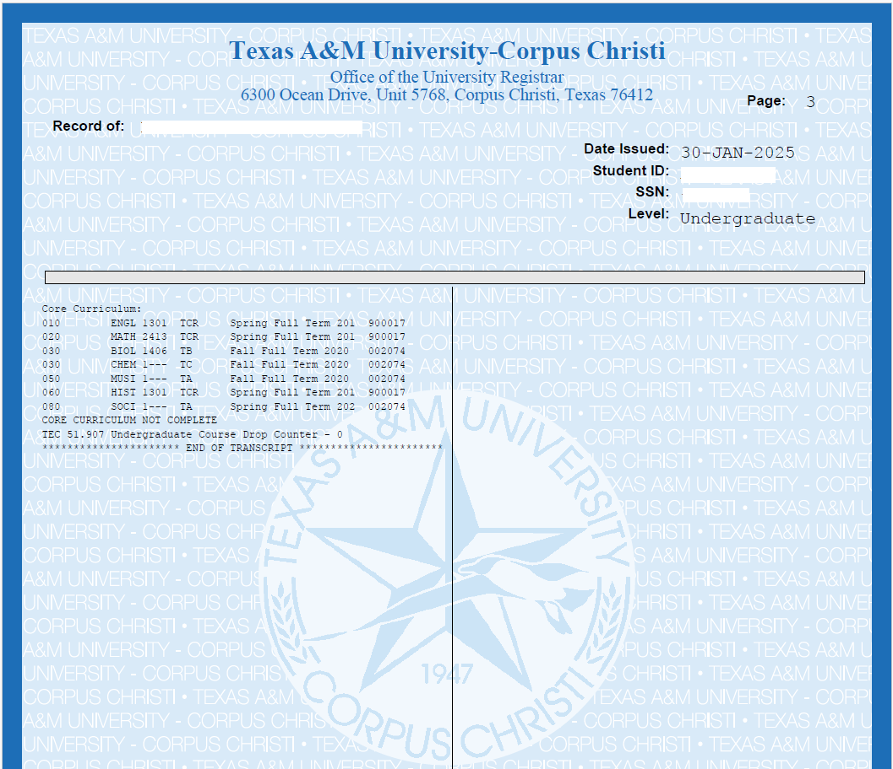
An official transcript is a verified document issued directly by the educational institution that details a student's academic history. It includes a complete list of courses taken, grades received, and credit hours earned, as well as information on majors, minors, and other pertinent academic details.
The transcript helps to identify the degree earned, the field of study, the date the degree was awarded, the institution that granted the degree, and the accreditation status of that institution.

Slide 16
Considerations Regarding Official Transcripts.
Official Transcripts must be sent directly to the Continuous Improvement & Credentialing Coordinator or the College/Department from the issuing agency/institution.
  NOTE: Transcripts may NOT be issued to students and are only considered official if sent directly between institutions.
If the degree with which the individual is being credentialed is from a non-accredited or foreign university, the transcripts must be evaluated for equivalency.

Slide 17
Foreign Transcripts Evaluation.
Foreign Transcripts must be evaluated by an organization that is a member of either the National Association of Credential Evaluation Services (NACES) or Association of International Credential Evaluators, Inc. (AICE). A detailed course-by-course evaluation report with an official transcript is required.
The evaluation agency must send the evaluation report directly to the Continuous Improvement & Credentialing Coordinator or the College/Department.
In these cases, the Foreign Transcript Evaluation Report is the document with which the credentialing packet forms will be completed.

Slide 18
Certification of Credentials

Slide 19
Tenured or Tenure-Track
Non-Tenure Track
Graduate Teaching Assistant

Slide 20
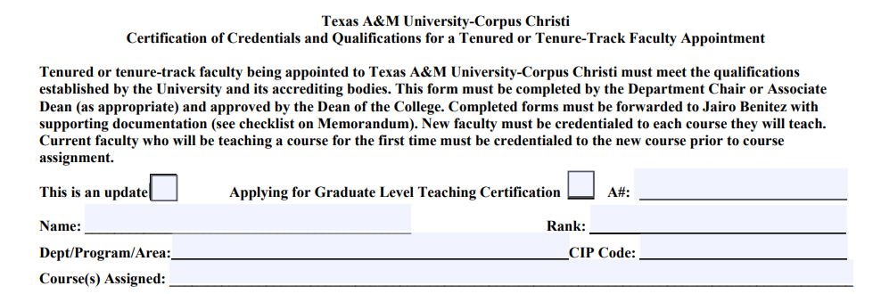
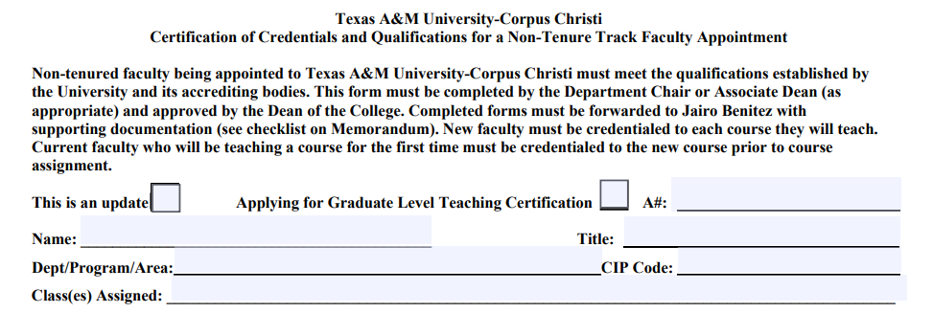

Slide 21
Select "This is an update" if the person is currently affiliated with the university as a faculty member (not a staff member); this indicates that the official transcripts are in our files (Laserfiche).

Slide 22
If an individual has been away from the university for more than one term, a complete application packet must be submitted for review again. (AND IT’S NOT AN UPDATE)
Official Transcripts (OT) must be retained for 5 years (FERPA regulations & the State of Texas Records Retention Schedule). Please check Laserfiche to verify if the OT are on file, or contact the Continuous Improvement & Credentialing Coordinator to access a copy so you can complete the forms.

Slide 23
This policy is currently under review. The Graduate Teaching Certification Form will be removed, so please select this checkbox as the confirmation source for Graduate-level faculty when necessary.
A number: Human Resources provides this identification number; without it, the packet cannot be processed in banner.

Slide 24
Name: Use only the official name.
Rank: The Rank must match the selected one in the biographical sheet.

Slide 25
The CIP code field aims to establish the primary CIP code that corresponds to the assigned courses.
Courses assigned: Please use the Course Code (e.g., CHEM-4344). The course title is optional. If it is a laboratory course, please add "Labs Only" at the end (e.g., CHEM-1411 Labs Only).

Slide 26
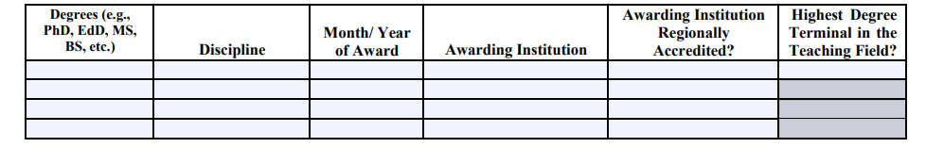

Fill out this form section with the data from the official transcripts (or Foreign Transcript Evaluation).
Degrees: Enter the full name or the corresponding acronym.
Discipline: This data is the Major that is in the OT.
Awarding Institution: Enter the official name that is indicated in the OT.

Slide 27
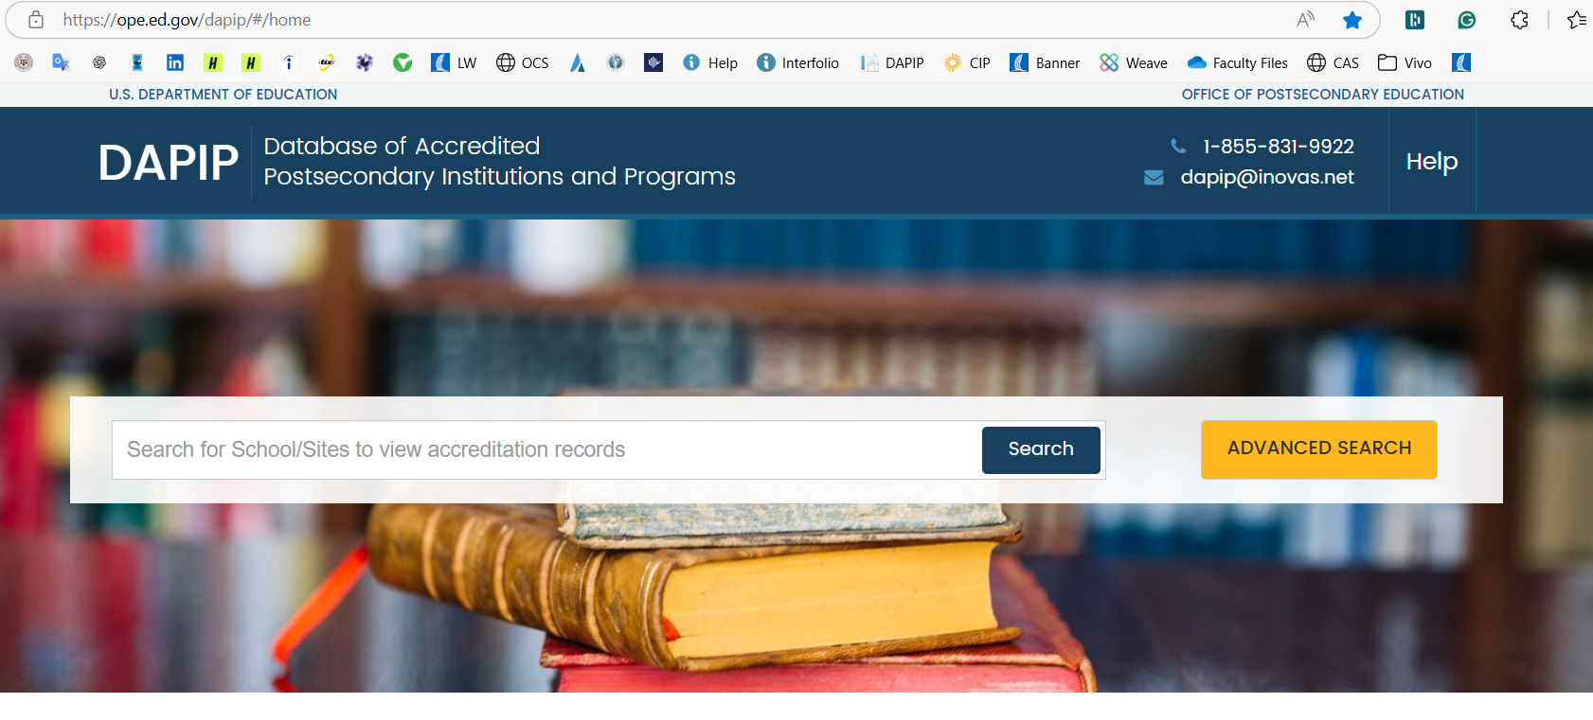
DAPIP | Homepage

Slide 28
Highest Degree Terminal in the Teaching Field: This is a Yes/No question indicating that the degree you indicate in this row corresponds to a terminal degree in the same field for which the person is being credentialed.
For example, if the person has a PhD in mathematics and will be teaching mathematics classes, the answer is yes.
If the person has a PhD in physics and will be teaching mathematics classes, the answer is no, and a justification of qualification (credentials) must be provided.

Slide 29
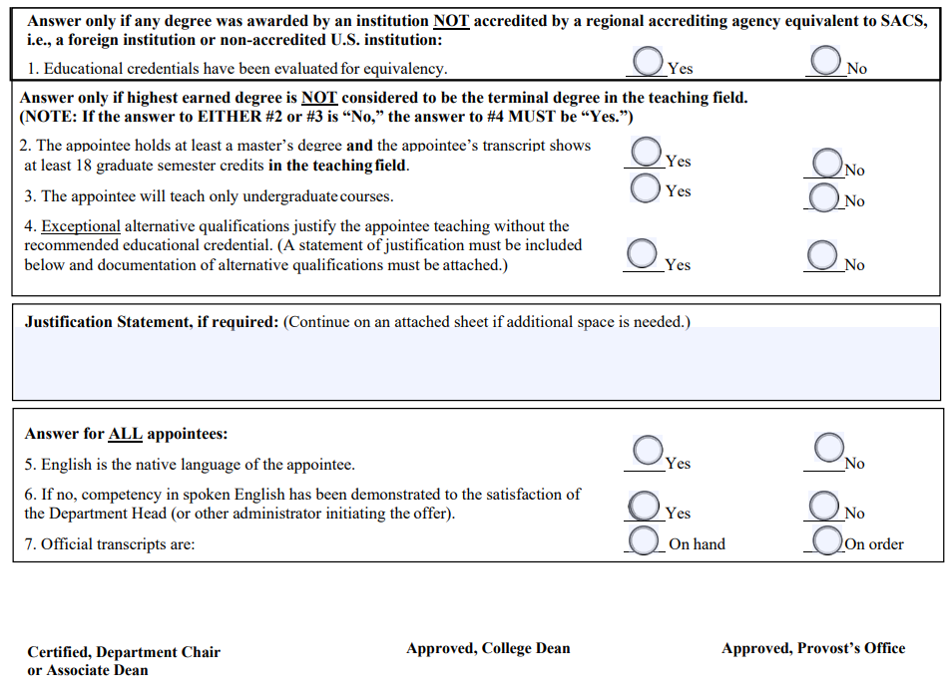
If you answered NO to the question "Awarding Institution Regionally Accredited ?" you must answer question #1.
Remember, all foreign institutions (universities) are NOT accredited in the U.S., and you must provide a Foreign Transcript Evaluation Report.

Slide 30
If the person has a terminal degree in the teaching field, go to question No. 5 (Questions 2, 3, and 4 should not be answered).

Slide 31
See the attached document.
If the person does not have a terminal degree in the teaching field, questions 2, 3, and 4 must be answered.
REMEMBER: “Persons holding a degree at the same or lower level than the level at which the course is taught require additional qualifications and the application of professional judgment. Additional justification is needed for these cases.”
We strongly recommend that the justification of qualifications (credentials) letter be prepared in another document so that the limited space on the form does not limit you.

Slide 32
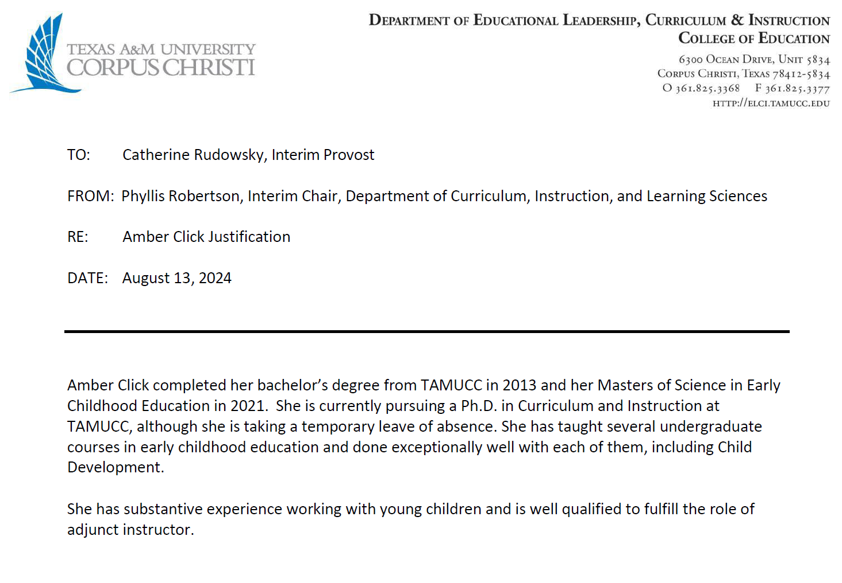
Aaaaa
Aaaaa

Slide 33
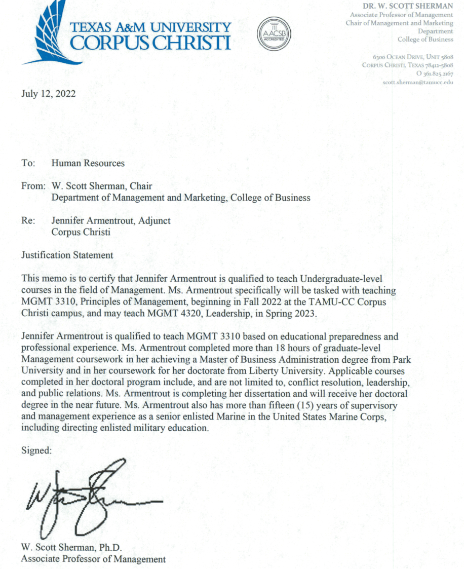
Aaaaa
Aaaaa
Aaa
Aaaaa
Aaa
Aaa
Aaa

Slide 34
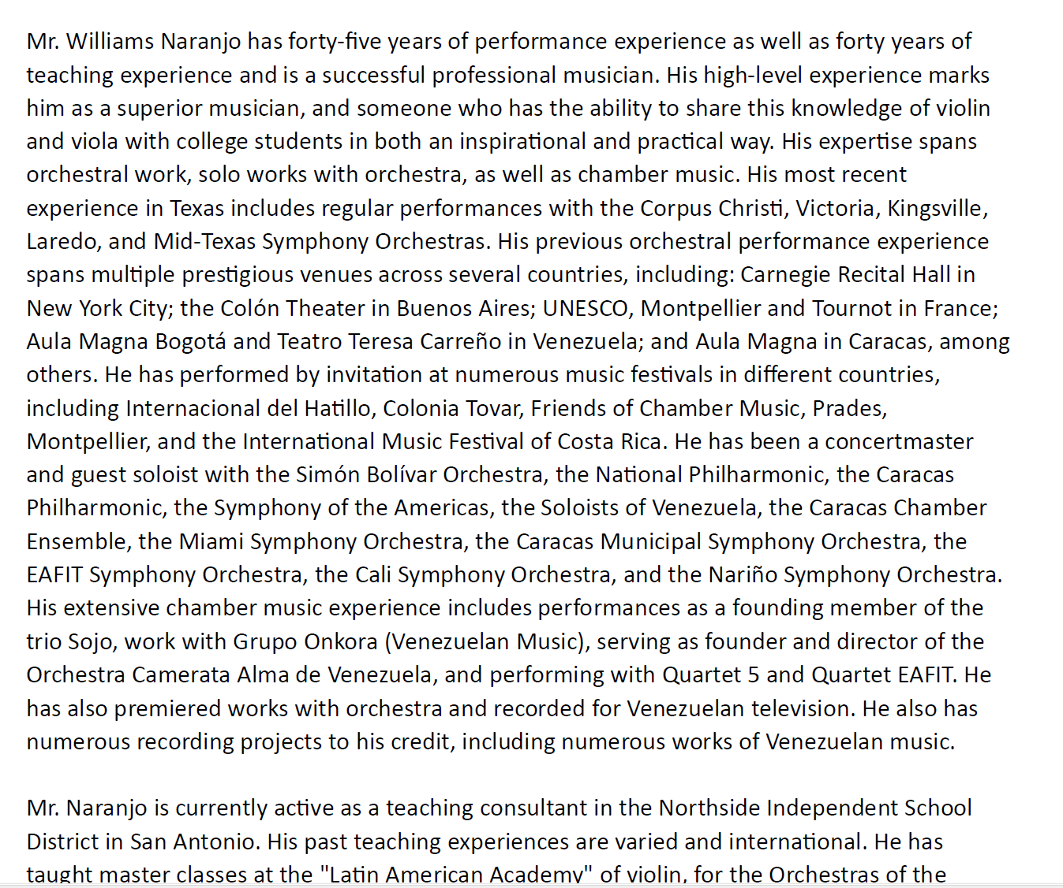
Aaaa
Aaaa

Slide 35
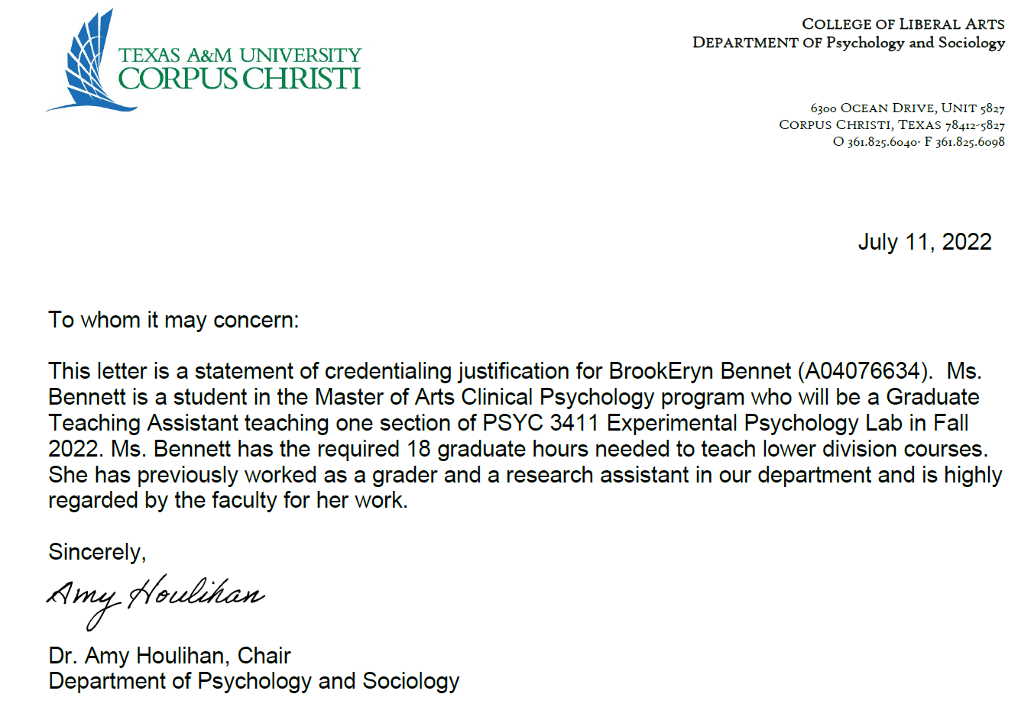
Aaaaa
Aaaa
Aaaa

Slide 36
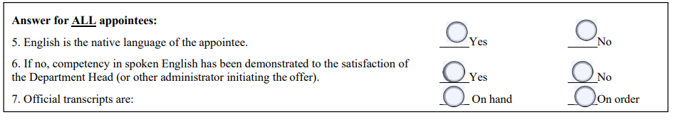
Answer for ALL appointees.
If your OT is "On Order," we can return the packet or request a new one if the information doesn't match.
Recommendation: Fill the forms with the OT on hand.

Slide 37
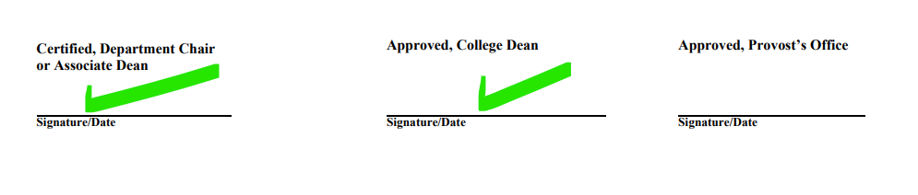
Remember that the packet must be Certified & Approved (First two signatures) by the assigned persons at the College.

Slide 38
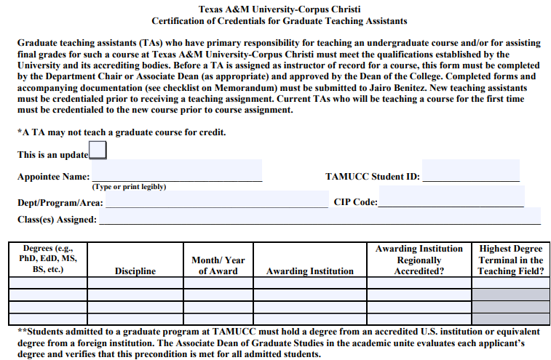
Graduate Teaching Assistant
Student ID = A Number
No Rank or Title Section
Only include university-level degrees (bachelor's, master's, or graduate coursework); these can be in progress. In the Month/Year box, enter the expected date followed by the letters EXP (e.g., 12/2025 EXP).
For GTAs credentialed with TAMU-CC degrees or coursework, you do not need to provide official transcripts; our office will request them.

Slide 39

Considerations for Graduate Teaching Assistants (GTA)
The university expects GTAs to follow the faculty credentialing process regardless of whether they are instructors of record. Of course, there are considerations for each case.
There are three options for GTA, from which you must select one in the Biographical Data Sheet:
If the degree with which the individual is being credentialed is from a non-accredited or foreign university, the transcripts must be evaluated for equivalency ONLY IF THE GTA IS INSTRUCTOR OF RECORD.
  NOTE: Transcripts may NOT be issued to students and are only considered official if sent directly between institutions.

Slide 40
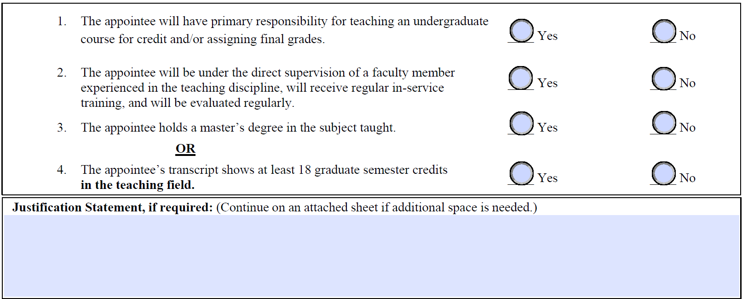
Graduate Teaching Assistant
Answer all the questions in this section.
If the GTA is an instructor of record, follow the guidelines in the Justification of Qualifications (Credentials) section.
If the GTA is not the instructor of record, please indicate who will supervise the GTA.
See the attached document.

Slide 41
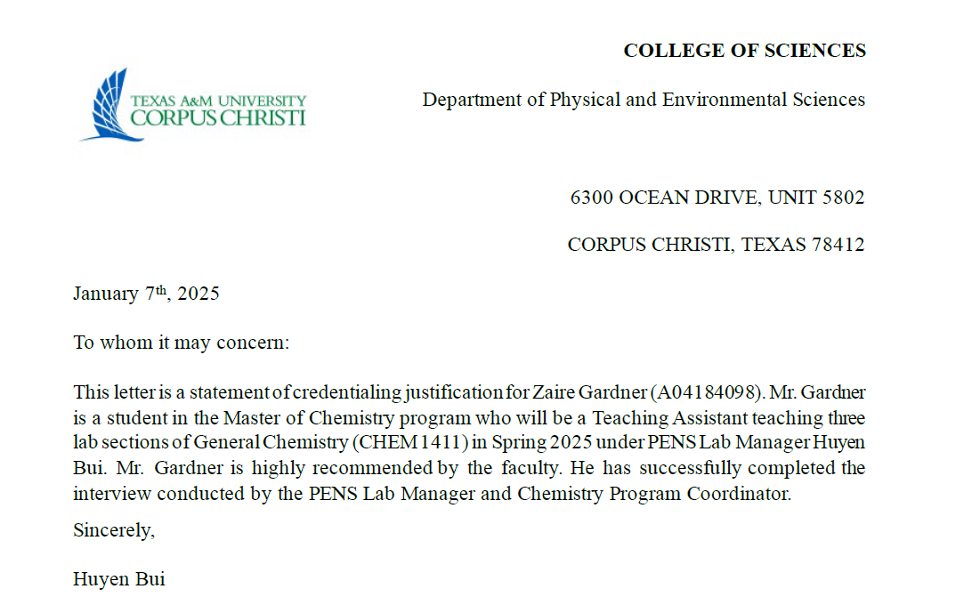
Aaaaa
Aaaa
Aaaa

Slide 42
Remember that the packet must be Certified & Approved (First two signatures) by the assigned persons at the College.

Slide 43

Let's practice!

Slide 44
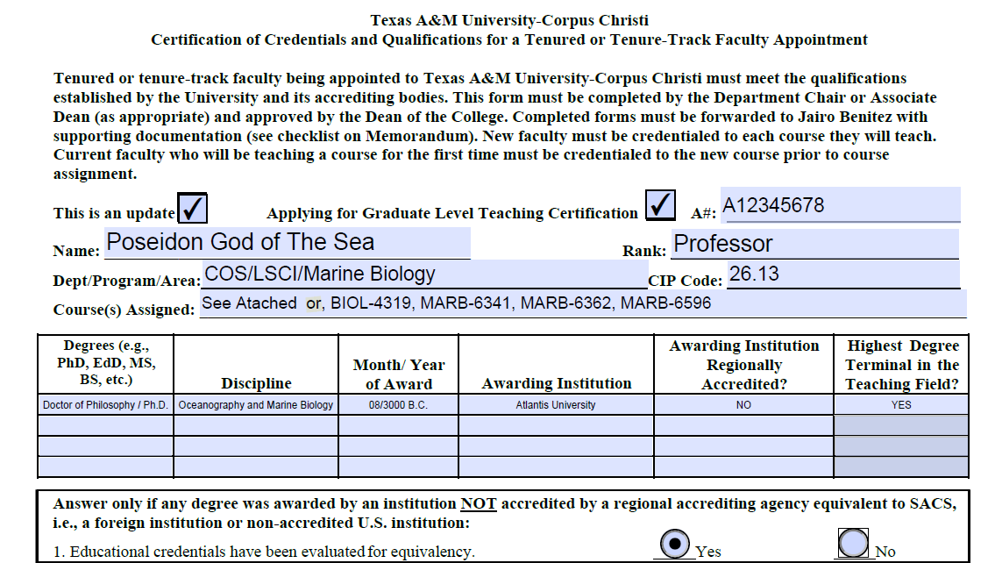
See Attached or,

Slide 45
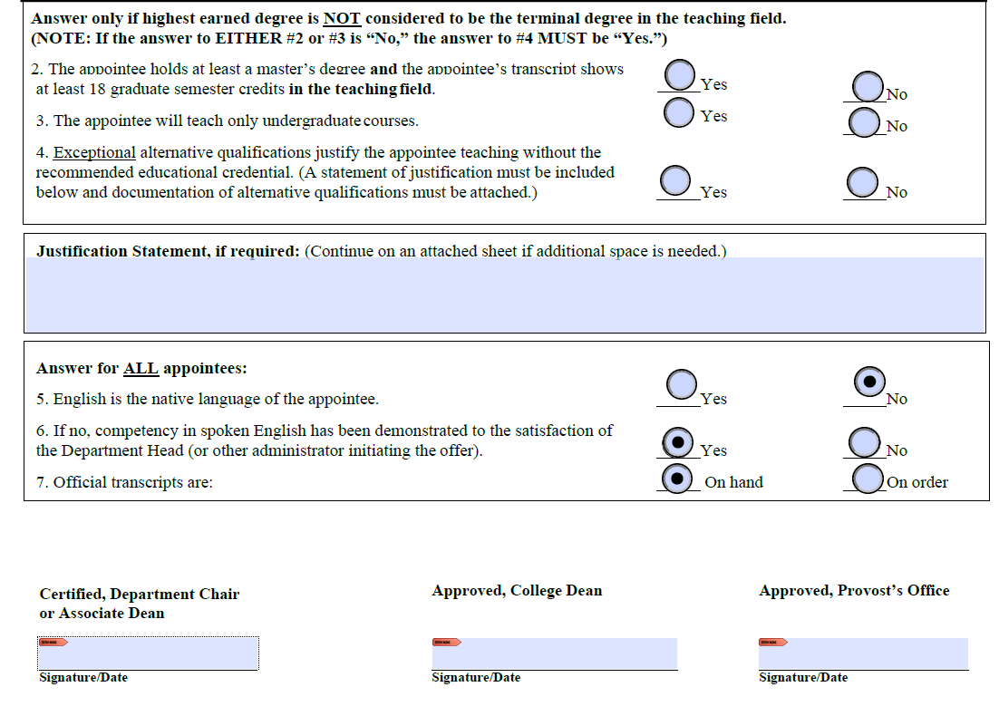

Slide 46
Biographical Data Sheet

Slide 47
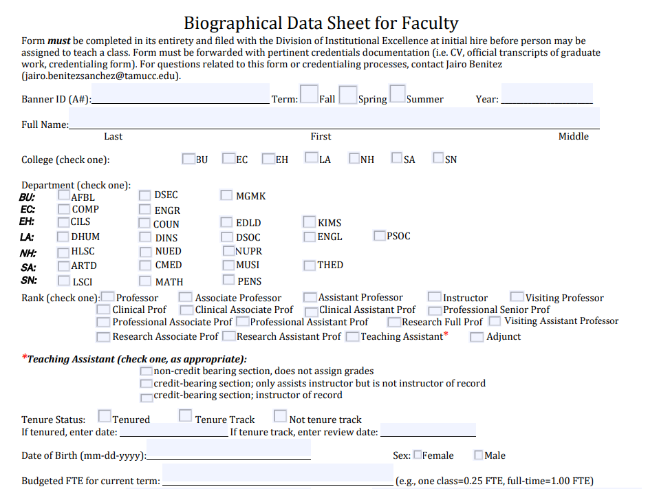
A number: Same at the Certification of Credentials
Please remember to select the term and specify the year.
Name: Use only the official name. (Last name – First Name)

Slide 48
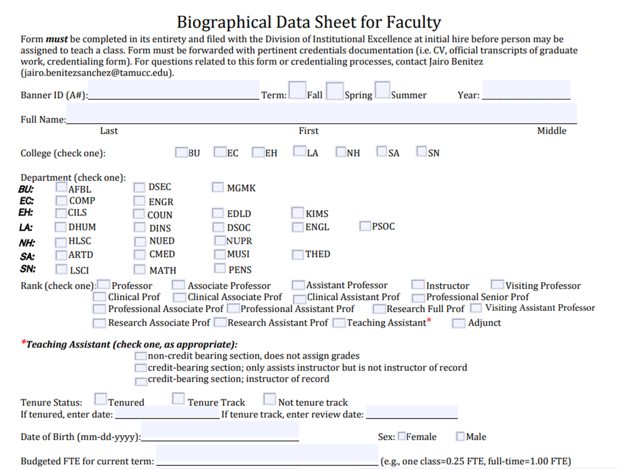
Choose your College and Department.

Slide 49
Choose Rank.
If you choose Teaching Assistant (TA), you must select one of the three options listed in the Teaching Assistant section. This requirement is exclusive to TAs and does not pertain to other ranks.

Slide 50
Choose Tenure Status and remember to enter the date when selecting tenured or tenure track status.
Budgeted FTE: This information is based on the hiring conditions and must be provided by the department chair.

Slide 51
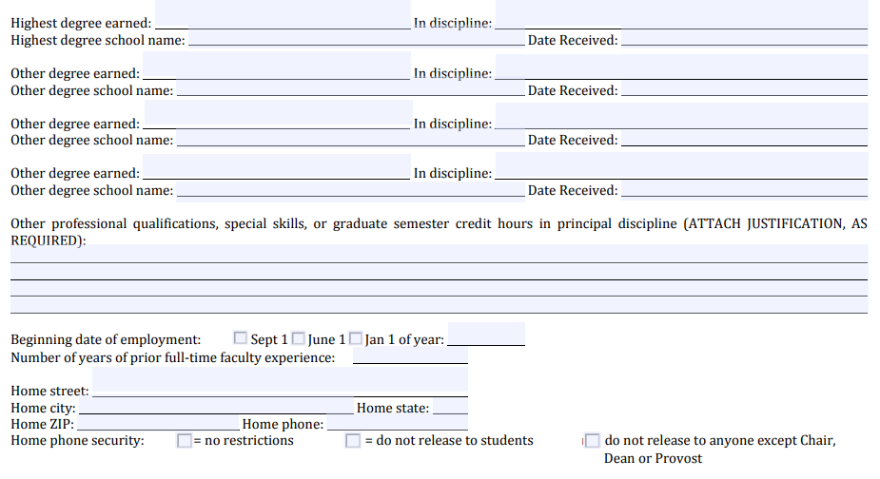
See the attached document.
Fill out this form section with the data from the official transcripts (or Foreign Transcript Evaluation).
Degrees: Enter the full name or the corresponding acronym.
Discipline: This data is the Major that is in the OT.
School name = Awarding Institution: Enter the official name that is indicated in the OT.
REMEMBER: “Persons holding a degree at the same or lower level than the level at which the course is taught require additional qualifications and the application of professional judgment. Additional justification is needed for these cases.”
We strongly recommend that the justification of qualifications (credentials) letter be prepared in another document so that the limited space on the form does not limit you.

Slide 52
Choose Tenure Status and remember to enter the date when selecting tenured or tenure track status.
Budgeted FTE: This information is based on the hiring conditions and must be provided by the department chair.

Slide 53
Let's practice!

Slide 54
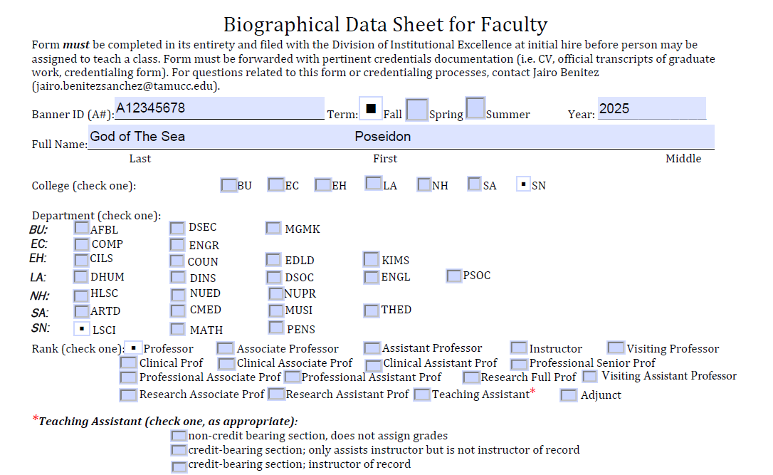

Slide 55
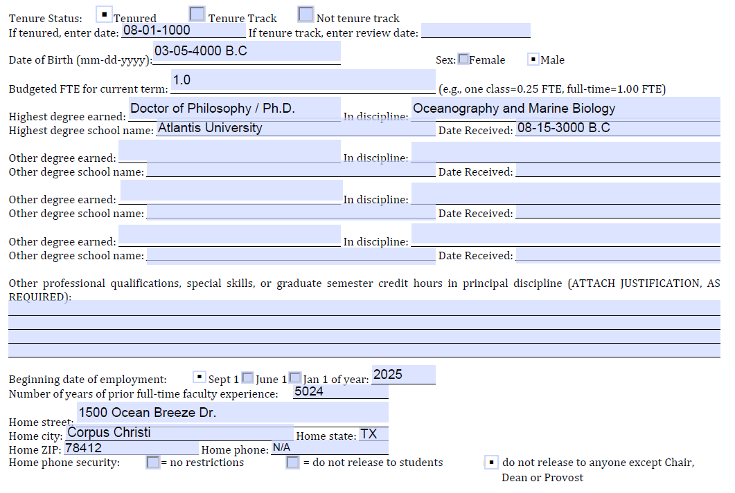
09/01/2023

Slide 56
Curriculum Vitae

Slide 57
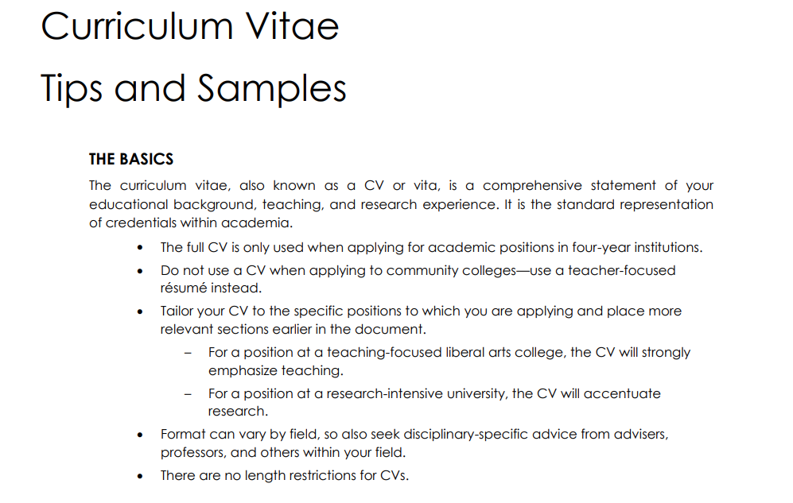
Please verify that the CV includes the individual's name and employment history.
From this CV, we will calculate the total years of relevant full-time professional experience the employee possesses.

Slide 58
Memorandum Checklist

Slide 59
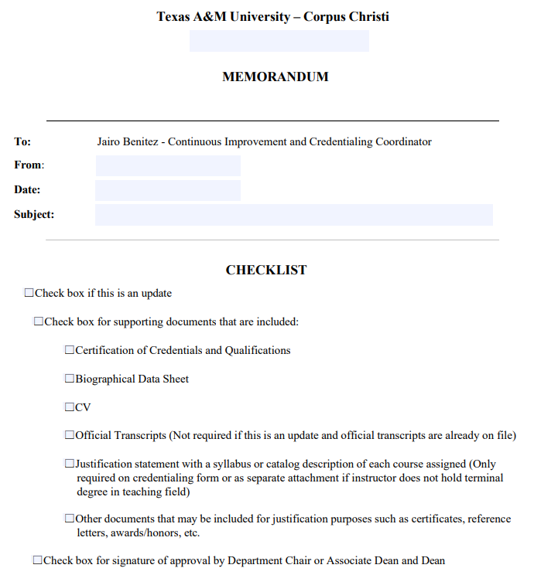
The memorandum checklist is essential for clearly understanding the packet's contents. It specifies whether the packet relates to a new hire or an update, and it details the documents included.

Slide 60


Learning Objectives:
1. Understand the faculty credentialing process and its importance.
2. Understand how to fill out the faculty credentialing packet forms.
Faculty Credentialing Packet:
Memorandum Checklist
Biographical Data Sheet (Form)
Certification of Credentials (Form)
Justification of Credentials (Letter)
Curriculum Vitae
Official Transcripts

Slide 61
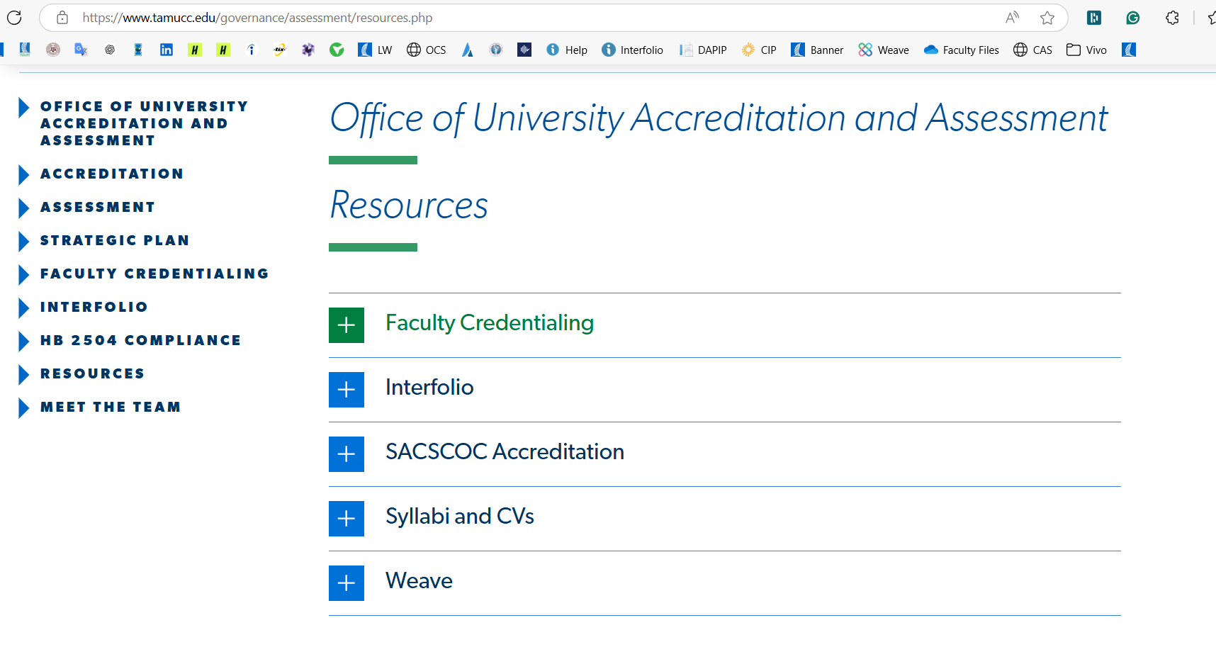
Resources:
> Faculty Credentialing Process
> Office of University Accreditation and Assessment – Resources

Slide 62

Please contact me if you need any information about the Faculty Credentialing Process, HB2504 (CV & Syllabi), or Interfolio.
Jairo Benitez.
Continuous Improvement & Credentialing Coordinator
Division of Institutional Excellence
jairo.benitezsanchez@tamucc.edu
Texas A&M University-Corpus Christi
Book time to meet with me

