Slide 1

TAMU-CC VetHUB Subcontracting Plan Brief:

Slide 2
State of Texas Subcontracting Plan
When the value of a purchase order or contract is expected to be $100,000 or greater, a Subcontracting Plan (SP) is required by the State of Texas
The New FY 2026 TAMU-CC VetHUB Subcontracting Plan is available at: https://www.tamucc.edu/finance-and-administration/financial-services/purchasing/hub-program/forms.php
Note: The New VetHUB Subcontracting Plan is to be used starting May 12, 2026

Slide 3
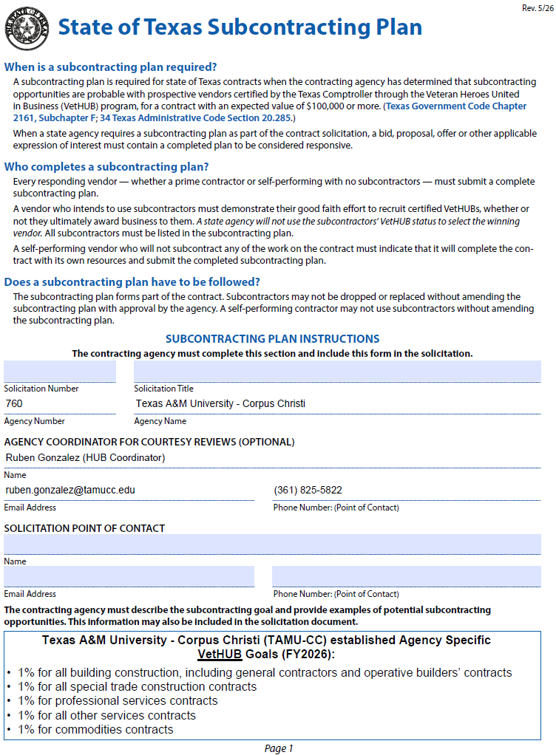
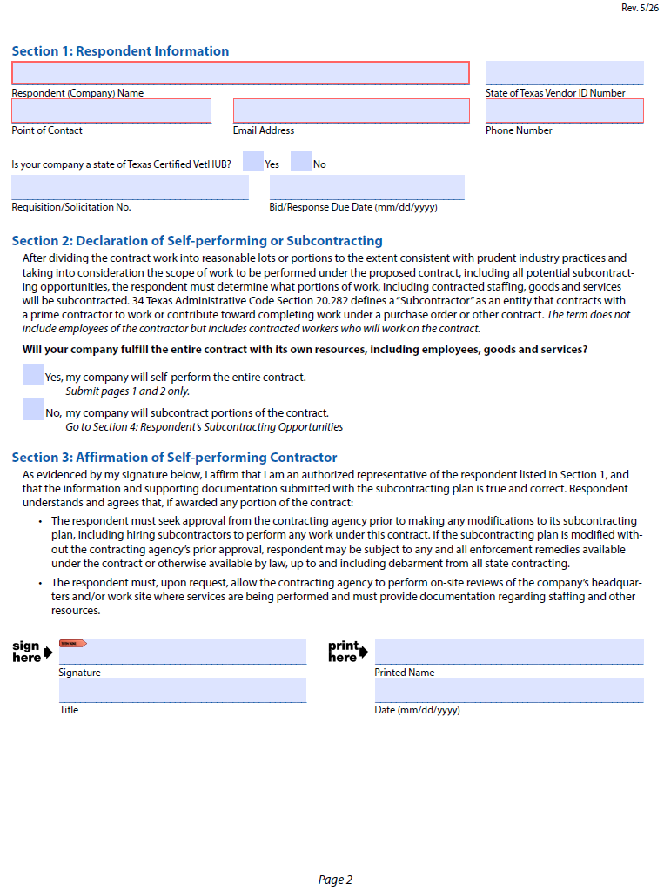
TAMU-CC HUB Subcontracting Plan (HSP)

Slide 4
State of Texas Subcontracting Plan (Page 1)
Tip 1: When self-performing the entire contract: Submit pages 1 & 2 only, that includes Section 3: Self-Performing Affirmation
Tip 2: If your Company will be subcontracting portions of the contract skip Section 3 there will be a Section 6: Prime Contractor Affirmation
Use Solicitation or Requisition or Project Number and Corresponding Title
Texas A&M University – Corpus Christi’s HUB Coordinator (For any questions or help filling out the Subcontracting Plan)
Solicitation / Requisition / Project POC
Solicitation/Bid Doc – found on Bid Document
Requisitions & Projects - will be the Ordering Dept or Admin Ops Dept
Texas A&M University – Corpus Christi’s established Agency Specific VetHUB Goals

Slide 5
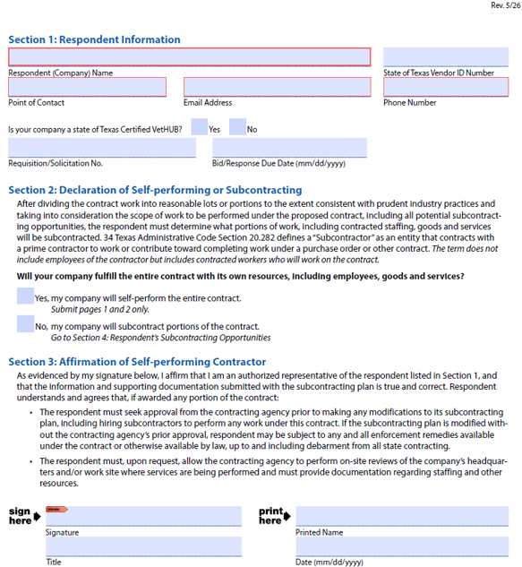
State of Texas Subcontracting Plan (Page 2)
Section 1: Respondent Information – Company Name and POC Information
Texas VID if available
Requisition/Solicitation Number if available
Bid/Response Date: needed if the project is a Bid/RFP/CSP/RFQ
Section 2: Indicate if Self-Performing
If Self-Performing, submit pages 1 & 2 only - Select “Yes” and continue to Section 3: Affirmation
If not Self-Performing – Select “No” & go directly to Section 4: Respondent's Subcontracting Opportunities
Section 3: Affirmation of Self-Performing
Acknowledgment and signature is required in this section is only if self-performing

Slide 6
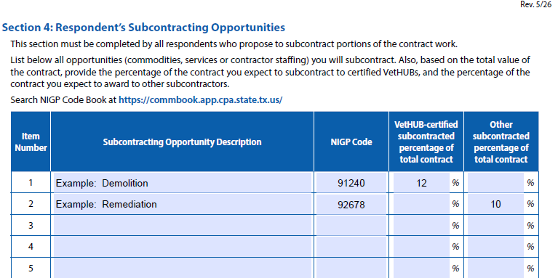
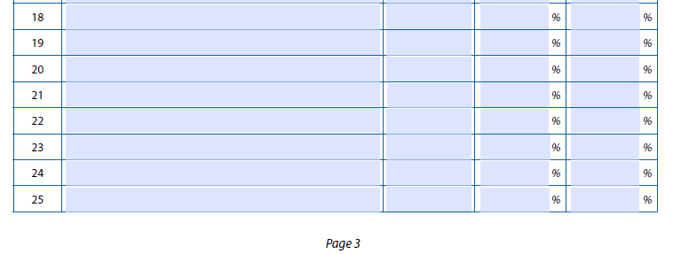
State of Texas Subcontracting Plan (Page 3)
Section 4: Respondent’s Subcontracting Opportunities (Required if Subcontracting)
List the Types of subcontracting work that will be required to complete the project or contract.
Examples include Demolition, Tile, Remediation, Plumbing, Painting, Masonry, Windows, etc.
NIGP Code if available, can be found on the CMBL/VetHUB Listing at:
https://mycpa.cpa.state.tx.us/tpasscmblsearch/
Provide the percent of the total contract you expect to subcontract per Subcontracting Opportunity, put the percent under the according column depending if VetHUB Certified or Not
Continue to Section 5: Subcontracting Plan – Good Faith Effort

Slide 7
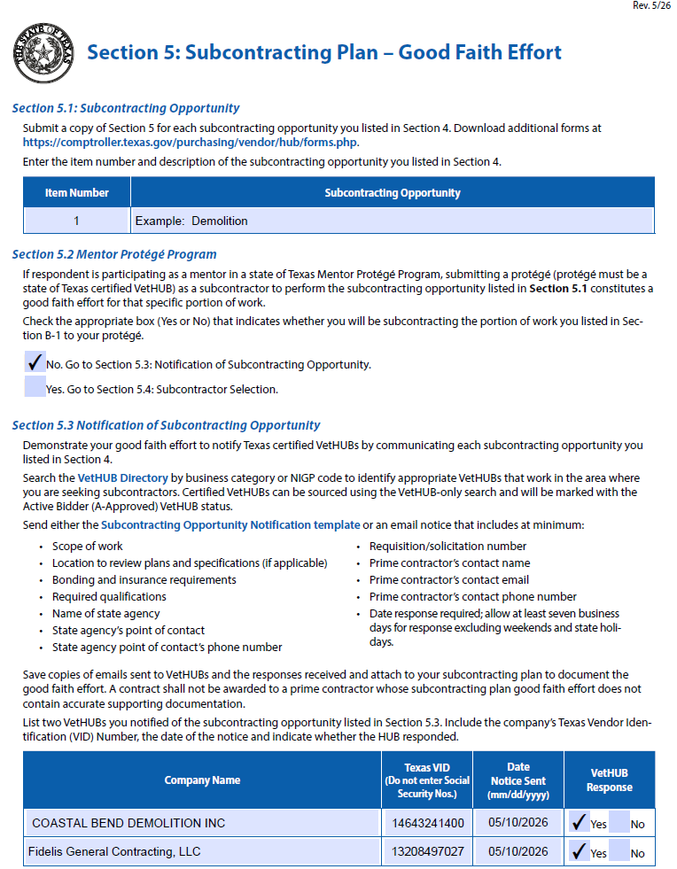
State of Texas Subcontracting Plan
Section 5: Subcontracting Plan – Good Faith Effort
Submit a copy of Section 5 (front & back) for each subcontracting opportunity you listed in Section 4 (if you had as in this example 2 subcontracting opportunities, you would have to submit 2 copies of Section 5, one for each opportunity)
Fill out Item Number and Subcontracting Opportunity for each one to match the Number and Opportunity as in Section 4
Section 5.2: Mentor Protégé Program
If respondent is participating as a mentor in a state of Texas Mentor Protégé Program, submitting a protégé (protégé must be a state of Texas certified VetHUB) as a subcontractor to perform the subcontracting opportunity
Section 5.3: Notification of Subcontracting Opportunity
List two VetHUBs you notified of the subcontracting opportunity per each Subcontracting Opportunity listed in Section 4 (Subcontractors can be found in the CMBL / VetHUB Directory or you can contact the Agency Coordinator listed in the first page)
Allow at least seven business days for response excluding weekends and state holidays
Save copies of emails sent to VetHUBs and the responses received, attach to your subcontracting plan

Slide 8
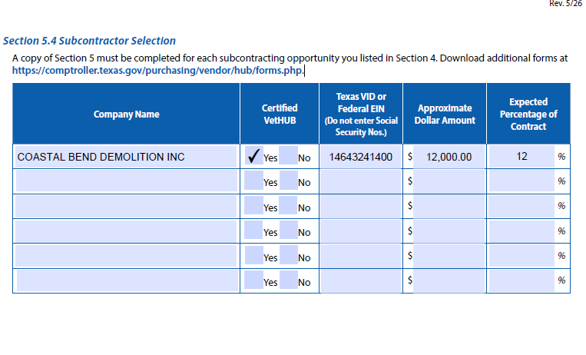

State of Texas Subcontracting Plan
Section 5.4: Subcontractor Selection
A copy of Section 5 must be completed for each subcontracting opportunity you listed in Section 4. Download additional forms https://comptroller.texas.gov/purchasing/vendor/hub/forms.php
Add the Subcontractor Selected from the Subcontractor Opportunity Solicitation Sent, whether Certified VetHUB or not
Add the Texas VID
Add Approximate Dollar Amount
Add Expected Percentage of Contract going to Subcontractor based on the Subcontracting Opportunity from the previous page
Subcontractor Selection should be based on lowest amount that meets the specifications your company sent on the emailed Subcontracting Opportunity Notification Form or Company’s Solicitation Email Notification
Continue to Section 6: Affirmation of Prime Contractor

Slide 9
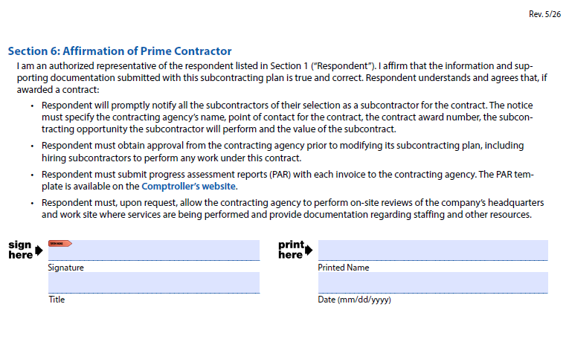

State of Texas Subcontracting Plan
Section 6: Affirmation of Prime Contractor
Affirm that the information and supporting documentation submitted with this subcontracting plan correct
Respondent will promptly notify all the subcontractors of their selection as a subcontractor for the contract
Respondent must obtain approval from the contracting agency prior to modifying its subcontracting plan (if modification is needed after submittal)
Respondent must submit progress assessment reports (PAR) with each invoice to the contracting agency

Slide 10
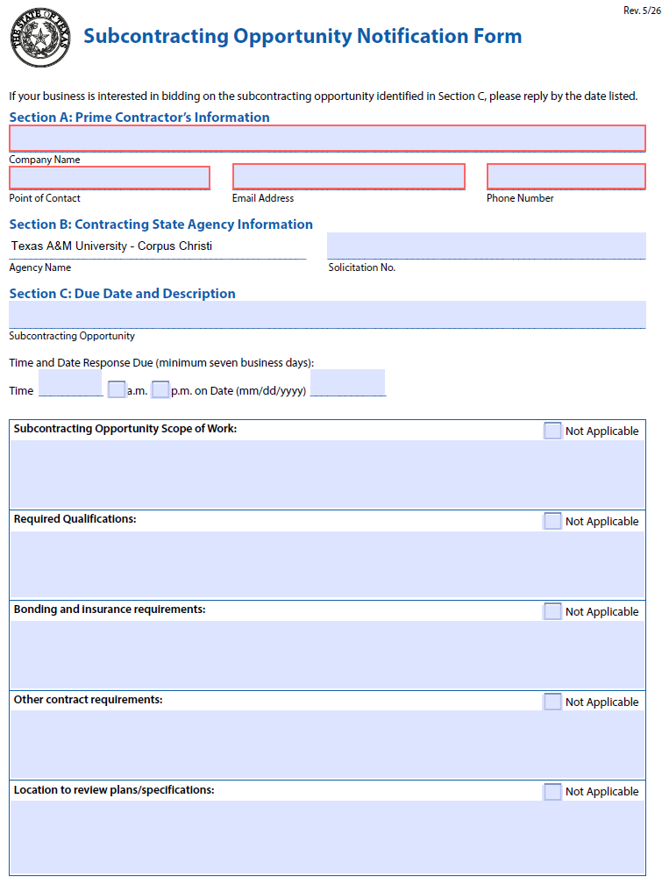
State of Texas Subcontracting Plan
Subcontracting Opportunity Notification Form
Subcontracting Solicitation Notification Form to notify subcontractors of the available subcontracting opportunities
Send either the Subcontracting Opportunity Notification Form or an email notice
If sending an email notice the minimum specifications or information needed are listed in Section 5.3
Give the possible subcontractor time to prepare a quote or bid, depending on the size and complexability of the project, date response is required; allow at least seven business days for response excluding weekends and state holidays

Slide 11
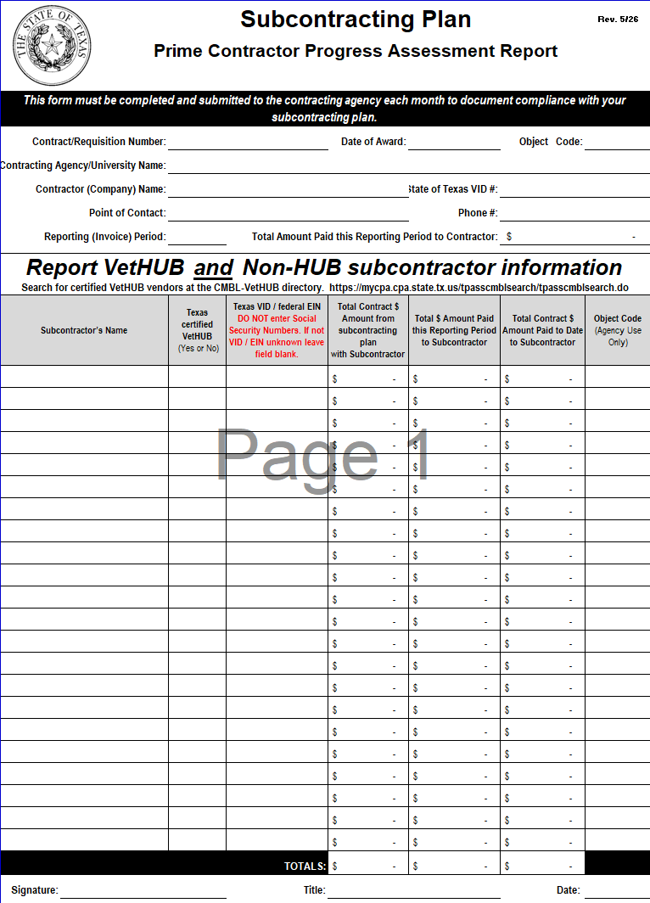
Prime Contractor Progress Assessment Report (PAR)
Prime Contractors
Prime Contractor Progress Assessment Report (PAR) shall be submitted with each request for payment (invoice) or monthly as a condition of payment.

Slide 12

Purpose of a Subcontracting Plan
Identify Subcontracting Opportunities
Document Subcontracting Opportunities
To show “Good Faith Effort”
Per Texas Government Code §2161.252

Slide 13
Things to remember about TAMU-CC Subcontracting Plans (SP)
Only required by TAMU-CC when the value of a purchase order or contract is expected to be $100,000 or greater including renewals and amendments
Seek approval from TAMU-CC VetHUB Office if SP needs to be modified before any changes can be made
PARs will be required as a condition for payment

