Slide 1



HUB Vendor Basics
Ruben Gonzalez, CTCD, CTCM
HUB Coordinator, Procurement & Disbursements
Texas A&M University - Corpus Christi
6300 Ocean Drive, Unit 5731
Corpus Christi, TX 78412-5731
ph: 361-825-5822
hub@tamucc.edu
ruben.gonzalez@tamucc.edu

Slide 2

HUB Program Mission
To promote participation of minority-, women-, and service-disabled veteran-owned small businesses, through the State of Texas HUB Program, and to make a "good faith effort" of ensuring that HUBs are afforded an equitable opportunity to compete for all procurement and contracting activities.

Slide 3
Texas A&M University – Corpus Christi HUB Program
The Comptroller’s Office is in the process of revising its administration of the HUB program and corresponding rules in light of the governor’s issuance of Executive Order GA-55 and recent decisions of the U.S. Supreme Court.
Texas A&M University - Corpus Christi does not award points in a bid evaluations or weights for being a HUB Vendor to keep the playing field equal and unbias.
Texas A&M University - Corpus Christi's HUB Program as in our mission is to promote participation of HUB Vendors and provide a "Good Faith Effort".

Slide 4

Why do we need a HUB Program?

Slide 5
The State of Texas Disparity Study – 2009
The 2009 Texas Disparity Study confirms the need for the continuation of the Statewide HUB Program. This conclusion is based primarily on:
Statistical disparities by race, ethnicity and gender classification in current HUB utilization, particularly in prime contracting.
Statistical disparities by race, ethnicity and gender classification in the private marketplace, particularly in the area of utilization of women- and minority- owned firms in commercial construction.
Statistical disparities in firm earnings by race, ethnicity and gender classification, even after controlling for capacity-related factors.
Anecdotal testimony of disparate treatment as presented by business owners in interviews, surveys, public hearings and focus groups.

Slide 6
Texas Government Code 2161.181 – 182
Sec. 2161.181
GOALS FOR PURCHASES OF GOODS AND SERVICES
A state agency, including the comptroller, shall make a good faith effort to increase the contract awards for the purchase of goods or services that the agency expects to make during a fiscal year to historically underutilized businesses based on rules adopted by the comptroller to implement the disparity study described by Section 2161.002(c).
Sec. 2161.182
GOALS FOR CONSTRUCTION CONTRACTS
(a) A state agency that contracts for a construction project, including a project under Section 2166.003, shall make a good faith effort to increase the construction contract awards that the agency expects to make during a fiscal year to historically underutilized businesses based on rules adopted by the comptroller to implement the disparity study described by Section 2161.002(c).

Slide 7
The Texas Administrative Code
TAC, Title 34, Part 1, Chapter 20, Subchapter D
Describes the minimum steps and requirements to be undertaken by state agencies to comply with the state's HUB rules.
TAC Rule §20.284
Identifies specific procurement goals that state agencies should make a good faith effort to meet.

Slide 8
Texas Government Code Vs Texas Administrative Code
The Government Code establishes the structure and authority of state government, whereas the Administrative Code provides the specific, detailed rules that state agencies use to operate.

Slide 9
HUB Program Benefits
TAMU-CC is constantly looking to do business with HUB Vendors as a part of the Texas Government Code showing a “Good Faith Effort.”
If a purchase is more than $25K, universities must at the very least have 3 quotes, 2 of them must be HUB Vendors.
Subcontracting is another opportunity, HUB Vendors will be listed on the HUB / CMBL list, where they can be selected as a subcontractor by Prime Contractors.
Networking and increased exposure, as a HUB Vendor, Pre-Proposal Conferences and Economic Opportunity forums where vendors can network and participate in spot bid fairs.
Its Free of Charge.

Slide 10
HUB Requirements
Good Faith Efforts are required by both the contracting agency (TAMU-CC / Departments) and the prime contractors/respondents.
Utilize HUB vendors whenever possible – We are trying to increase both HUB participation and our annual percentage.
Plan
Procurement
Contract Oversight
HUB
Contract Formation

Slide 11
Reasons to Purchase from HUBs
HUB purchases benefit the Texas and Local economy. Because HUBs are located in Texas, they hire Texans, spend money in Texas, and pay state taxes. Buying from HUBs keeps state revenue in Texas and ultimately benefits Texans.
State law and A&M System policy require a "good faith effort" make sure HUBs are afforded an opportunity to compete for all procurement and contracting activities.
Poor HUB performance can lead to loss of state funding and negative audit findings.

Slide 12
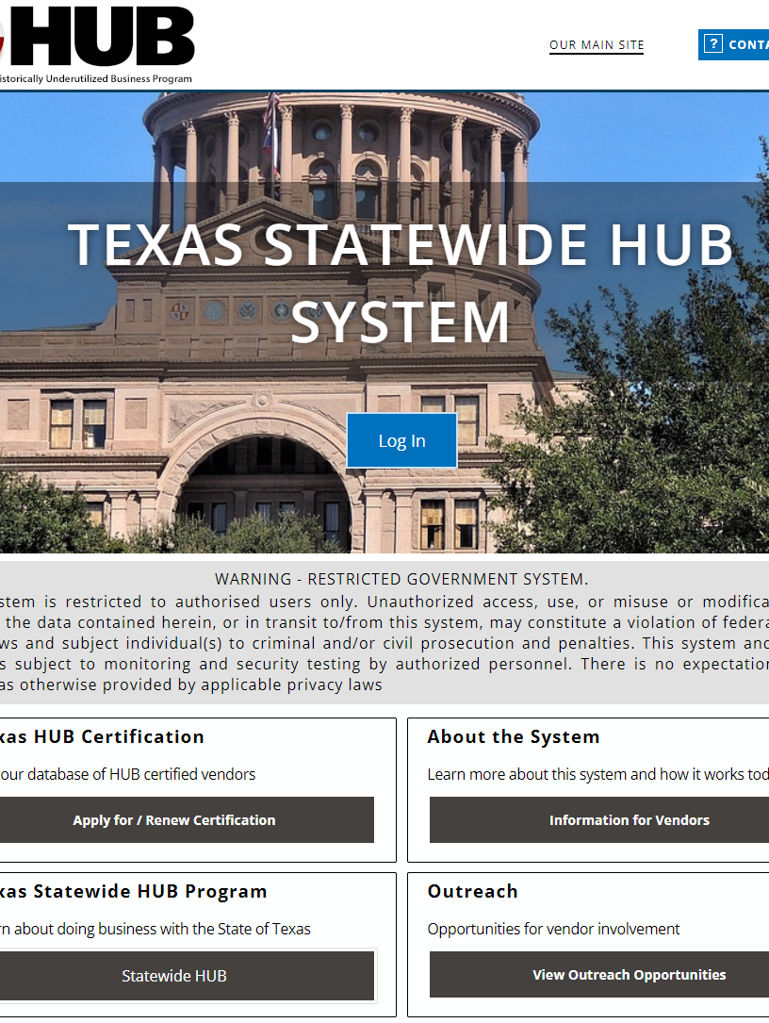
Not HUB Certified Yet?
Looking to get HUB certified or need more information, look no further, below is the link to the Texas Statewide HUB System for your certification needs.
https://texashub.gob2g.com/

Slide 13
Texas A&M University – Corpus Christi Historically Underutilized Business FY26 Goals
17.89% building / general construction
12.15% special trade construction
35.44% professional services contracts
13.26% all other services contracts
28.52% commodity contracts

Slide 14
Where do I start looking for Opportunities?
TAMUCC’s list of current competitive bid opportunities and request for proposals are available at: https://www.tamucc.edu/finance-and-administration/financial-services/purchasing/bid-opportunties.php
Set up an appointment with TAMUCC’s HUB Coordinator or send me email to ruben.gonzalez@tamucc.edu for a list of department POCs, which could be interested the services / commodities you provide, and for upcoming opportunities.
Search the Electronic State Business Daily for opportunities at http://www.txsmartbuy.com/sp.
Become HUB certified and if possible, sign up for the CMBL, so opportunities could find you.

Slide 15
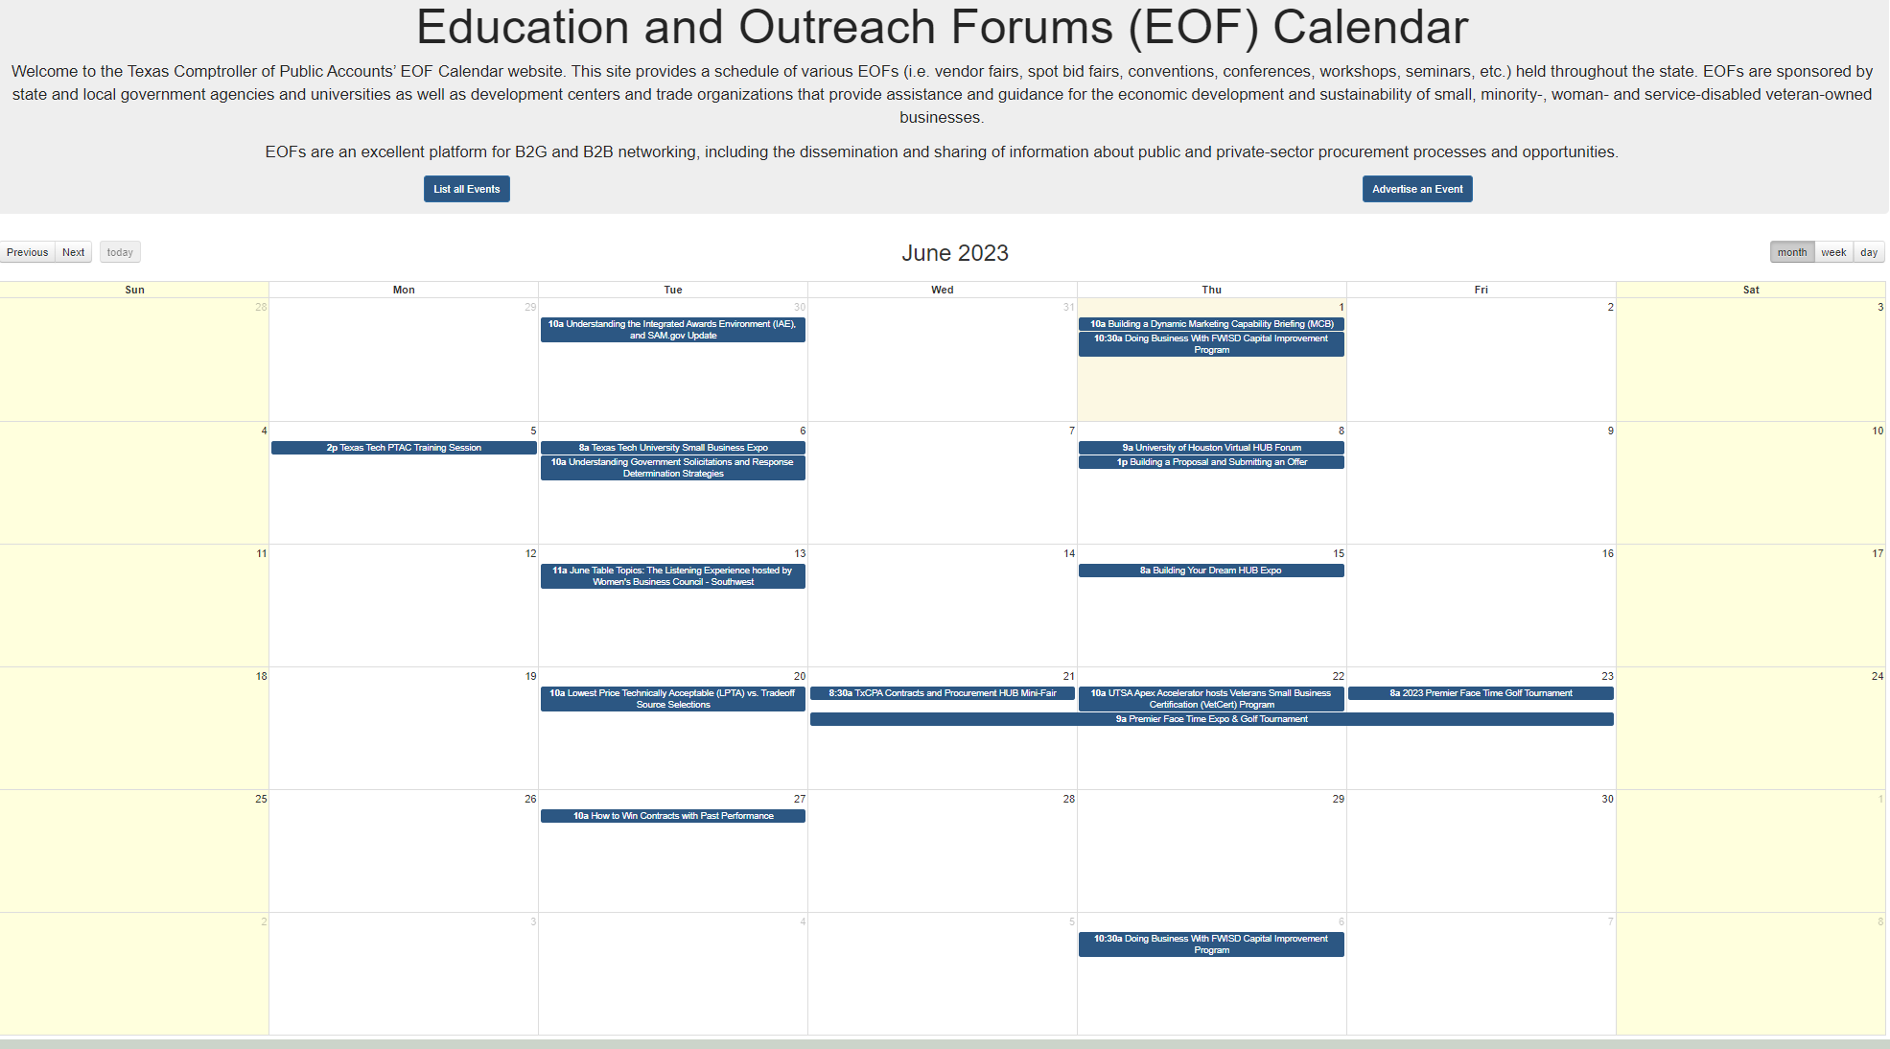
Economic Opportunity Forums (EOF) Calendar https://www.txsmartbuy.com/eof/index.html

Slide 16
GROUP PURCHASING PROGRAMS
If available, TAMU-CC purchases material, supplies, or equipment through group purchasing programs, (Cooperatives, Alliances, etc.)
These types of purchases have already been bid and awarded and do not require any additional bidding process.
Buyboard
OMNIA Partners
HGAC
E&I
GoodBuy (Local)
Choice Partners
TIPS
Provista Vizient
Sourcewell (NJPA)
DIR

Slide 17

TAMU-CC Procurement Process
Department Identifies a Need
(Commodities / Services)
Department Requests Quote(s) from HUB Vendor(s)
Department Receives Quote(s) from HUB Vendor(s)
Department determines procurement method (Requisition / P-Card)
Department submits a Requisition through IslanderBuy for approval
If vendor is not in IslanderBuy, the New Supplier Onboarding Method will be used, where the Department request New Supplier on IslanderBuy, and the system will email the new Supplier for set-up
Under $5,000 can use PCard (Instant Payment)
**As long as no agreement is required and/or the purchase is not a controlled / capitalized item
Procurement converts Requisition to a Purchase Order and sends to Vendor electronically
Vendor receives Purchase Order and ships out Commodities / Performs Services
Department verifies and receives Commodities / Services in IslanderBuy, which in turn sends payment to Vendor

Slide 18
Procurement Process Continuation
Delegated Purchase Requisitions:
Process govern by Amount
Spot Purchases
( ≤ $25,000.00)
Informal Bids
($25,000.01 - $50,000.00)
Formal Bids
($50,000.01 and above)
Cooperative Purchases
(Already has been Bid)
Vendor Quote Required
Three (3) bids are required in which two (2) must be certified HUB Vendors
Procurement requests and receives Formal Invitation for Bid Solicitations from Vendors in which two (2) must be certified HUB Vendors at very least
Vendor Quote is Required with Cooperative and Contract number clearly stated on the Quote
HUB Vendors are highly encouraged when available
TAMU-CC Buyers will check if the item can be purchased through a HUB Vendor when possible
Procurement will verify Quote is within Cooperative scope
Note: if the goods or services quote requires a signature on terms and conditions, TAMU-CC will send it for Contract Review
Note: if total amount is $100,0000.00 or above a HUB Subcontracting Plan will be required from the Vendor

Slide 19

TAMUCC HUB Subcontracting Plan Brief:

Slide 20
HUB Subcontracting Plan (HSP)?
When the value of a purchase order or contract is expected to be $100,000 or greater, a HUB Subcontracting Plan is required by the State of Texas
Note: FY 2026 HUB Subcontracting Plan will be available on 12/01/2025

Slide 21
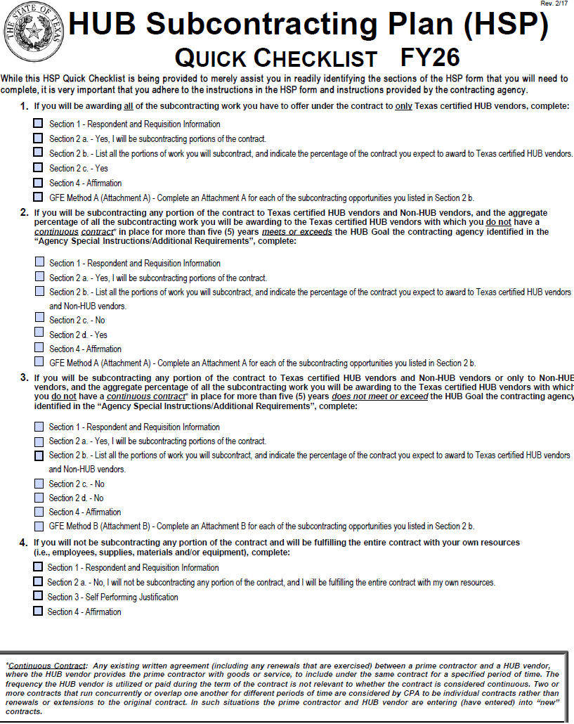
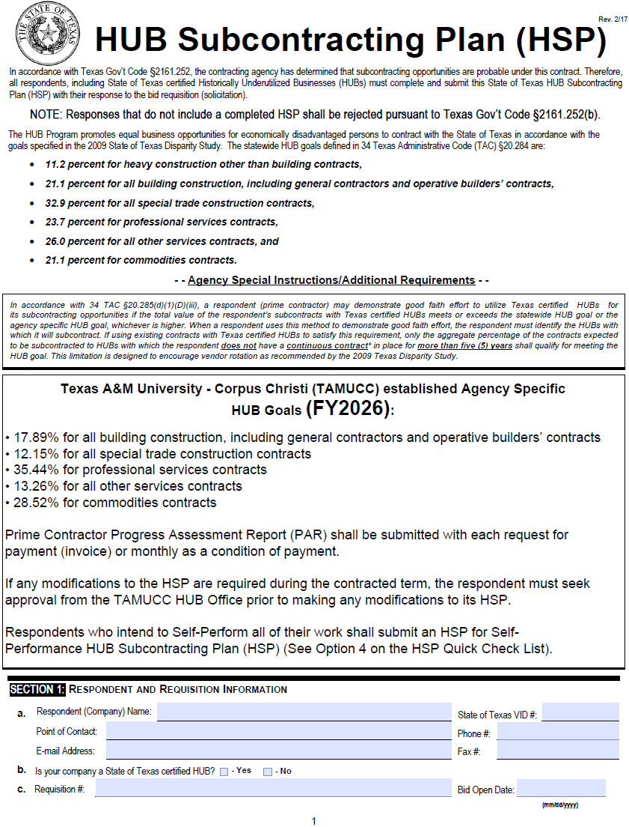
TAMU-CC HUB Subcontracting Plan (HSP)
Texas A&M University – Corpus Christi HUB Subcontracting Plan

Slide 22
HSP Quick Checklist
Using only HUBs, for all subcontracting listed
Using Subs (HUB & Non)
Meets/Exceeds TAMUCC HUB Goals
Using Subs (HUB & Non)
Does Not Meet/Exceed TAMUCC HUB Goals
Self-Performing: using own resources

Slide 23
TAMU-CC HUB Program
Good Faith Effort Requirement Methods:
Utilizing 100% HUBs for Subcontracting (Attachment A)
Meeting or Exceeding a HUB Goal (Attachment A)
Solicitation (Attachment B)

Slide 24
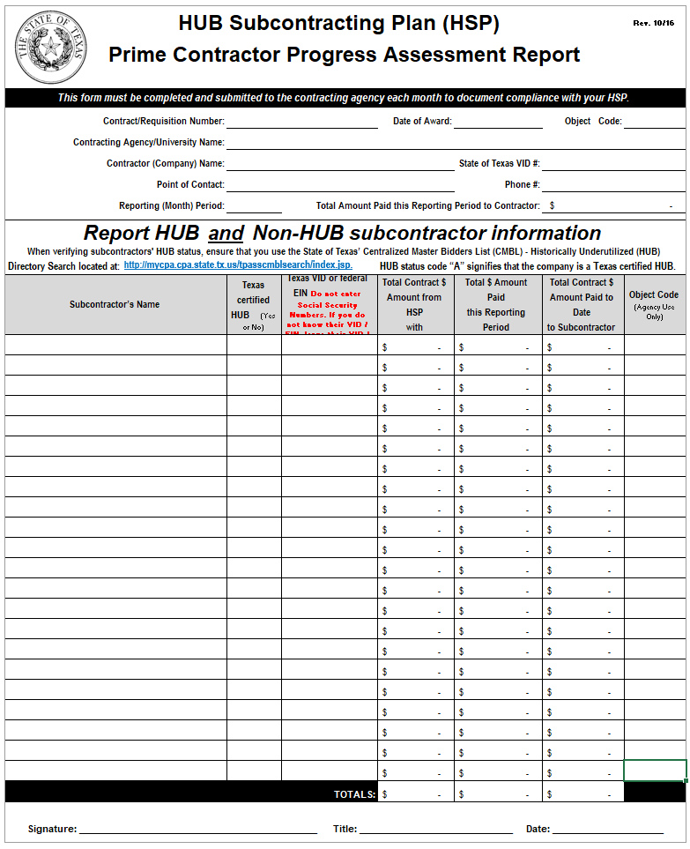
HUB Subcontracting Plan (HSP) Prime Contractor Progress Assessment Report (PAR)
Prime Contractors
Prime Contractor Progress Assessment Report (PAR) shall be submitted with each request for payment (invoice) or monthly as a condition of payment.

Slide 25

Purpose of a HUB Subcontracting Plan
Identify Subcontracting Opportunities
Document Subcontracting Opportunities
To show “Good Faith Effort”
Per Texas Government Code §2161.252

Slide 26
Things to remember about Subcontracting Plans
Only required by TAMU-CC when the value of a purchase order or contract is expected to be $100,000 or greater including renewals and amendments
Use the HSP Quick Checklist as a navigation tool, not all pages of the HSP will need to be filled out
Seek approval from TAMU-CC HUB Office if HSP needs to be modified before any changes can be made
PARs will be required as a condition for payment

Slide 27
HUB Resources and Information:
Texas A&M University – Corpus Christi HUB Program Website:
https://www.tamucc.edu/finance-and-administration/financial-services/purchasing/hub-program/index.php
Texas Comptroller HUB Program Website:
https://comptroller.texas.gov/purchasing/vendor/hub/
Texas A&M University Vendor Resources Website:
https://aggiebuy.tamu.edu/vendor-resources.html
Texas A&M University - Corpus Christi Vendor Care Website:
https://www.tamucc.edu/finance-and-administration/financial-services/disbursements-travel-services/vendor-care/index.php
Texas A&M University – Corpus Christi Bid Opportunities:
https://www.tamucc.edu/finance-and-administration/financial-services/purchasing/bid-opportunties.php
Texas A&M University AggieBid sourcing opportunities: https://bids.sciquest.com/apps/Router/PublicEvent?CustomerOrg=TAMU
Electronic State Business Daily Search: http://www.txsmartbuy.com/sp
Centralized Master Bidders List - HUB Directory Search link: https://mycpa.cpa.state.tx.us/tpasscmblsearch/tpasscmblsearch.do

