Slide 1
HUB Vendor Basics
Ruben Gonzalez, CTCD
HUB Coordinator, Procurement & Disbursements
Texas A&M University - Corpus Christi
6300 Ocean Drive, Unit 5731
Corpus Christi, TX 78412-5731
ph: 361-825-5822
hub@tamucc.edu
ruben.gonzalez@tamucc.edu

Slide 2
HUB Program Mission
To promote small business participation of minority-, women-, and service-disabled veteran-owned, through the State of Texas HUB Program for procurement of goods and/or services and to make a "good faith effort" of ensuring that HUBs are afforded an equitable opportunity to compete for all procurement and contracting activities.

Slide 3
Why do we need a HUB Program?

Slide 4
The State of Texas Disparity Study – 2009
The 2009 Texas Disparity Study confirms the need for the continuation of the Statewide HUB Program. This conclusion is based primarily on:
Statistical disparities by race, ethnicity and gender classification in current HUB utilization, particularly in prime contracting.
Statistical disparities by race, ethnicity and gender classification in the private marketplace, particularly in the area of utilization of women- and minority- owned firms in commercial construction.
Statistical disparities in firm earnings by race, ethnicity and gender classification, even after controlling for capacity-related factors.
Anecdotal testimony of disparate treatment as presented by business owners in interviews, surveys, public hearings and focus groups.

Slide 5
Texas A&M University – Corpus Christi Historically Underutilized Business (HUB) Goals
14.87 % building construction
21.31% special trade construction
17.29% professional services
10.63% all other services
30.34 % commodity contracts

Slide 6
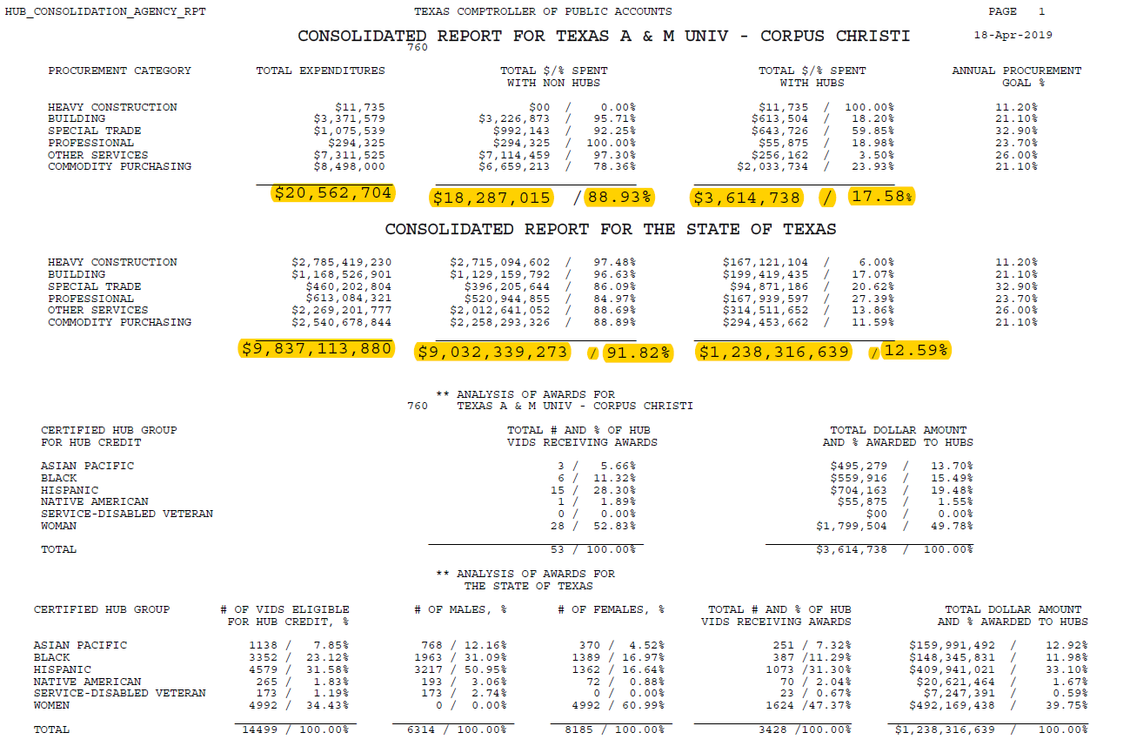

Slide 7
Where do I start looking for Opportunities?
TAMUCC’s list of current competitive bid opportunities and request for proposals are available at: https://purchasing.tamucc.edu/Bid-opportunities.html
Set up an appointment with TAMUCC’s HUB Coordinator or send me email to hub@tamucc.edu for a list of department POCs, which could be interested the services / commodities you provide, and for upcoming opportunities.
Search the Electronic State Business Daily for opportunities at http://www.txsmartbuy.com/sp.
Become HUB certified and if possible sign up for the CMBL, so opportunities could find you.

Slide 8
TAMUCC Procurement Process
Department Identifies a Need
(Commodities / Services)
Department Requests Quote(s) from HUB Vendor(s)
Department Receives Quote(s) from HUB Vendor(s)
Department determines procurement method (Requisition / P-Card)
Department submits a Requisition through IslanderBuy for approval
If vendor is not in IslanderBuy, department will request a Substitute W9 from vendor, then the vendor will receive a Supplier Registration email: https://aggiebuy.tamu.edu/vendor-resources/
Under $5,000 can use PCard (Instant Payment)
Procurement converts Requisition to a Purchase Order and sends to Vendor electronically
Vendor receives Purchase Order and ships out Commodities / Performs Services
Department verifies and receives Commodities / Services in IslanderBuy, which in turn sends payment to Vendor

Slide 9
Procurement Process Continuation
Delegated Purchase Requisitions:
Process govern by Amount
Spot Purchases
( ≤ $25,000.00)
Informal Bids
($25,000.01 - $50,000.00)
Formal Bids
($50,000.01 and above)
Cooperative Purchases
(Already has been Bid)
Vendor Quote Required
Three (3) bids are required in which two (2) must be certified HUB Vendors
Procurement requests and receives Formal Invitation for Bid Solicitations from Vendors in which two (2) must be certified HUB Vendors at very least
Vendor Quote is Required with Cooperative and Contract number clearly stated on the Quote
HUB Vendors are highly encouraged when available
TAMUCC Buyers will check if the item can be purchased through a HUB Vendor when possible
Procurement will verify Quote is within Cooperative scope
Note: if the goods or services quote requires a signature on terms and conditions, TAMUCC will send it for Contract Review
Note: if total amount is $100,0000.00 or above a HUB Subcontracting Plan will be required from the Vendor

Slide 10
HUB Resources and Information:
Texas A&M University – Corpus Christi HUB Program Website:
https://purchasing.tamucc.edu/HUB%20Program/Index.html
Texas Comptroller HUB Program Website:
https://comptroller.texas.gov/purchasing/vendor/hub/
Texas A&M University Vendor Resources Website:
https://aggiebuy.tamu.edu/vendor-resources/
Texas A&M University - Corpus Christi Vendor Care Website: https://purchasing.tamucc.edu/Vendor%20Care/index.html
Texas A&M University – Corpus Christi Bid Opportunities:
https://purchasing.tamucc.edu/Bid-opportunities.html
Texas A&M University AggieBid sourcing opportunities: https://bids.sciquest.com/apps/Router/PublicEvent?CustomerOrg=TAMU
Electronic State Business Daily Search: http://www.txsmartbuy.com/sp
Centralized Master Bidders List - HUB Directory Search link: https://mycpa.cpa.state.tx.us/tpasscmblsearch/tpasscmblsearch.do

