Slide 1
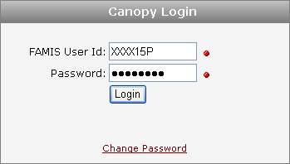
OPEN COMMITMENTS Use Canopy to view and research Open Commitments. Canopy is http://canopy.tamu.edu.

Slide 2
OPEN COMMITMENTS The Open Commitments tab under the FRS Account menu contains all the same filter fields as FAMIS Screen 021. Canopy allows the user to download the list to Excel by pressing the Download button.

Slide 3
OPEN COMMITMENTS
Open Commitments are also known as Encumbrances on the account. This is a dynamic list. The Open Commitments stay on this screen until they are fully Liquidated or Paid. New Documents are added to the list as they are closed.

Slide 4
OPEN COMMITMENTS
Open Commitments can be identified in the Reference 1 column as one of the following:
Payroll = SAL0001 Exempt Purchase Document = E
Benefits = BENB001 Limited Purchase Document = L
Cell Phone = CP Requisition Document = R
Copiers = AC Purchase Order Document = P
Telecom = TC & LD

Slide 5
OPEN COMMITMENTS
The Encumbrances for Cell Phones, Copiers & Telecom are entered at the beginning of the FY. These are an estimated total of the expenses for the FY. They are liquidated by the actual amount each month. They may also be adjusted as needed.

Slide 6
OPEN COMMITMENTS
The Open Commitments (Encumbrances) have an Original amount. The Adjusted column is the total of all changes to the Encumbrance. The next column is for the total of what has been Liquidated (transactions reducing the amount of the Encumbrance). Then the Current column is the remaining Encumbrance total.

Slide 7
OPEN COMMITMENTS
Canopy also allows the user to filter and sort the Open Commitments (Encumbrances). Type in an Object code next to the account to filter to that code. To sort, click on the column heading and the list is sorted as descending.

