Slide 1

FY2021
Year-End Workshop

Slide 2


PURPOSE OF WORKSHOP
1) Review of Year-End Memo – Will Hobart, Director of Procurement & Disbursements
2) Receiving – Will Hobart, Director of Procurement & Disbursements
3) Voucher Creates – Will Hobart, Director of Procurement & Disbursements
4) Travel and Procurement Card – Will Hobart, Director of Procurement & Disbursements
5) Accounting – FAMIS Security
6) Fiscal Year 2022 – Will Hobart, Director of Procurement & Disbursements
7) Questions & Answers

Slide 3

YEAR-END DEADLINES - PURCHASE REQUISITIONS FOR FY 2020
The deadlines and instructions for online submittal of requisitions for the remainder of fiscal year 2021 are listed below.
FISCAL YEAR 2021
Type of Purchase | Deadline
Facilities Modifications Request (FMR) submitted to Administrative Operations | July 14, 2021**
Requisitions ($50,000 or above) Formal bids required | July 14, 2021
Requisition ($≤ 50,000) informal bids required | July 30, 2021
State & TX MAS Contracts, Cooperatives and Blanket Awards | August 16, 2021
Purchases through IslanderBuy (< $5,000) | August 20, 2021
Procurement Credit Card purchases | August 27, 2021
**Any Facilities Request submitted after the deadline will be reviewed on a case by case basis and may not be able to be completed by August 31st.
GRANT ACCOUNTS
If you have a grant account fund and an exception is necessary to meet your contractual obligation, it will be granted after review on a case by case basis.

Slide 4
Funds that WILL Rollover
Description | Account Prefix | Rules for closing out funds at year end
State accounts, includes lab fee accounts | “12”, “13”, “16”, “17” & “18” | Funds to cover encumbrances are carried forward to the next fiscal year.
Research Development | “140” | Funds may be carried over to next year if within the biennium
HEF funds | “1609xx” | Funds to cover encumbrances are carried forward to the next fiscal year.
Designated Tuition- funded accounts | “28” | Funds to cover encumbrances are carried forward to the next fiscal year.
Fee-funded accounts-usually have the word “Fee” in the title | “2” & “3” | Funds to cover encumbrances are rolled forward to the new fiscal year.
Program accounts | Usually “2” | These accounts have been opened for a program or event and year-end processing of funds is determined by the account manager or program needs.
Grants and Contracts | “6” | Fiscal year and project length are determined by the awarding entity and funds are rolled forward according to the grant or contract.
Construction | “830xxx” “8307xx” | Most construction related accounts only roll forward funds to cover encumbrances. Construction accounts funded by gifts roll forward.
For further details about year-end processing, see screen 006 in FAMIS as shown in the example below

Slide 5




SERVICES:
(object codes 5350-5680)
The purchase of services must be charged to the fiscal year in which the services are rendered. DON’T issue purchase orders or submit requisitions for services that will cross fiscal years.
Create a Requisition for current fiscal year to end August 31, 2021 and then create a Requisition for the service to begin on September 01, 2021, for FY22.

Slide 6


CAPITAL ASSETS & CONTROLLED ASSETS
(object codes 5750-5772, 5773-5797 & 8000)
Equipment that has a value of $5,000.00 or more and an estimated useful life of more than one year is considered a Capital Asset.
A Controlled Asset is equipment that does not meet the capitalization threshold but must be inventoried and tracked due to the nature of the item (Example: computers, cameras, etc.).
These Assets must be charged to any fiscal year or combination of fiscal years that are in existence on the date that the purchase order is awarded. Note: If order is not delivered by August 31, 2021, purchase order will roll forward and funds remain encumbered until received.

Slide 7


Controlled but Non-Capitalized Items at Year-End
Computers (Object Code: 5787)
10 Computers ordered on AUGUST 13TH
10 Computers received on SEPTEMBER 7TH
This order WILL rollover with FY21 funds for two reasons:
it used object code 5787 and
the purchase order was placed PRIOR to August 17, 2021.
Example A

Slide 8
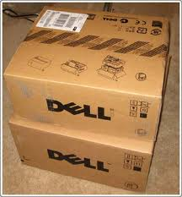



MIXED PURCHASES
When an order is a combination of a consumable, service, and/or capital item, the dominant purchase would govern the entire purchase order and will determine the fiscal year.

Slide 9


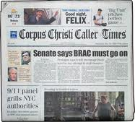
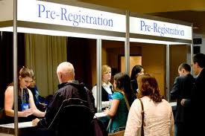

Exceptions to the Fiscal Year-End Determination
Subscription to memberships, registrations, magazines and newspaper
(object code – 5211-5217,5765)
A particular fiscal year may be used to pay for the complete cost of a membership, magazine or newspaper subscription even if the subscription covers more than one fiscal year, providing that the subscription begins in the fiscal year being charged.

Slide 10

Receiving – CREATE RECEIPT
All items delivered by August 31, 2021 should be entered into IslanderBuy as received by August 31, 2021. When entering the receiving information on IslanderBuy manually enter the date received otherwise it will default to the current date.
Important:
If you place an order using FY2022 funds and they are delivered “BEFORE” September 1, 2021; department must use FY2021 funds to pay for goods.

Slide 11
EXAMPLE A: (Order delivered to Central Receiving)
  FY22 FUNDS were used
  FY22 Purchase Order was created
  3 Projectors ordered on AUGUST 15TH
  3 Projectors “RECEIVED” on AUGUST 31st or prior
PROBLEM: FY22 FUNDS may NOT be used for a delivery received prior AUGUST 31, 2021.
RESOLUTION: CONTACT Buyers to change funding from FY22 to FY21.

Slide 12
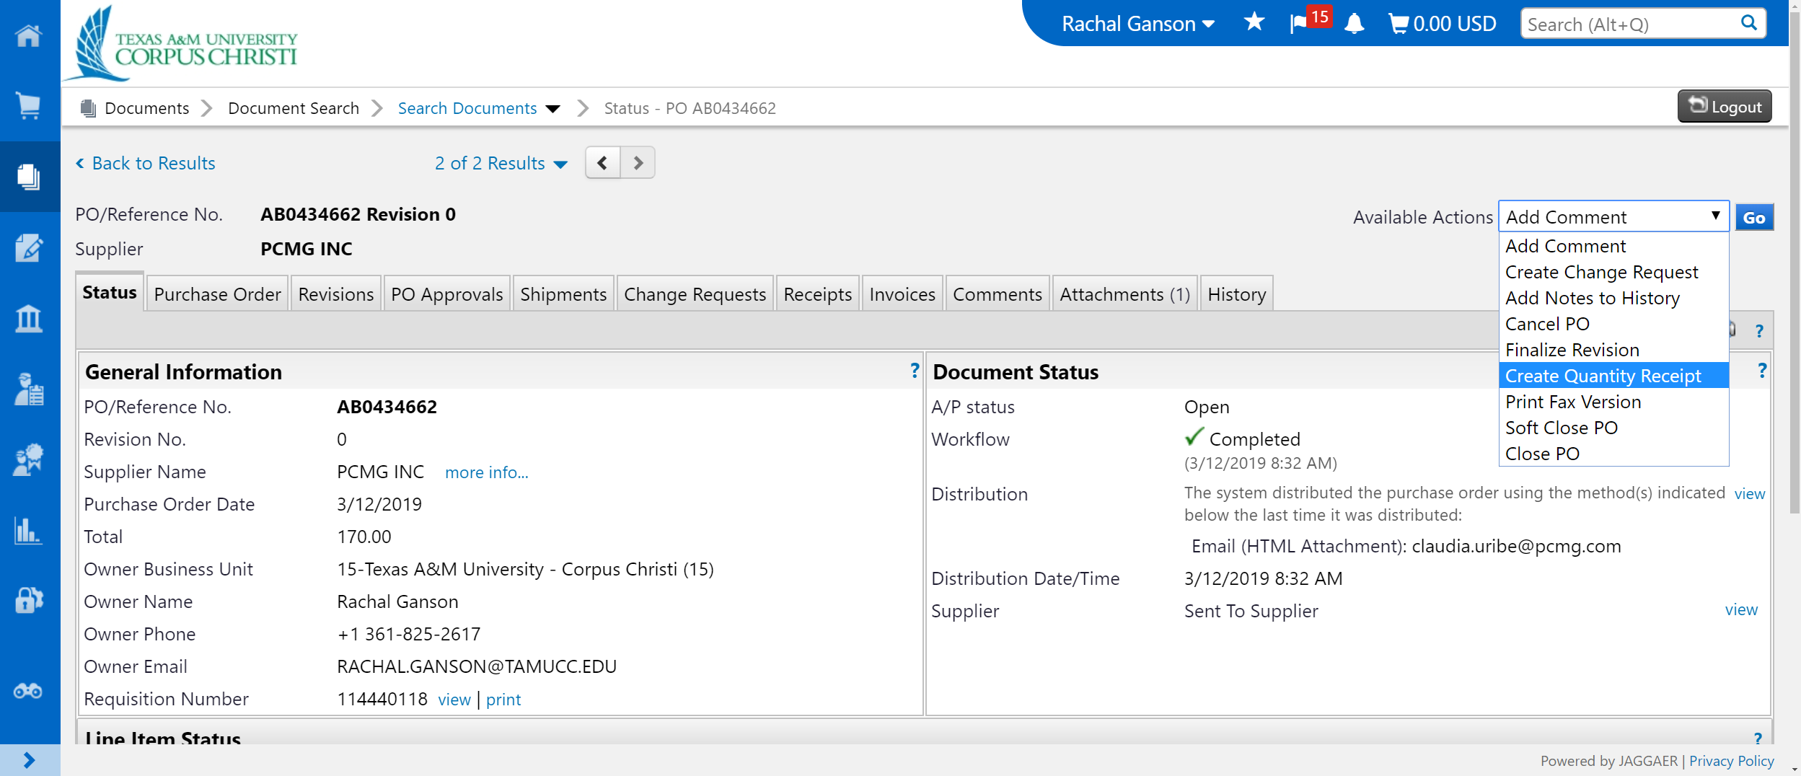
IslanderBuy Receiving – Entered by Department
For all other shipments delivered to the department, the department creates the receiving process in IslanderBuy. The shipment is added as per illustration below.

Slide 14
PURCHASING TO OPEN COMMITMENTS
In September, the Procurement and Disbursements Department will review all open commitments for status.
  Capitalized purchases (object codes 5700 and 8000 series) the
  encumbrance and budget will be rolled forward and paid with FY2021
  funds.
  Non-capital items that are physically received on or before August 31,
  2021 must be received in FAMIS by August 31, 2021.
The encumbrance will be paid with FY2021 funds upon a valid purchase order that can be verified as received by August 31, 2021.
The state requires an accurate detail of all open commitments to be rolled into the next fiscal year.
NOTE: The Departments should be reviewing and monitoring their Open Commitments on a monthly basis by using screens 021, 022, 061 in FAMIS or CANOPY.

Slide 15

Accounts Payable
Items being paid on a Non-PO Invoice must be must be received in the Accounts Payable Department
by August 24, 2021, by 5:00 pm in order to be processed with FY2021 funds.
No manual payables will be created.
The first payment for FY2022 will be issued (approx.) September 7, 2021.
Invoices arriving in Accounts Payable will not begin to be paid until FY2022 is opened for processing which could be approximately September 7, 2021.

Slide 16

CBT Travel Credit Card
              eTravel/Concur Expense Reports
              All State travel related expenses incurred must be processed on an eTravel/Concur Expense Report (FY2021 funds) by Monday, August 17, 2021. Expense reports must be received in the Travel back office by Monday, August 24, 2021. Expense reports processed on September 1, 2021 and beyond will be posted as FY2022 activity. If funds were encumbered properly, the encumbrance and related budget will roll forward to cover these charges. If the travel was not encumbered, a local FY2022 account number will be required to process the payment.
              Note: Travel Office is located in the Purchasing Building

Slide 17

Procurement Credit Card
Wednesday, August 26, 2021 is the last day to do any purchasing with your P-Card in order to allow transactions to post by Monday, August 31, 2021.
If expense reports are not reconciled by August 31, 2021, they will post to FY22.
Best Practice should be to submit P-Card reports as soon as possible after items post in Concur.

Slide 18
Pcard continued: STATE FUNDS
All expense reports with State funds are due in Concur no later than 12:00 p.m., Monday, August 24, 2021.
State Transactions:
  Strongly Recommend using Local Funds during month of August.
  State and HEAF Funds – Must have original receipts, NO Sales Tax charged and all other required supporting documentation
  HEAF Accounts: Remember supplies are not allowed to be purchased.

Slide 19

Accounting Important Dates
Month Close
Month Closing Date
July - August 2nd
August - September 3rd
IDT deadline: Due to Accounting on the 23rd of every month. August close requires all IDTs through August 31st be turned-in by noon on September 1st.
Petty Cash: Please submit petty cash reimbursements to the Business Office by August 31st.

Slide 20
ACCOUNTING CORRECTIONS
State/Local, Local/State, State to State
All transaction correction requests involving a state account must be received by August 6th
Local to Local
All local transaction correction requests must be received by the accounting office by August 31st
All local DCR’s must be entered and routed by August 30th. DCR’s will be disabled August 31st

Slide 21

Payroll Corrections
Payroll Corrections – PCT documents must be in completed status by August 20th to post in FY21.
PCTs required for June 30, 2021 Time & Effort Reports must be in a completed status by July 14th for final certification prior to August 28th.
Approved FY21 One-time (Supplemental) Pay Forms must be received by Payroll by August 17th for monthly employees and August 23rd for biweekly employees.
*Documents received after these dates will require use of FY22 funds.

Slide 22

ACCOUNTING POSTING TIMING
Deposits 2-3 days after
Payroll Bi-weekly & end of month
Banner Weekly & end of month
IDT’s After 25th , After 31st for August

Slide 23

Accounting Tips
Tips to use your accounts wisely:
  Check account balances before and after the 25th of each month.
  Use DBRs (Departmental Budget Requests) and DCRs (Departmental Correction Requests) to move budget or actuals as needed.
  Review expenses in current month to be sure they are on the correct account.

Slide 24
Accounting Tips, cont.
  Double check all object codes on documents before you close them.
  Be sure your documents have completed all their routing.
6) Review Open Commitments and check for documents that are not needed, or manual encumbrances that need to be changed.

Slide 25
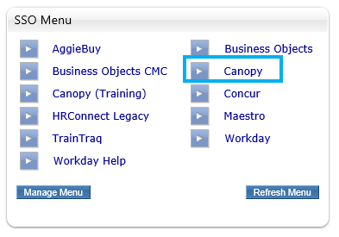
OPEN COMMITMENTS
Use Canopy to view and research your Open Commitments.
Canopy is now available on the SSO menu

Slide 26
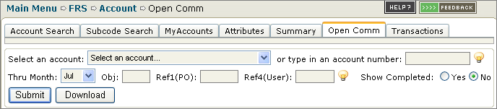
OPEN COMMITMENTS
The Open Commitments tab under the FRS Account menu contains all the same filter fields as FAMIS Screen 021. Canopy allows the user to download the list to Excel by pressing the Download button.

Slide 27
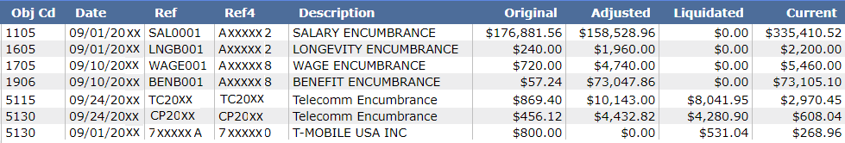
OPEN COMMITMENTS
Open Commitments are also known as Encumbrances on the account. This is a dynamic list. The Open Commitments stay on this screen until they are fully liquidated or paid. New documents are added to the list as they are closed.

Slide 28
OPEN COMMITMENTS
Open Commitments can be identified in the
Reference column as one of the following:
Payroll = SAL0001 Exempt Purchase Document = E
Benefits = BENB001 Limited Purchase Document = L
Cell Phone = CP Requisition Document = R
Copiers = AC Purchase Order Document = P
Concur = 000xxxx IslanderBuy PO = 7 digit reference (numbers/letters)
Telecomm = TC

Slide 29
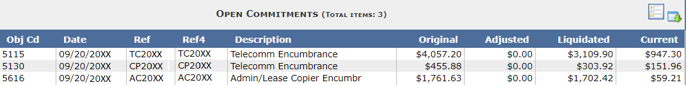
OPEN COMMITMENTS
The Encumbrances for Cell Phones, Copiers & Telecom are entered at the beginning of the FY. These are an estimated total of the expenses for the Fiscal Year. They are liquidated by the actual amount each month. They may also be adjusted as needed.

Slide 30
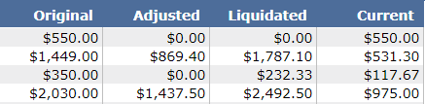
OPEN COMMITMENTS
The Open Commitments (Encumbrances) have an Original amount. The Adjusted column is the total of all changes to the Encumbrance. The next column is for the total of what has been Liquidated (transactions reducing the amount of the Encumbrance). Then the Current column is the remaining Encumbrance total.

Slide 31
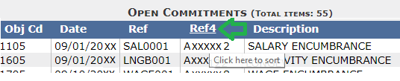
OPEN COMMITMENTS
Canopy also allows the user to filter and sort the Open Commitments (Encumbrances). Type in an Object code next to the account to filter to that code. To sort, click on the column heading and the list is sorted as descending.

Slide 32
FY22 Opening Dates
Departments will be able to enter Fiscal Year 2022 requisitions into IslanderBuy at any time.
Encumbrances in FAMIS should occur as soon as FY2022 Budgeted Funds available.
For emergency orders that must be delivered on or shortly after September 1, 2021, please contact Will Hobart, ext. 2616.

Slide 33

That’s all folks ~
Thank you for coming.

