Slide 1
TouchNet Marketplace
TEXAS A&M UNIVERSITY – CORPUS CHRISTI
SPRING 2021

Slide 2
Objectives
Marketplace – An Introduction
What is uStore?
What is uPay?
Reporting
GL Interface

Slide 3
Marketplace: Introduction
Enables TAMUCC to build and operate secure, web-based shopping cart applications and online payment pages.
Connects buyers and sellers electronically, making it easy for students, parents, alumni, and the community to do business with the campus.
Uses TouchNet Payment Gateway™ for electronic payment processing

Slide 4
Marketplace: Introduction
Uses the Marketplace Operation Center as the web based software interface that allows you to build and manage online shopping sites and online payment pages;
Uses the familiar shopping cart theme to allow buyers to browse and make purchases online.
Is a self-contained e-commerce solution, combining online storefronts with inventory control, order fulfillment, and financial reporting.

Slide 5
Web Application
Marketplace includes three web-based applications:
Marketplace Universal Stores (uStores) shopping site
Marketplace Universal Payment (uPay) site
Marketplace Operations Center administrative site

Slide 6
How can I use Marketplace?
The first decision you want to consider is how to use Marketplace.
A key component in this decision is differentiating between the uStore and uPay functionality.

Slide 7
What is uStores?
Think of uStores as a self contained online store.
In it, you can create a store front, establish store specific settings, products and perform all online store activity such as order fulfillment and reporting. Most schools choose to have all of the activity occur with the uStore itself and require little to no interaction with other applications.

Slide 8
Some common ways uStores is used:
uStores can be used in many ways. Some schools use stores for the selling of traditional products, such as school apparel. Other schools, including TAMUCC, have used uStores to sell non-physical products such as application fees and testing services.
A few ways we have seen other schools use uStores:
Conference and Camp Registration
Donations
Parking Permits
Fundraising Events
Coordinating the issuing of non-chargeable events such as Graduation tickets or Freshmen Orientations

Slide 9
TAMUCC has utilized uStores for:
Graduate Application Fees
Academic Testing
Dive Safety Classes
Nursing Pins
TAMUCC Marketplace

Slide 10
What is uPay?
uPay is what’s referred to as a Payment Application.
The goal of uPay is not to replace an existing Business Application but instead provide a PCI Compliant way for you to take payments for it.
The uPay functionality focuses on the payment collection and reporting aspects of the process where as your Business Application would remain as the core business functionality.

Slide 11
What is uPay?
An example of a Business Application could be a web site your team has written to sell athletic tickets, be used by non-students to apply for admissions or be an alumni website where alumnus could make donations or sign up for alumni events, to name a few.
The Business Application would handle the business process and link to the uPay site for the collection of the payment.

Slide 12
Some common ways uPay is used:
One of the strengths of uPay is that it can operate largely independent of the specific Business Application. This means that a uPay site tied to an Athletic Ticket Business Application can be very similar to a uPay site tied to an Alumni Giving Business Application.
However, here are a couple of alternate ways uPay can be used:
As a standalone application to collect donations.
As a standalone application to collect recurring donations.

Slide 13
TAMUCC has utilized uPay for:
Online Giving
Islander Launch (NSO)
Alice Workshop
Business Incubator

Slide 14
uStore Reporting
Merchants
Currently, Merchants are defined in Marketplace by functional areas (Academic Testing, Graduate Studies, Athletics, Institutional Advancement)
Can pull summary reports for respective Merchant.
Store Managers
Can pull reports by product, stock number, product type or totals
Can export reports to Excel for sorting by various modifiers
(Examples on following pages.)

Slide 15
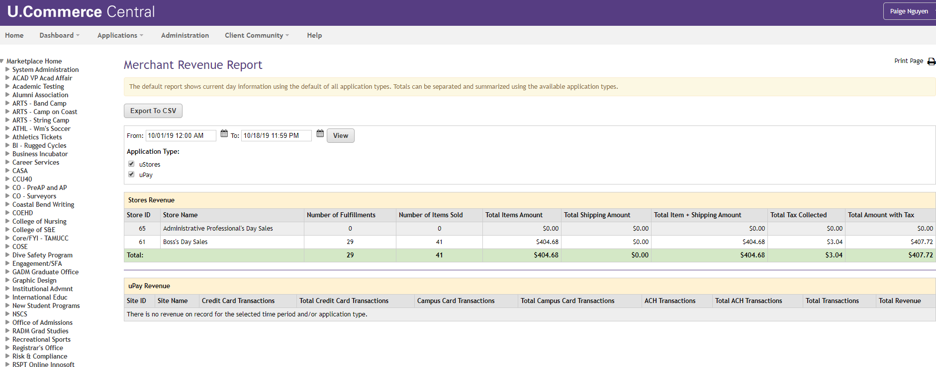
Merchant Revenue Report
Marketplace Home > Markeplace Reports > Merchants > Revenue

Slide 16
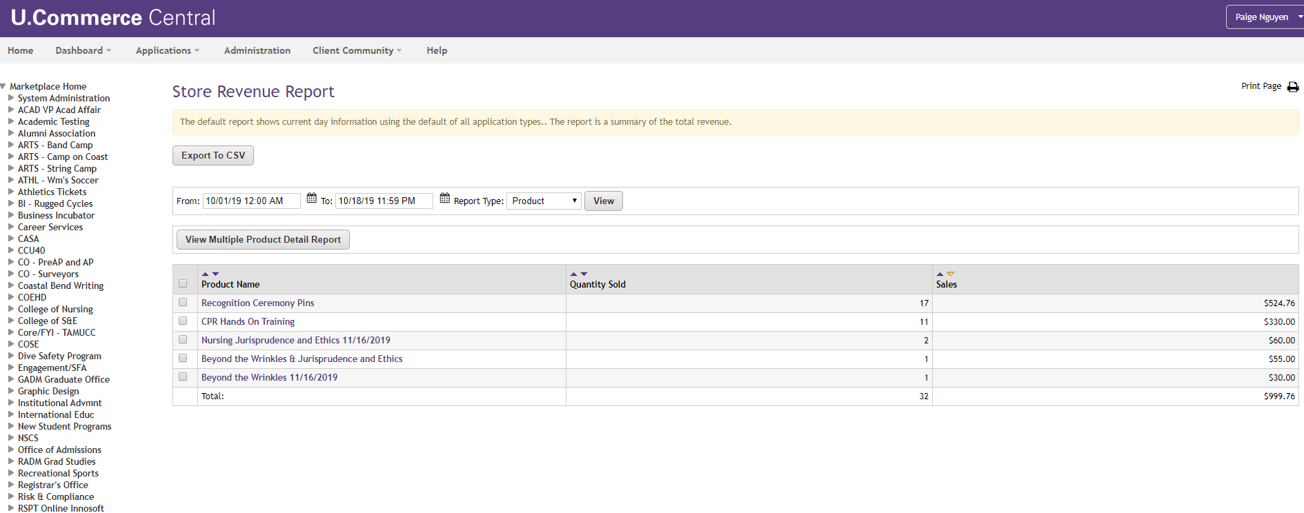
Store Revenue Report (by Product)
Marketplace Home > Markeplace Reports > Stores > By Product

Slide 17
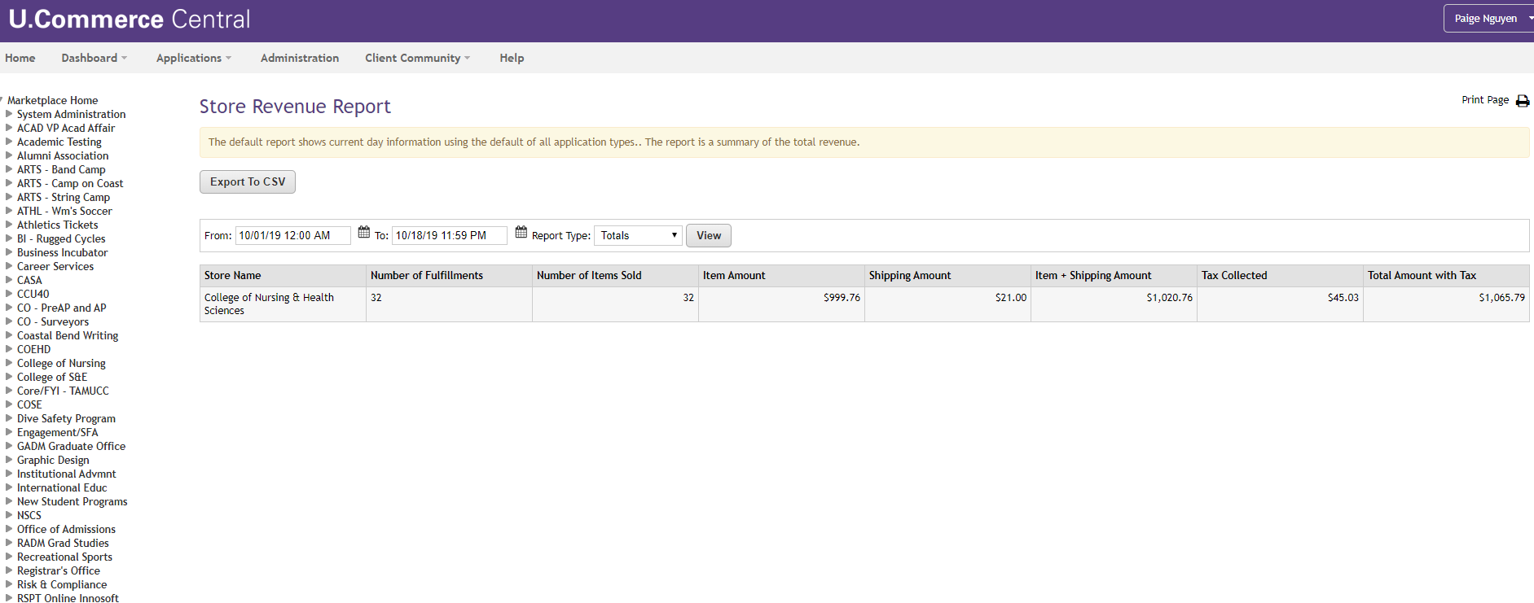
Store Revenue Report (Totals)
Marketplace Home > Markeplace Reports > Stores > By Totals

Slide 18
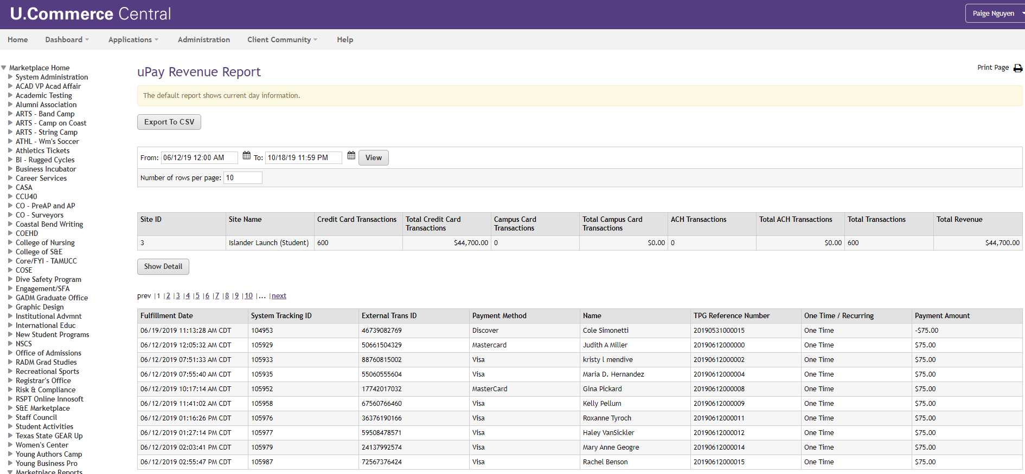
uPay Revenue Report
Marketplace Home > Markeplace Reports > uPay Sites > Revenue

Slide 19
How do I, a Store Manager, see my money?
Account numbers are defined by the Store Manager, and Accounting codes are set up in Marketplace by the Comptroller’s Office.
On a nightly batch process, the Payment Gateway produces a file of approved credit card transactions that is uploaded to FAMIS on the next business day or very soon thereafter.
The Store Manager is responsible for reconciling their monthly activity to FAMIS each month.

Slide 20
Important Points to Remember
Credit Card fees will be allocated monthly to the various Marketplace uStore and/or uPay sites.
Setting up a uStore or uPay site in Marketplace has a six-week lead time for the Comptroller’s Office.
Setting up a uPay site in Marketplace requires coordination with the department’s IT and Comptroller’s Office.

Slide 21
Interested in Marketplace Store?
How to Request Marketplace Store?
Contact the Comptroller’s Office to set up a meeting to see if Marketplace will work for you.

Slide 22
Sample Links
Texas A&M University
University of Texas at Dallas
Texas A&M University - Kingsville

Slide 23
Additional Information
Double Click the users guide

Slide 24
Questions?
Please send an email to merchant.services@tamucc.edu

