Slide 1
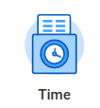
Time Tracking
Financial Management Course

Slide 2

Course Topics:
Time Tracking Overview
Deadlines & Lockout periods
Security Roles & Responsibilities
Entering time
Submitting & Approving Time
  Manual & Mass Advance
Errors & Warnings
Reviewing reports
FAQs
Q&A
Say Hello to Workday Services New Website!
Contact Us

Slide 3
Time Tracking Overview
Time tracking refers to the process of submitting and approving time sheets for payroll purposes. Completed by Employees, Managers and Timekeepers*
Only nonexempt salaried employees & hourly employees will have time tracking enabled
Employees enter time and
overtime automatically calculates
if applicable. Workday will also
identify critical issues for the Manager and Timekeeper to resolve in advance of Payroll processing. Timesheets can also be mass approved by Managers
All time tracking information can be viewed by Timekeepers with the Review Time report
*Timekeepers will enter time if needed but are not a necessary part of the process

Slide 4
Deadlines & Lockout Periods

Slide 5
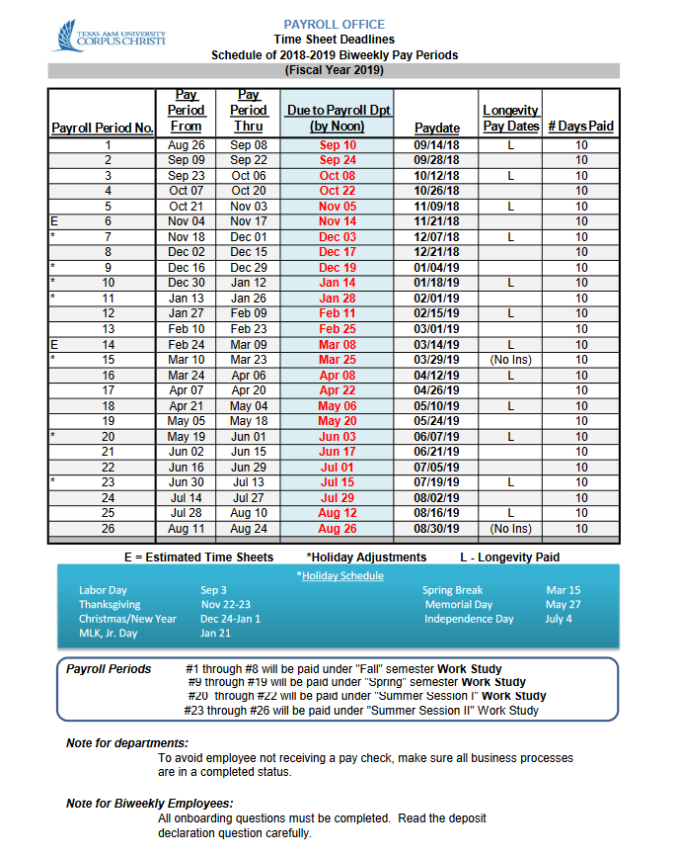
Deadlines
Biweekly schedule can be found on our website under “Schedules”.
Work Week: Sunday - Saturday
“E*” – Pay periods with estimated time
Nonexempt employees- must estimate time in order to receive payment for the full work period.
Students – at managers discretion.
Due to Payroll – Monday’s by Noon

Slide 6
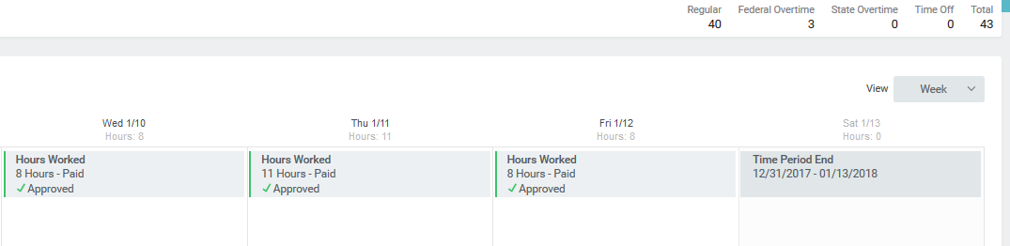

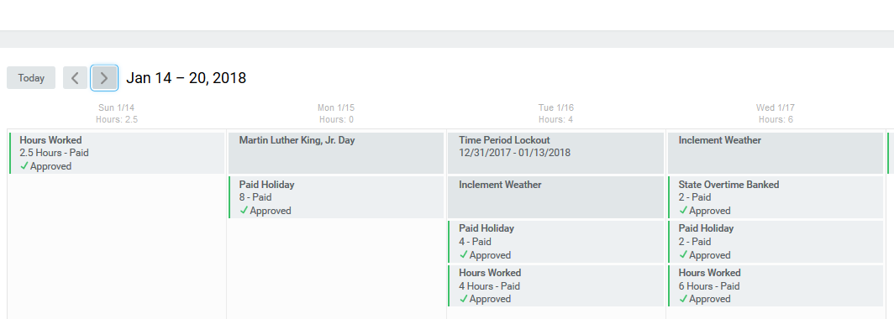
Lockout Period
Refers to the time in which employees & managers are no longer able to submit, approve, or make corrections to an employee’s timesheet.
During this time only timekeepers and Payroll partners are able to make changes.
Saturday -End of the pay period
Time Period Lockout

Slide 7
Security roles & responsibilities

Slide 8
Security Roles & Responsibilities
Initiate
Employee – responsible for entering his/her time daily and submitting at the end of the biweekly pay period.
Manager* - can enter hours on behalf of his/her employee.
Timekeeper*- Support employees and managers by entering & submitting time on behalf of the employee & approving timesheets on behalf of managers.
Payroll Partner*- At the timekeepers request can enter/correct time for employee.
Approve
Manager – responsible for approving employee’s time.
*If anyone other than the employee enters time on behalf of the employee, there is no additional approval step

Slide 9
Time entry types

Slide 10
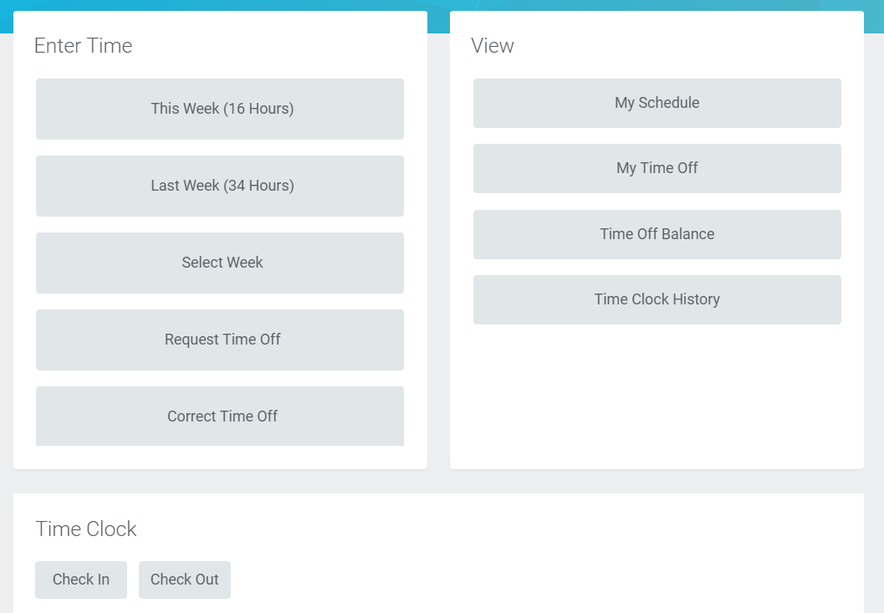
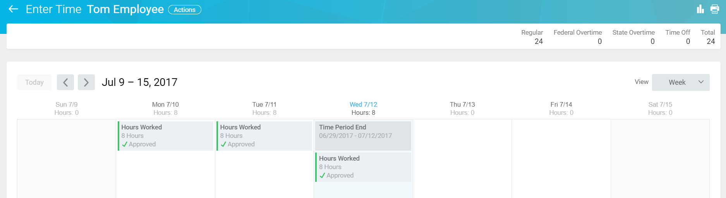
Time Entry Employees:
Enter total number of hours worked per week.
Most staff (nonexempt)

Slide 11
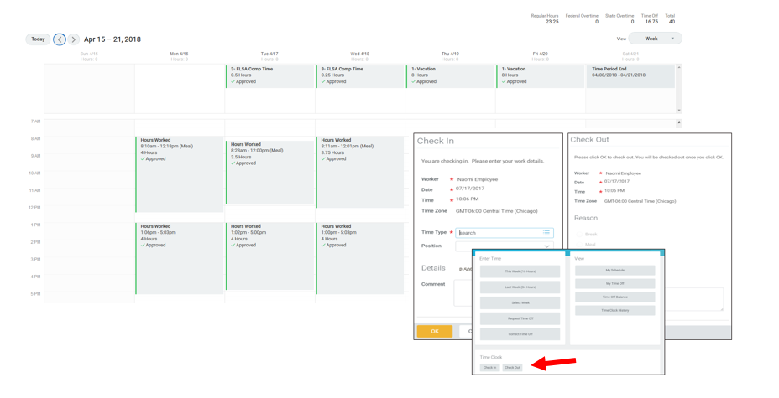
Time Clock or “In/out” Employees:
These employees use the time clock feature & record actual time worked, rather than the number of hours
Our workstation/company has configured all student workers to report their time using the time clock feature.
Staff were setup with this time entry type at supervisors request.

Slide 12
enter time

Slide 13
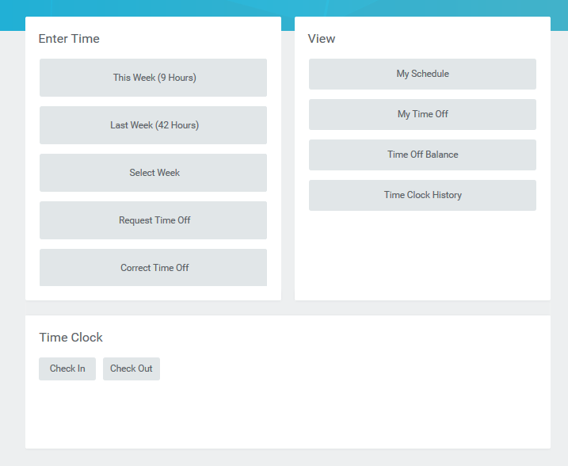
Enter Time
Time Entry Employees – Calendar timesheet only
“In/Out Employees” – Time Clock or Calendar timesheet
1
1
2

Slide 14
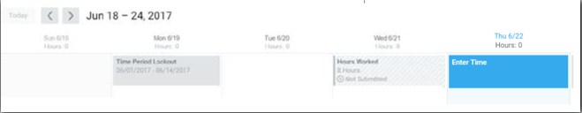
Enter Time – Time Entry Employees
1
2
3
4

Slide 15
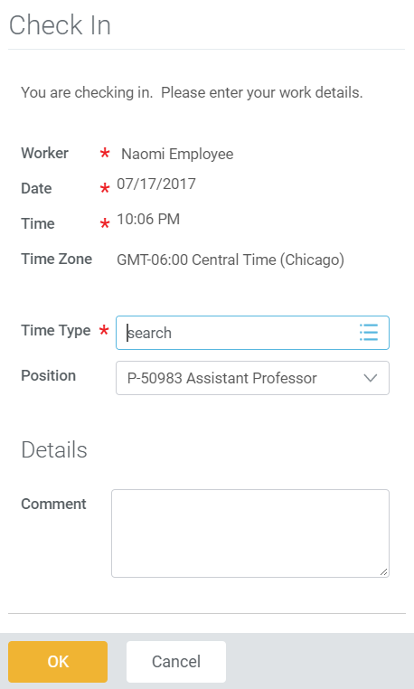
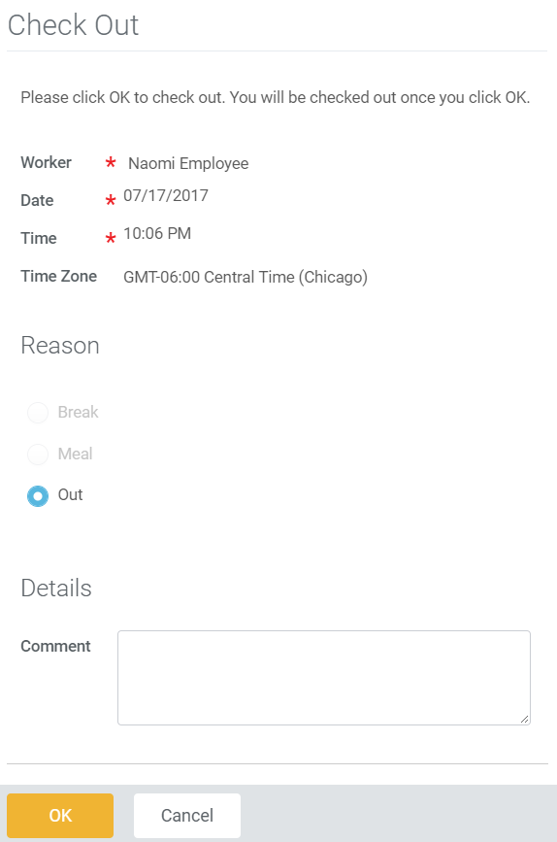
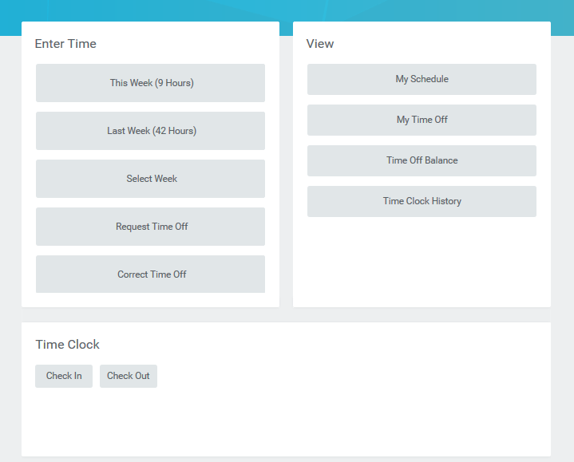
In/Out Employees- Enter time (Time Clock feature)
2
3
Select check out reason
1
P-50983 Student Tutor

Slide 16
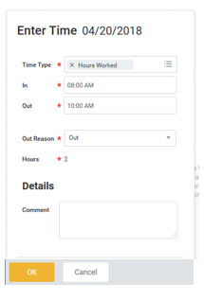
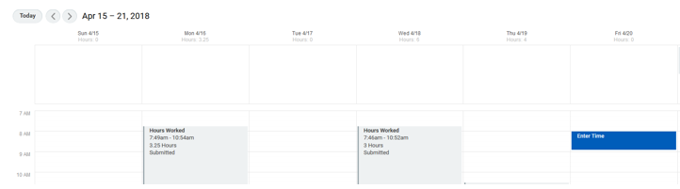
In/out employees – Enter Time (Calendar timesheet)
1
3
Select check out reason
2

Slide 17
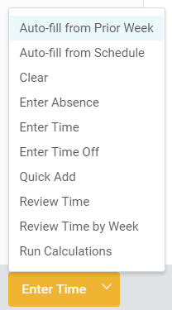
Enter Time: Additional Functionality
Workday offers several options to make entering time easier for Employees and Timekeepers, listed below:
Auto-fill from Prior Week: copies some or all of time entered from prior weeks onto current timesheet
Auto-fill from Schedule: adds all hours an employee was scheduled to work onto the current timesheet
Quick Add: inputs hours for the entire week at once, rather than requiring the Employee or Timekeeper to click on each day individually from the Calendar View
Run Calculations: use Run Calculations to run all applicable calculations for the employee (i.e. refresh timesheet)
  Calculations automatically run when time is entered. If you need to run calculations without making a change to the timesheet, you can.
*Note: Auto-fill from prior week & Auto-fill from Schedule are not available for in/out employees.

Slide 18
Submitting & Approving Time

Slide 19
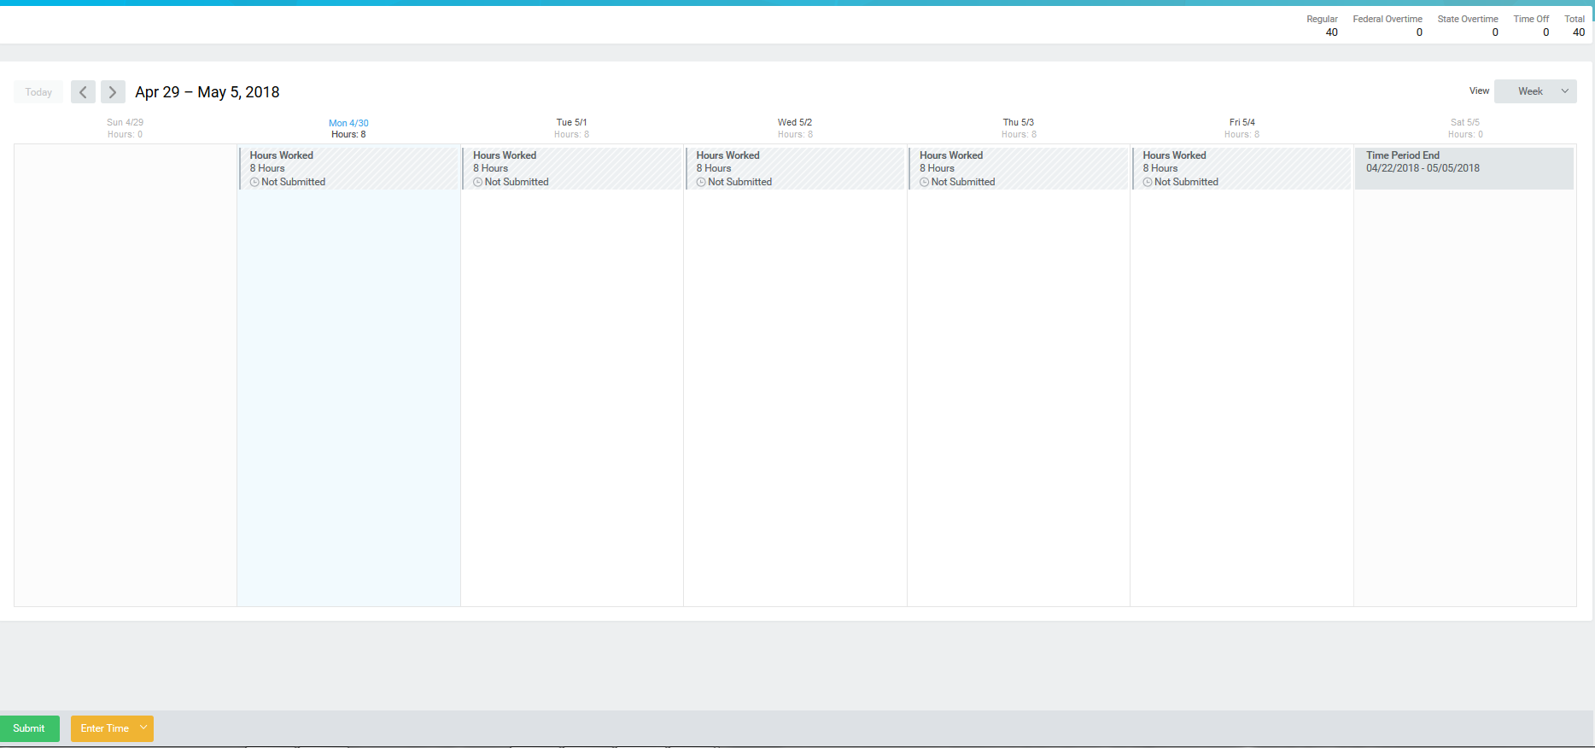
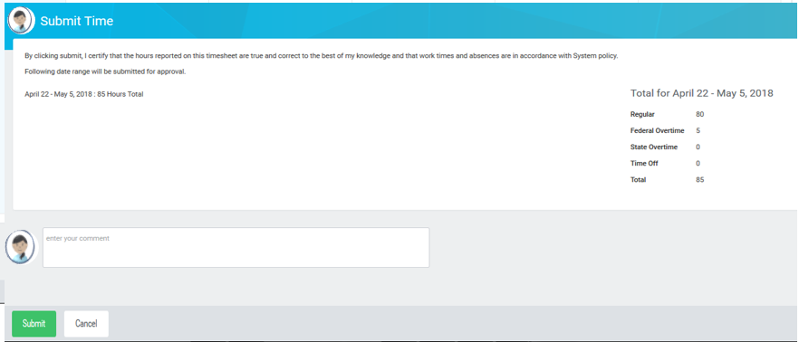
Submitting Time
Time should be entered by week or daily and submitted at least once every two weeks.

Slide 20
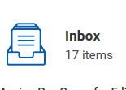
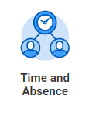
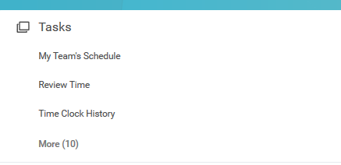
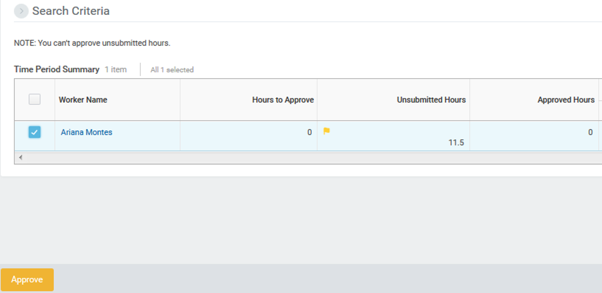
Approve Time
Once the employee submits their time, manager will receive an Inbox task for Time Entry Approval.
Submitted time can also be approved from the “Review Time” task.

Slide 21
Manual & Mass Advance Business Process Tasks
Manual Advance
Mass Advance
Single transaction (Enter Time/Request Time Off)
Use the Employee’s Worker History
Requires Timekeeper & Absence Partner security roles
    Timekeeper Role – Time Manual Advance
    Absence Partner – Request Time Off Manual Advance.
Advance a group of transactions (Enter Time/Request Time Off)
Use the Mass Advance Business Process task
Requires Timekeeper & Absence Partner security roles
    Timekeeper Role – Time Mass Advance
    Absence Partner – Request Time Off Mass Advance.

Slide 22
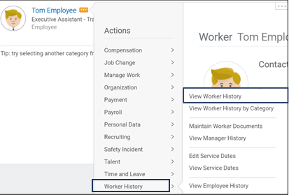
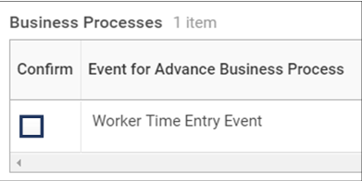
Manual Advance Task
1
4
3
5
6
2
7
x
8
*Most commonly used to approve/advance time when manager is not available for approval.
9
x
Notes:
From the Workday Home page:
1.Type the Employee Name in the Search bar and press Enter
2. From the Employee’s Related Actions, hover over Worker History and click View Worker History
3. The View Worker History screen displays for the Employee. Click the View Worker History by Category button
4. The View Worker History by Category screen displays. Click the Personal Data / Time Off and Leave tab
Note: All Enter Time transactions will be in the Personal Tab and all Request Time Off transactions will be in the Time Off and Leave tab
5. The Personal Data tab displays. Under the System User History section, from the Time Entry’s Related Actions, hover over Business Process and click Advance Manually
6. The Advance Business Process screen displays. Type an appropriate reason in the Reason for Advancing Business Process field
7. Check the Send to Completion checkbox
Note: We recommend not to check the Suppress Notifications checkbox
8. In the Business Process section, check the Confirm checkbox
9. Click the OK button
This completes the Advance Business Process

Slide 23

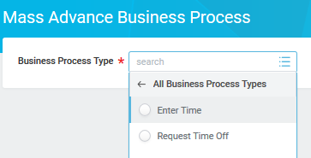
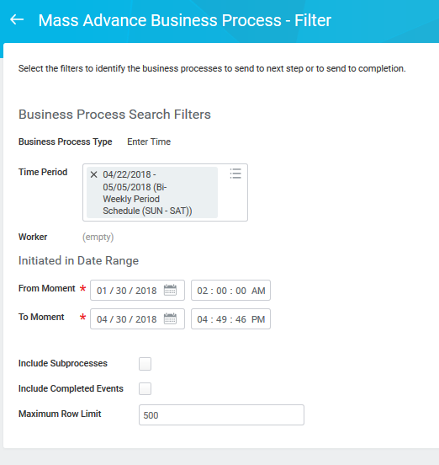
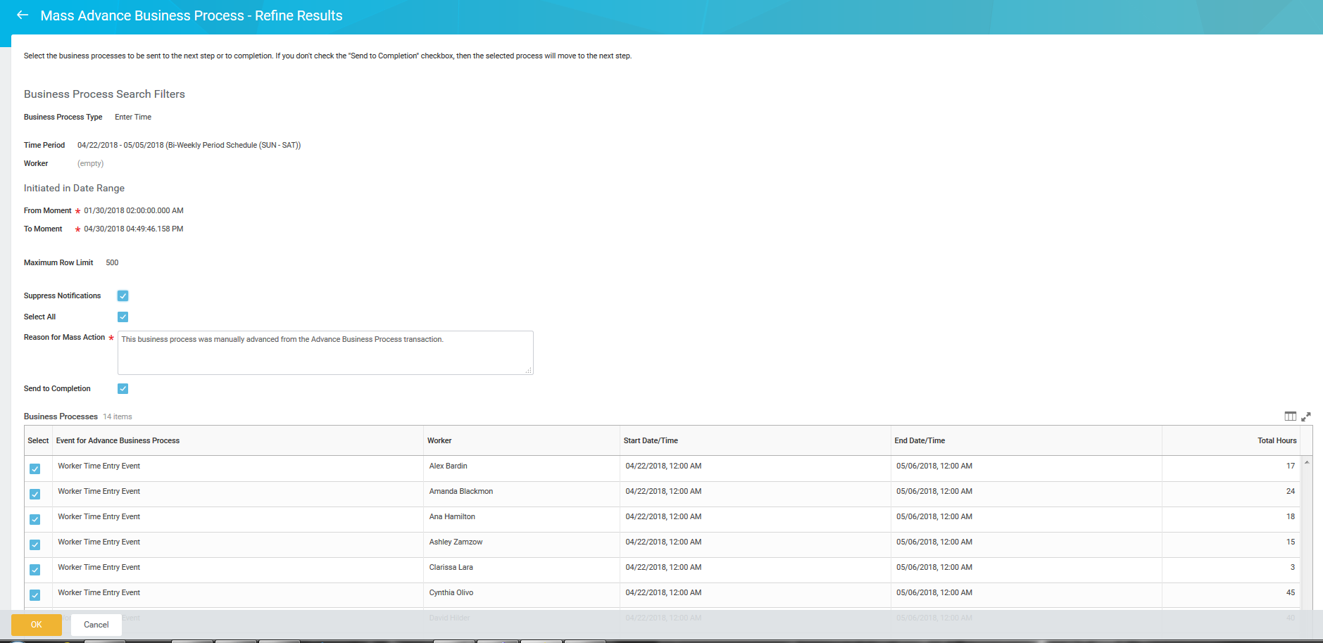
Mass Advance Business Process Task
1
2
*Most commonly used to approve/advance time for a large number of employees (i.e. entire supervisory org).
3
4
Notes:
Worker History-Mass Advance Task
From the Workday Home page:
1.Type the Employee Name in the Search bar and press Enter
2. From the Employee’s Related Actions, hover over Worker History and click View Worker History
3. The View Worker History screen displays for the Employee. Click the View Worker History by Category button
4. The View Worker History by Category screen displays. Click the Personal Data / Time Off and Leave tab
Note: All Enter Time transactions will be in the Personal Tab and all Request Time Off transactions will be in the Time Off and Leave tab
5. The Personal Data tab displays. Under the System User History section, from the Time Entry’s Related Actions, hover over Business Process and click Advance Manually
6. The Advance Business Process screen displays. Type an appropriate reason in the Reason for Advancing Business Process field
7. Check the Send to Completion checkbox
Note: We recommend not to check the Suppress Notifications checkbox
8. In the Business Process section, check the Confirm checkbox
9. Click the OK button
This completes the Advance Business Process process

Slide 24

Errors & alerts

Slide 25

Errors : Timesheet can not be submitted until error is cleared
Error | Who ? | When? | Fix
This timesheet contains insufficient hours. Budgeted employees’ timesheets must account for all scheduled hours. Enter more work hours or take paid or unpaid time off for the remaining hours. | Nonexempt employees Time entry & in/out nonexempt employees (full time staff only). *Note: Students & contingent workers would not receive this errors since they don’t have a built- in work schedule. | Employee doesn’t account for 80 hours in the pay period. *Note: Not triggered in pay period when new hire or terminated | Total hours for the two week period must equal 80hrs. Enter more work hours or take paid or unpaid time off for the remaining hours.
Time overlap | Only applies to in and out time reporters | Time entered overlaps with previously entered time block Ex. 1st time block: 1:30pm-5pm 2nd time block: 5pm-6pm | Check in/out time for 2nd time block must be adjusted.
You reported more than 24 hours of work for a single day on <day of week>. Please correct your time entry | Nonexempt, temp, & student employees | Total Reported Hours for Day > 24 | Correct time to reflect actual time worked.
You are not authorized to enter more than 3 instances of 30 minutes each for Wellness Release Time | Time entry & in/out nonexempt employees | If someone enters more than 3 wellness entries in a week (3 instances of 30 minutes each) | Only 3 instances of Wellness Release Time allowed (30 min each)

Slide 26
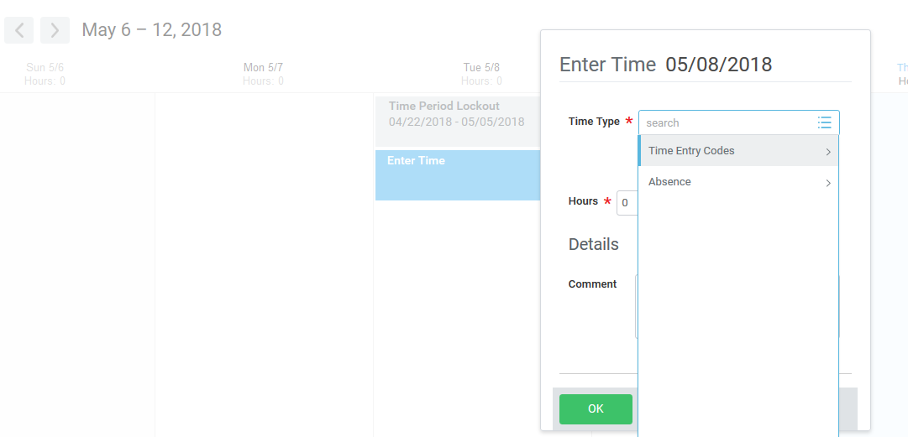
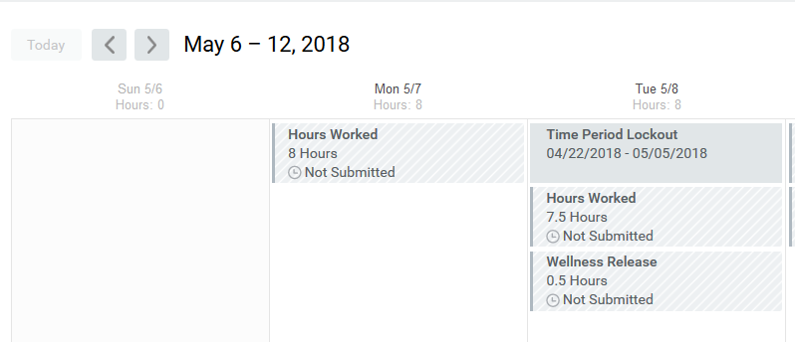
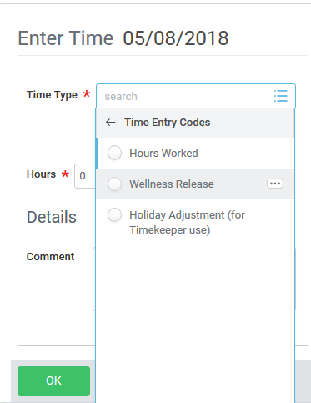
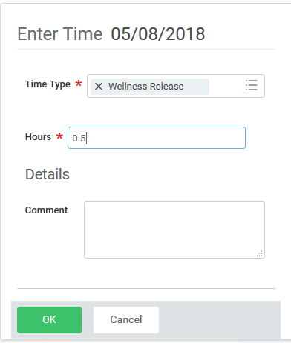
Wellness Release Time Entry
Wellness Release Time -A voluntary program consisting of university-sponsored physical fitness activities and wellness education opportunities during the workday.
1
4
2
3
*Note: Recommended Wellness Release Time entry for a day should be between .25 and .5 hrs.

Slide 27
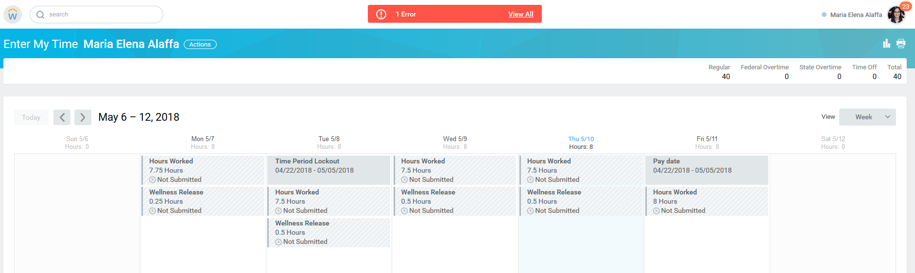
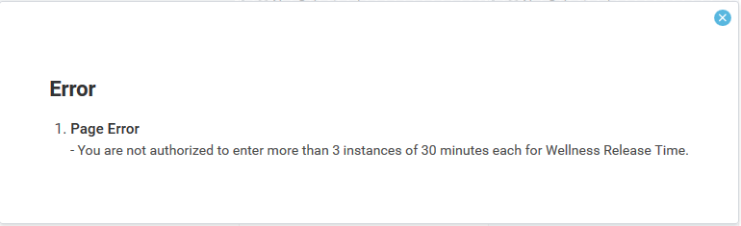
Wellness Release Time Error

Slide 28

Alerts : Does not prevent employee from submitting time
Alert | Who ? | When? | Fix
The hours worked and /or time off you have entered exceeds 8 hours in a day. If this is incorrect, please click on the block of time to edit it. | Nonexempt employees Time entry & in/out nonexempt employees. | Employee exceeds the scheduled hours in a day. The warning is letting employee know that by exceeding the scheduled hours they could end up with overtime hour. | Only a warning/alert- no fix is needed if employee worked over the scheduled time.
You have entered time on a holiday. If this is incorrect, please click on the block of time to delete it. If this is correct, you can proceed with submitting your time sheet when all hours have been entered | Time entry & in/out nonexempt employees | Regular hours are being reported on a day with holiday hours | Only a warning/alert- no fix is needed if employee worked on that holiday.
International students may only work 20 hours per week while school is in session. You may work more than 20 hours per week during the summer semester, spring break, and winter break. ***Violating these rules can jeopardize your visa status. *** | International students | Work hours reported exceeds 20hrs during the regular semester | Employees must be compensated for any time worked. Contact Norma Lozano in HR (ext. 2198) if you have any questions regarding any possible visa issues.
Unmatched time clock event exists: You have a time clock event (Check In) that does not have a matching (Check Out) time clock event. | Only applies to in and out time reporters | Employee forgot to check out | In the Time worklet you can click on Time Clock History to see all Unmatched Clock Events. Clicking on Add Clock Event will allow you to add a Check Out for the appropriate date and time.

Slide 29
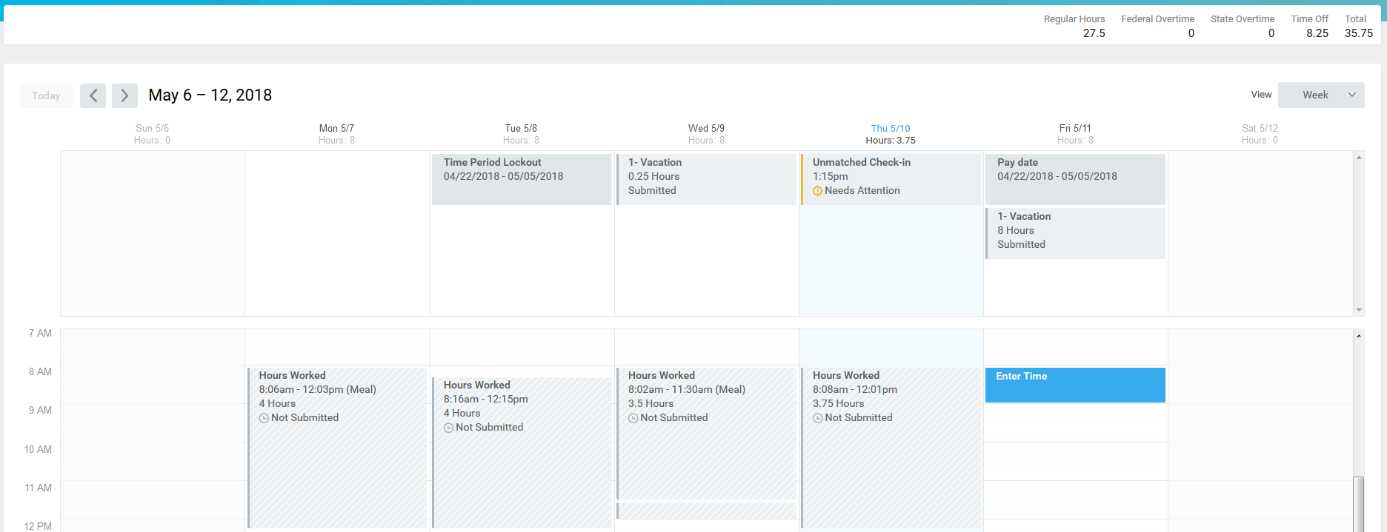
Unmatched time clock event exists- Alert
Employee checked in & forgot/has not checked out

Slide 30
Adjusting/Correcting Time

Slide 31
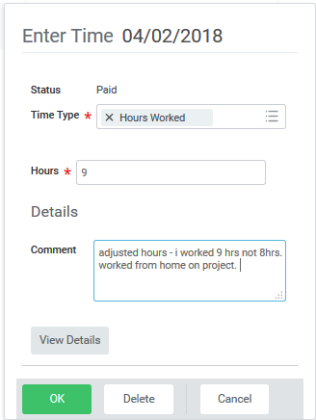
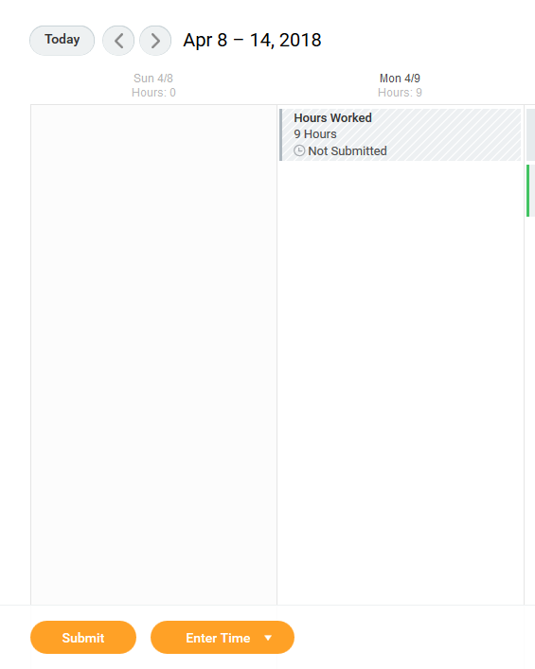
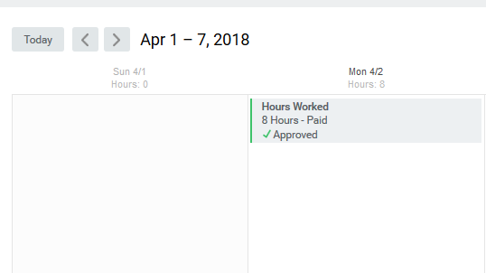
Adjusting / Correcting Time - Employee
3
If additional hours need to be entered (or hours that were entered need to be deleted), changes can be made on the timesheet by the employee, timekeeper, or manger.
These hours will be picked up in the next bi-weekly payroll’s retro process.
Any adjustments/corrections must be submitted for approval.
4
2
1

Slide 32
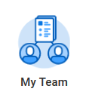
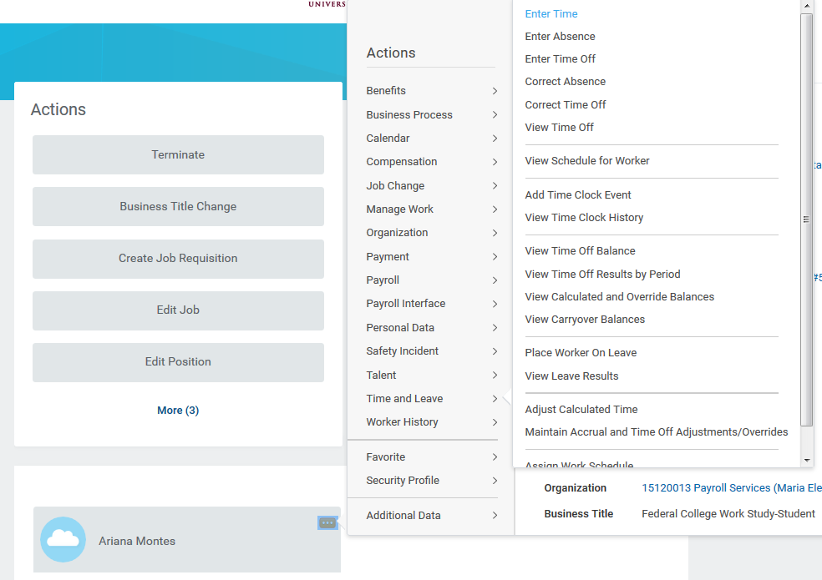
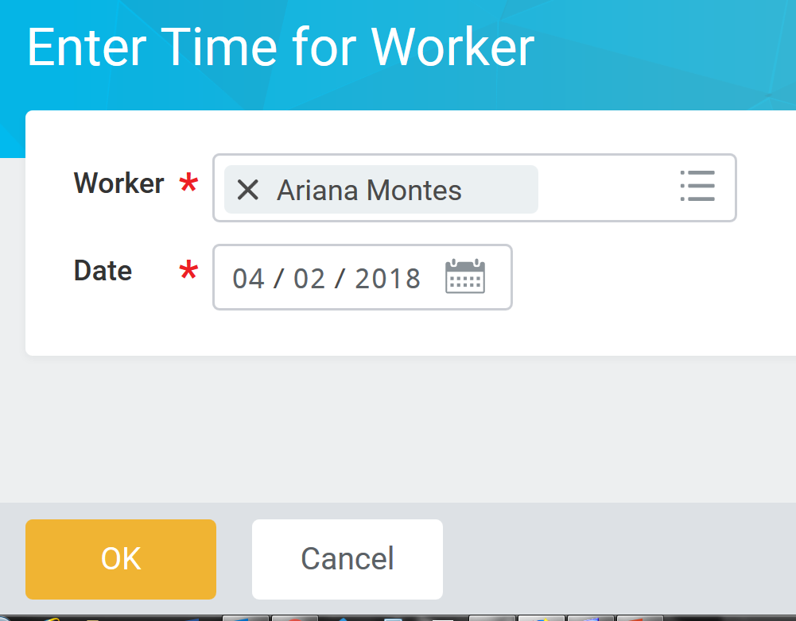
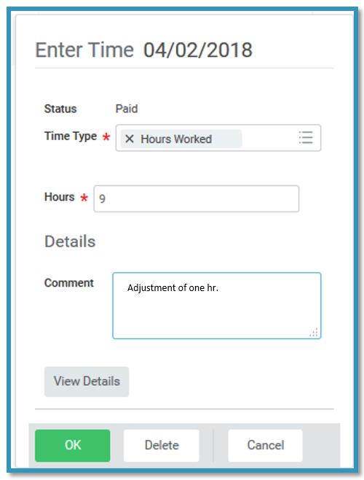
Adjusting / Correcting Time - Manager
1
3
4
2
*Note: If anyone other than the employee enters time on behalf of the employee, there is no additional approval step

Slide 33
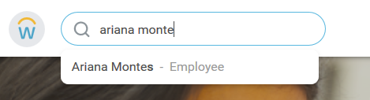
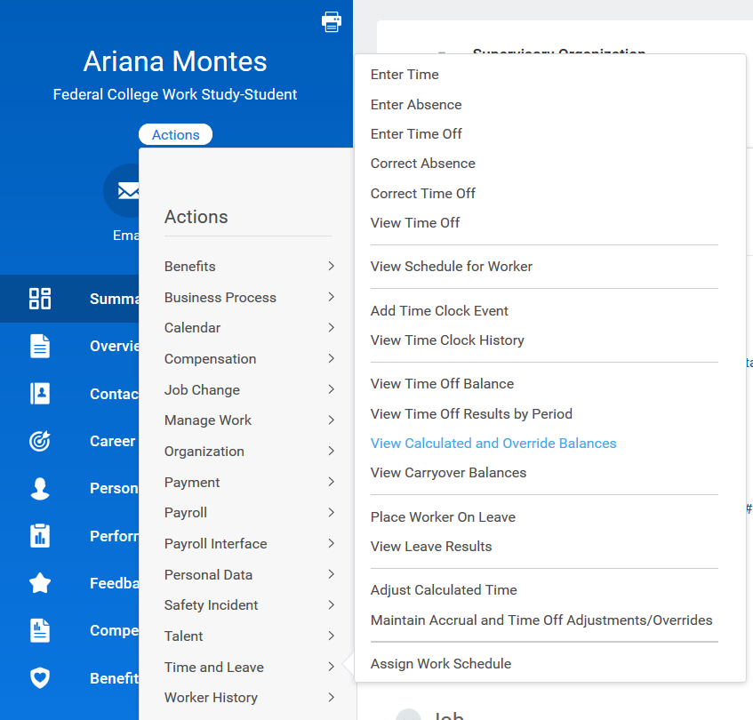
Adjusting / Correcting Time – Timekeeper/Manager
6
1
4
2
5
8
7
3
*Note: If anyone other than the employee enters time on behalf of the employee, there is no additional approval step

Slide 34

Reviewing Reports

Slide 35


Review Time Report: Overview
Used to review, approve and track time submitted and approved
Managers
Timekeepers
All team time can be approved at the same time as long as all hours have been submitted
Acts as a consolidated approval
Used to identify employees who have not entered time for the week or entered time but did not submit
Used to view managers that still need to approve timesheets

Slide 36
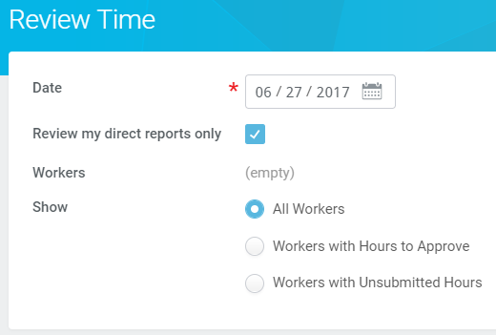
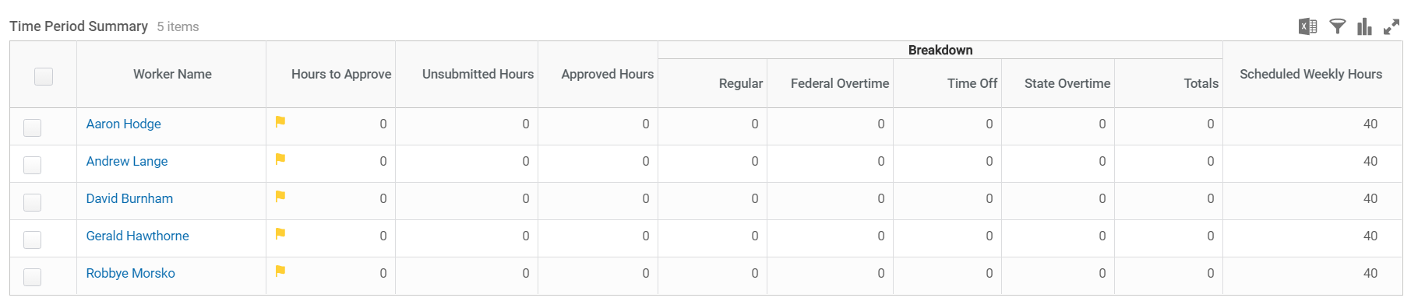
Review Time Report
Locate the report by searching for Review Time in the workday search bar
Select the Workers to view
  Option to only view direct reports is available
  Additional filters available
  Limited to 250 employees
1
2

Slide 37
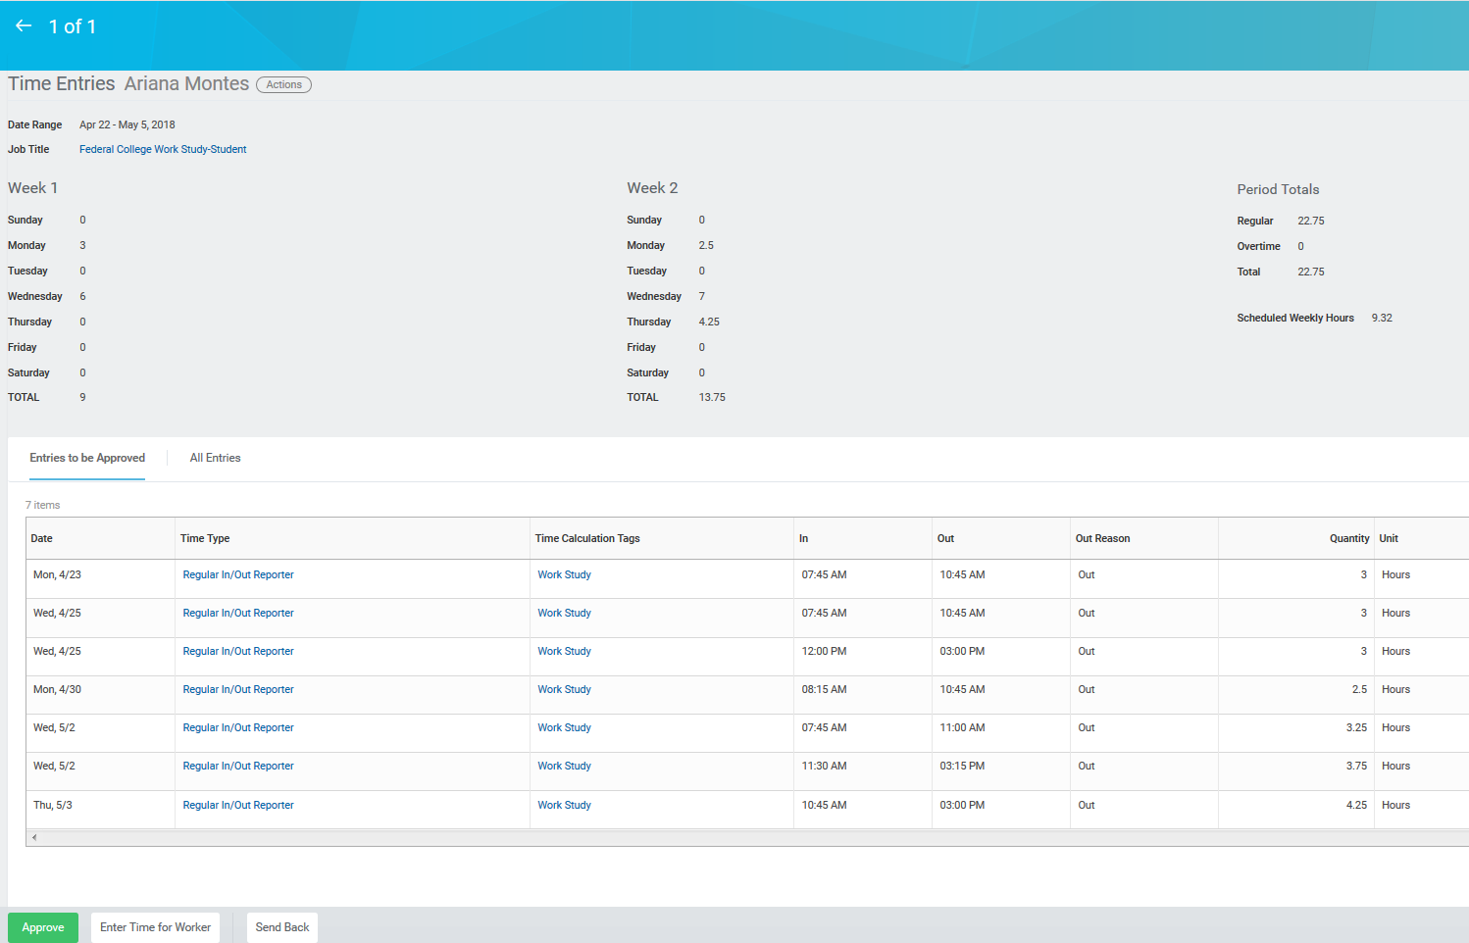
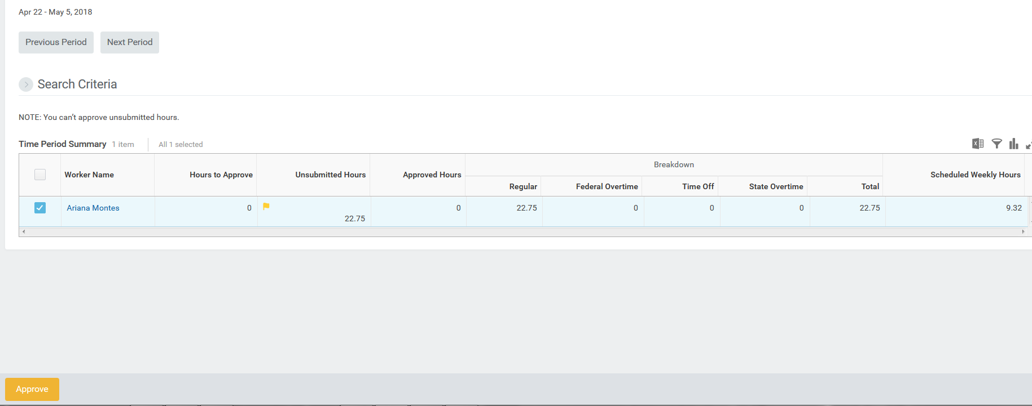
Review Time Report
Managers can use the Review Time page to approve hours
Consolidated approval by selecting all employees
Timekeepers can use this report to keep track employee’s unsubmitted, submitted, and approved time.
Click on employee’s name to view time entry details
1
2

Slide 38
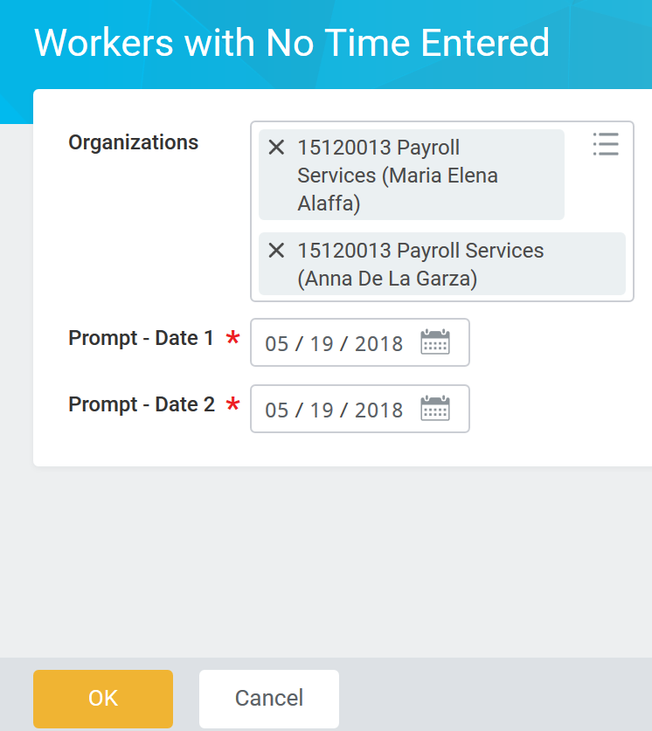
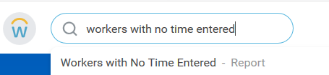
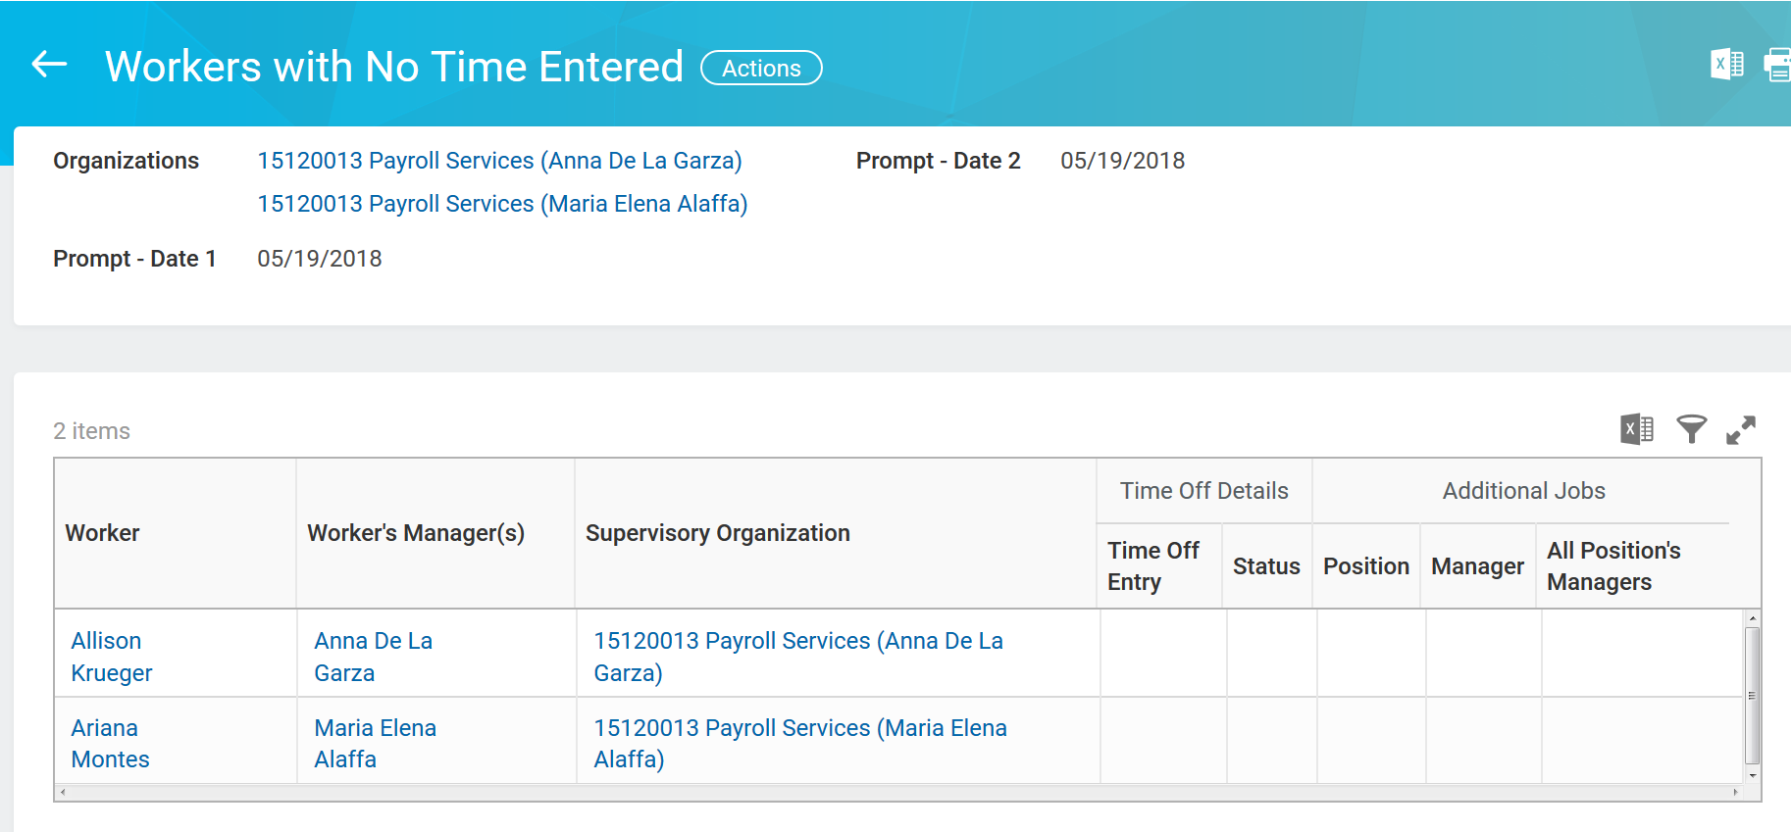
Workers w/ No Time Entered Report
Identifies employees who have not entered time for the current pay period.
2
Select one or multiple supervisory org(s)
1
End of the pay period
3
  *Note the following:
  This report is configured to send alerts to employees on the last Friday of the pay period.
  Only Timekeepers can run this report.

Slide 39

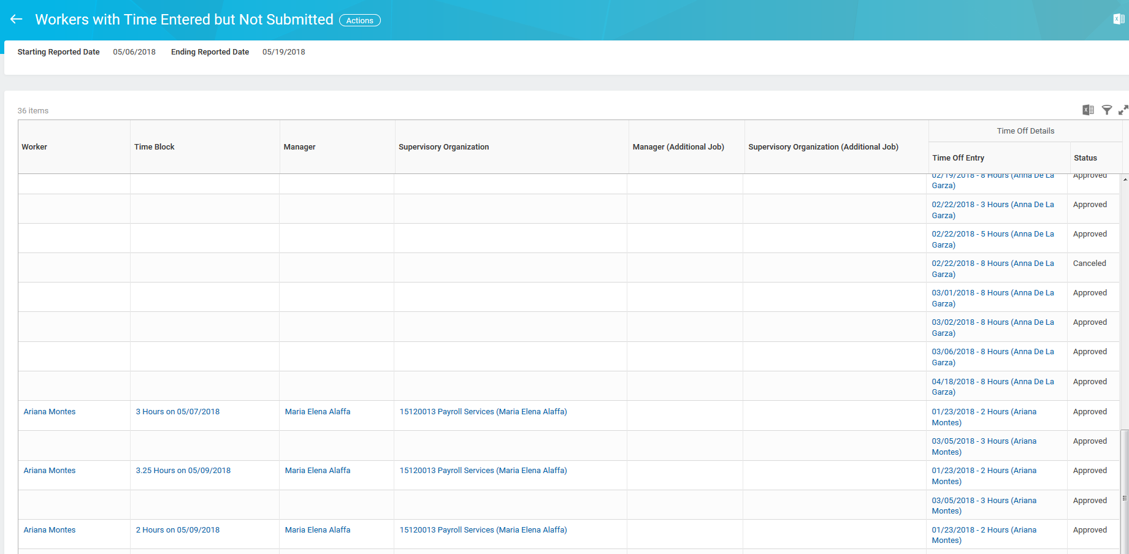

Workers w/ Time Entered but Not Submitted Report
Identifies employees who have entered time for the pay period but have not submitted to their manager.
pay period dates
Time/time block not submitted
1
3
2
  *Note: This report is configured to send alerts to employees on the last Friday of the pay period. Only Timekeepers can run this report.

Slide 40
Reviewing Reports – Other Useful reports
Other useful reports for timekeepers to run:
Time Summary Review report - This report returns time block hours (not submitted, not approved, approved, regular hours, and overtime hours) and time off hours during prompted date range.
Workers with Time Submitted but Not Approved Primary Position - Identifies managers of primary positions that have outstanding time sheets to approve. This report is configured to
Workers with Time Submitted but Not Approved Additional Jobs - Identifies managers of additional jobs that have outstanding time sheets to approve. This report is configured to send alerts to employees on the Monday following the end of the pay period.
Check-in Status - report allows Timekeepers and Manager to see who is currently clocked-in for their organization (timekeepers & managers)
*Visit Workday Help for a list of more commonly used reports.

Slide 41

Q1. How do employees see multiple timesheets when applicable? Only one timesheet but you will have a drop down to select which position you want to enter time for.
Q2. Can time & effort be certified in workday like we use to in Time Traq? No. Time & Effort certification is done through time and effort in SSO like it was done in legacy system.
Q3. If the employee submits but manager does not approve do they get a warning? Yes, Monday after the pay period ends an email alert will go out to notify managers of the timesheets pending approval. Timekeepers can also run report (review time report) to check unapproved timesheets and have the access to move timesheets along. *Note: Alert only goes to the manager not timekeepers.
Q4. Does Time Off need to be approved before Timesheets can be processed? No, time off does not have to be approved before a timesheet can be submitted. However, if the time off is not approved before payroll processes, it will not be paid on that pay date.
Q5.If the manager delegates the task to approve time, does the person that the task was delegated to get the alert if the timesheet is not approve in time? No, the alert only goes to managers since they are responsible for that employee’s time.

Slide 42


Slide 43

Say Goodbye to Workday Help and Hello to Workday Services!
The new Workday Services Help website is LIVE! Besides a new look, the Workday Services Help site offers:
Goodbye to multiple clicks – Hello to dynamic search
Type key words or phrases in the search box on the Home page to find all items related to what you are looking for
Goodbye to confusing navigation – Hello to new menu structures
Along with recent updates visible from the Home page
Goodbye delay in outage or impact notifications – Hello to current alerts in real-time
Visit the new website at it.tamus.edu/workdayservices

Slide 44



CONTACT US
Ana delaGarza ………………………………825-3231
Raquel Flores ……………………………..825-2411
Maria E. Alaffa ………………………….....825-5884
Rosemary Muffoletto ……………………… 825-5792
Email: payroll@tamucc.edu
Helpful links:
Workday Help: https://it.tamus.edu/workday/
Payroll Webpage:
http://comptroller.tamucc.edu/payroll/index.html
Biweekly Schedule:
https://comptroller.tamucc.edu/payroll/assets/bi-wkly-pay-schedule.pdf

Slide 45





True / False
Employees with multiple jobs report their time on multiple timesheets.

