Slide 1

Accounting Resources
Cassie Eyring
Yolanda Castorena

Slide 2
Table of Contents
Accounting Resources
Overview of Resources
Accounting Handbook
Accountant Responsibilities
Trainings Offered
Department Paths
FAQ’s

Slide 3
Review of Available Resources
Accounting Resources
Website http://comptroller.tamucc.edu/accounting/
Online Forms- DCR Access, Signature Card, NAR http://comptroller.tamucc.edu/accounting/online_forms.html
Reference Material http://comptroller.tamucc.edu/accounting/reference_material.html

Slide 4
Accounting Handbook
Accounting Resources
Located on Comptroller’s Page
Texas A&M University-Corpus Christi - Accounting Handbook

Slide 5

Accounting Handbook
Highlights
  Section 01.01 Accounting Staff
  Section 01.05 Controlling Risks
  Section 03.02.01 HEAF

Slide 6
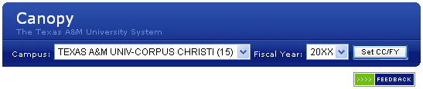
Accounting Handbook
Section 08.03.02.06 Canopy vs. FAMIS
  Looking Back?
    Screen 882 in FAMIS
  Summary by Budget Pool
    Screen 34 in FAMIS
    FRS Account Summary S/L Display Summary by Budget Pool
      **Note: Under S/L Display if you select “Summary by Object Code” that is the equivalent of FAMIS screen 19

Slide 7
Accounting Handbook
Section 08.03.02.06 Canopy vs. FAMIS cont’d
  Transactions by Month/ Year
    FAMIS Screen 23- Transaction Inquiry by Account (screen 63 for support accounts)
    FAMIS Screen 46- Transactions for a Month (screen 76 for support accounts)
    FAMIS Screen 48- Transaction Inquiry by Account/ Subcode/ Month (screen 48 for support accounts)
    FRS Account Transactions
  Account Search
    FAMIS Screen 29 (screen 68 for support accounts)
    FRS Account Search

Slide 8
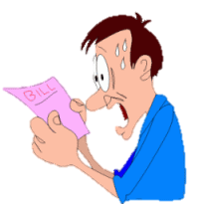
Accounting Handbook
Section 11.03 Interdepartmental Transfers
  Billing between 2 departments on campus
  Batches with prefix “ID” or “IT”
  Cutoff 20th of the month; accounting will post by close of month.

Slide 9
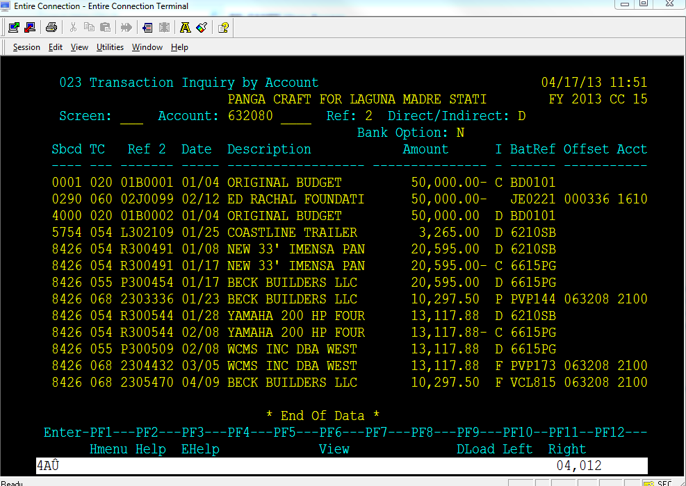
Accounting Handbook
Section 11.05 T-Codes (Budgets)
Accounting Resources

Slide 10
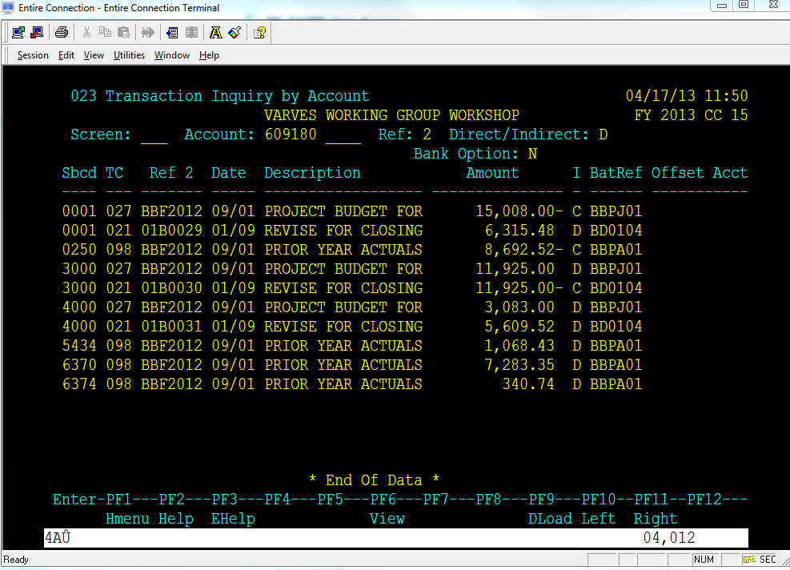
Accounting Handbook
Section 11.05 T-Codes (Budgets)
Accounting Resources

Slide 11
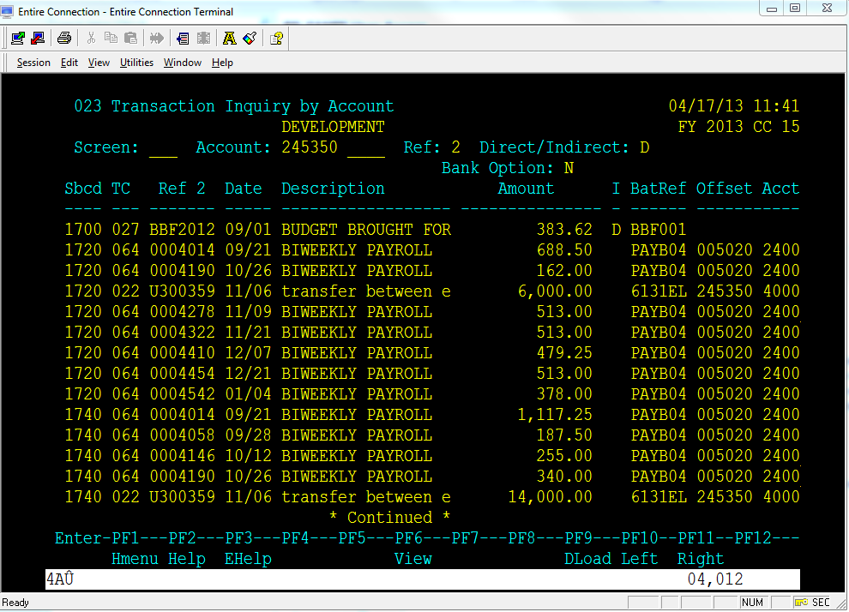
Accounting Handbook
Section 11.05 T-Codes (Budgets)
Accounting Resources

Slide 12
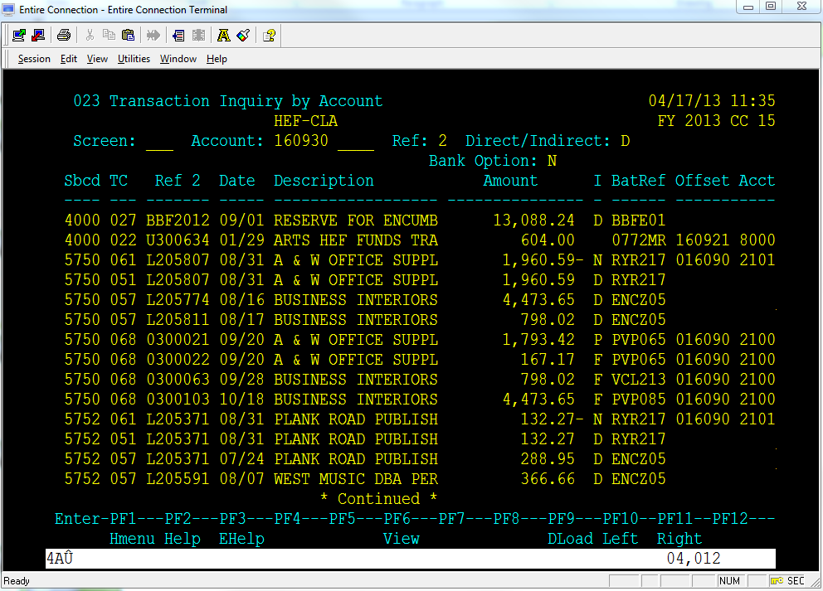
Accounting Handbook
Section 11.05 T-Codes (Journal Entries & Encumbrances)
Accounting Resources

Slide 13
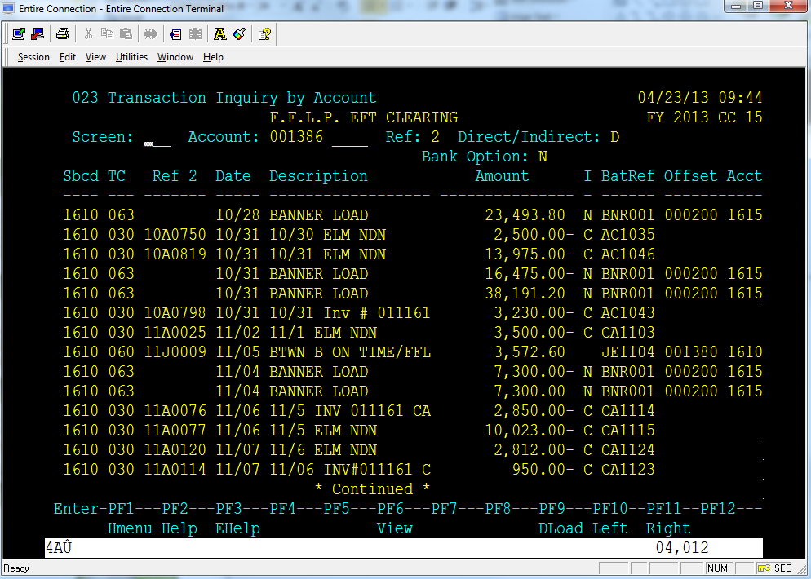
Accounting Handbook
Section 11.04- Header Codes
Accounting Resources

Slide 14
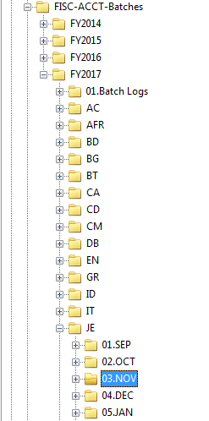
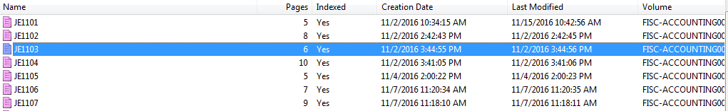
Laserfiche
Section 13
Accounting Resources
Let’s find JE1103 in Fiscal Year 2017
Login to Laserfiche and go to:
FISC-ACCT-Batches → FY2017 → JE → 03.NOV
After you click on 03.NOV you will see all documents and you can double click on the document you need to retrieve the back up

Slide 15
Accountant Responsibilities
Accounting Resources
Assist with questions on various postings to your accounts
Create a new non-grant account per your request
Change responsible person or department on your non-grant account
Make a correcting entry on your account if you are unable to fix it with a DCR

Slide 16
If not Accounting, Then Who?
Accounting Resources
Review your accounts for incorrect postings or insufficient funds
Lift flags on the accounts for insufficient budget
Instruct you on how to return an overpayment on an invoice

Slide 17
If not Accounting, Then Who?
Accounting Resources
Freeze/Delete your accounts
Instruct you on what object code to use when creating a limited purchase order
Assist you with completing a voucher create
Make budget corrections to your accounts

Slide 18

Trainings Offered
Accounting Resources
In the Classroom
  Canopy Training
  Routing & Approvals
  Department Correction Request (DCR)
Notes:
We offer various Canopy and FAMIS trainings through FAMIS Security.
DCR is Department Correction Request. FAMIS Security in our office complestes these trainings. If your department does not currently have DCR capabilities and would like them please contact FAMIS Security for more information.

Slide 19

Trainings Offered
Accounting Resources
Available on Train Traq
  Guidelines for Disbursement of Funds
  FAMIS Training
  Canopy Training
  Controlling Risks

Slide 20
Department Paths
Accounting Resources
Screen 860 – Dept Table Maintenance
How to look up 4/5 letter department
Information needed to view routing path on Screen 921
Screen 921 – Dept Paths Create/Modify
different types of routing paths
view names on the desks in the routing path

Slide 21
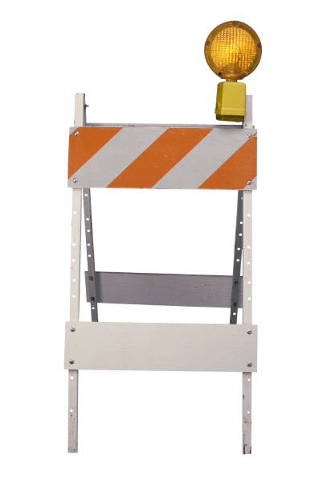
*Disclaimer on Routing*
Accounting Resources
This is just a quick preview and review
Any questions directly related to routing should be directed to famis.security@tamucc.edu.

Slide 22
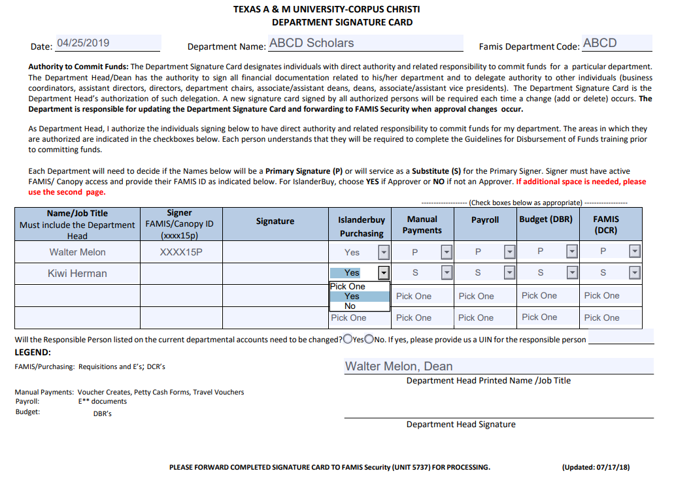
Primary vs. Substitute
Accounting Resources
Indicate if P or S
Primary signer - The document is going directly to that person, they are the ones in charge of that department and automatically receive notifications that they have documents pending
Substitute signer – The sub can go into the Primary Signer’s box and sign for them, but they do not automatically receive notifications
http://comptroller.tamucc.edu/accounting/assets/department-signature-card.pdf

Slide 23
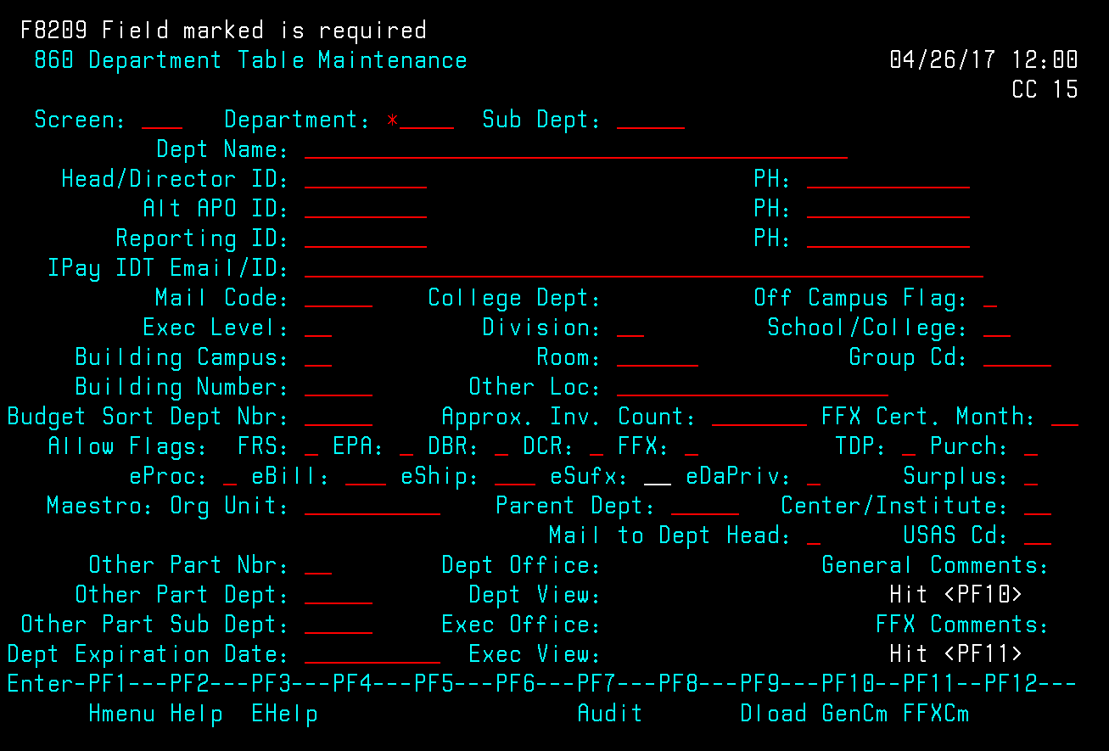
Screen 860 Dept Table Maintenance
Not sure of your 4/5 letter Department code?
Accounting Resources
Place an* beside Department: and hit enter

Slide 24
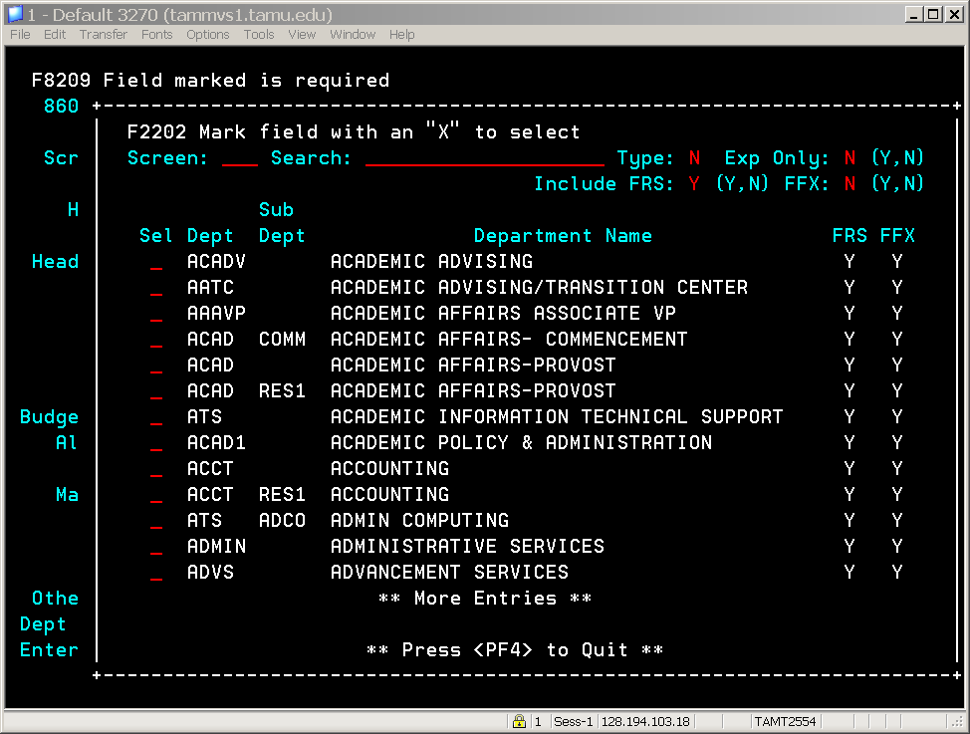
Lists all the departments
Accounting Resources
Hit enter to see more screens if the dept does not appear
Place an X beside department to select and hit enter or
Press F4 to exit pop up.

Slide 25
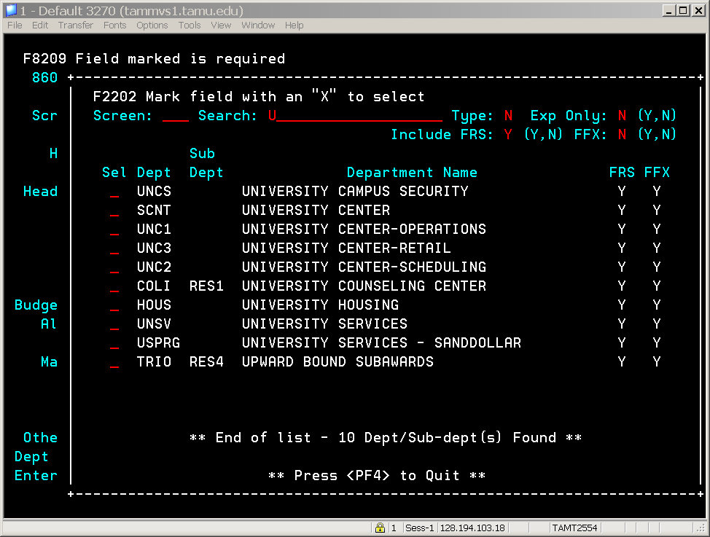
Screen 860 Dept Table Maintenance
Another way to search for department name
Accounting Resources
Doesn’t start with a U? Replace with another letter and hit enter

Slide 26
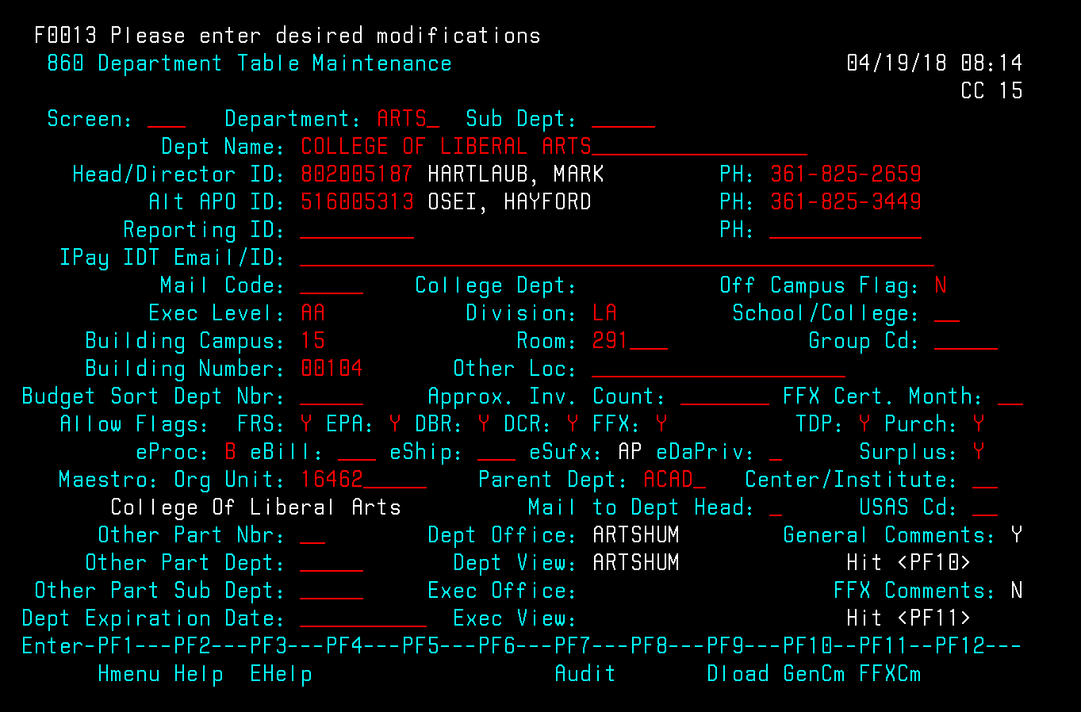
Screen 860 Dept Table Maintenance
Accounting Resources

Slide 27
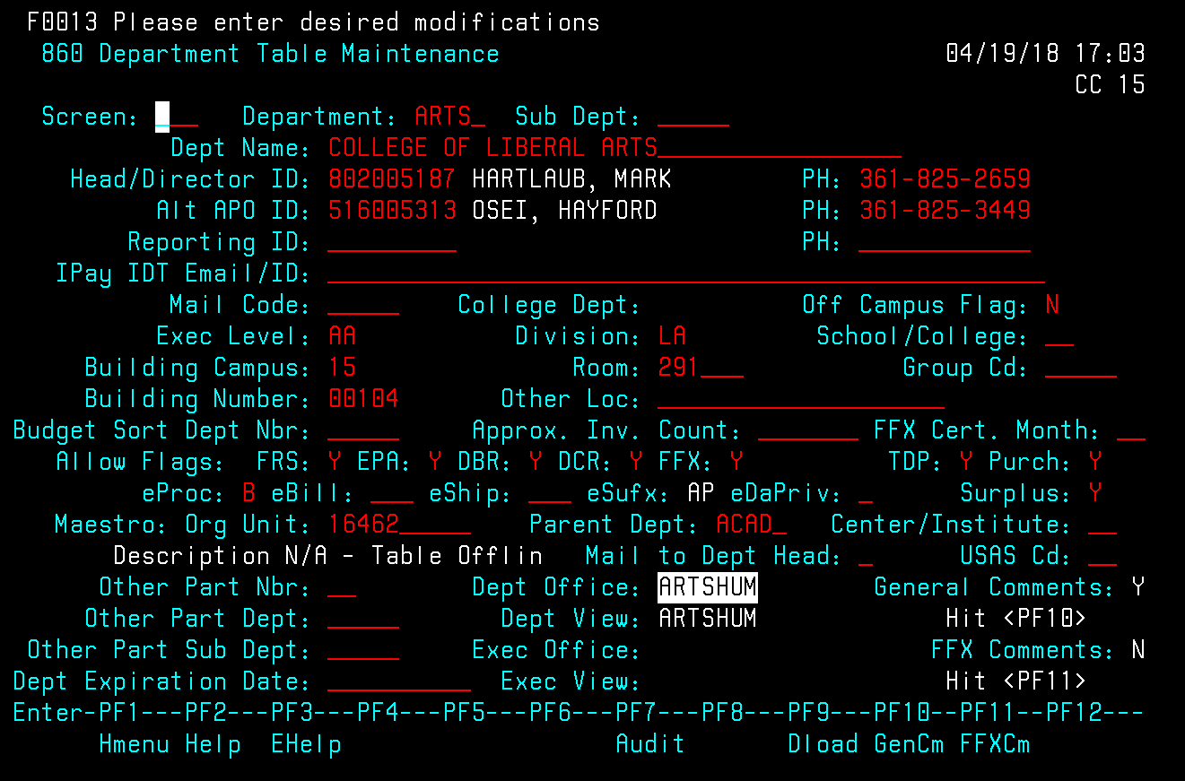
Screen 860 Dept Table Maintenance
Accounting Resources
Left click to highlight Dept Office name

Slide 28

Screen 860 Dept Table Maintenance
Accounting Resources
Edit (menu bar) and select Copy

Slide 29
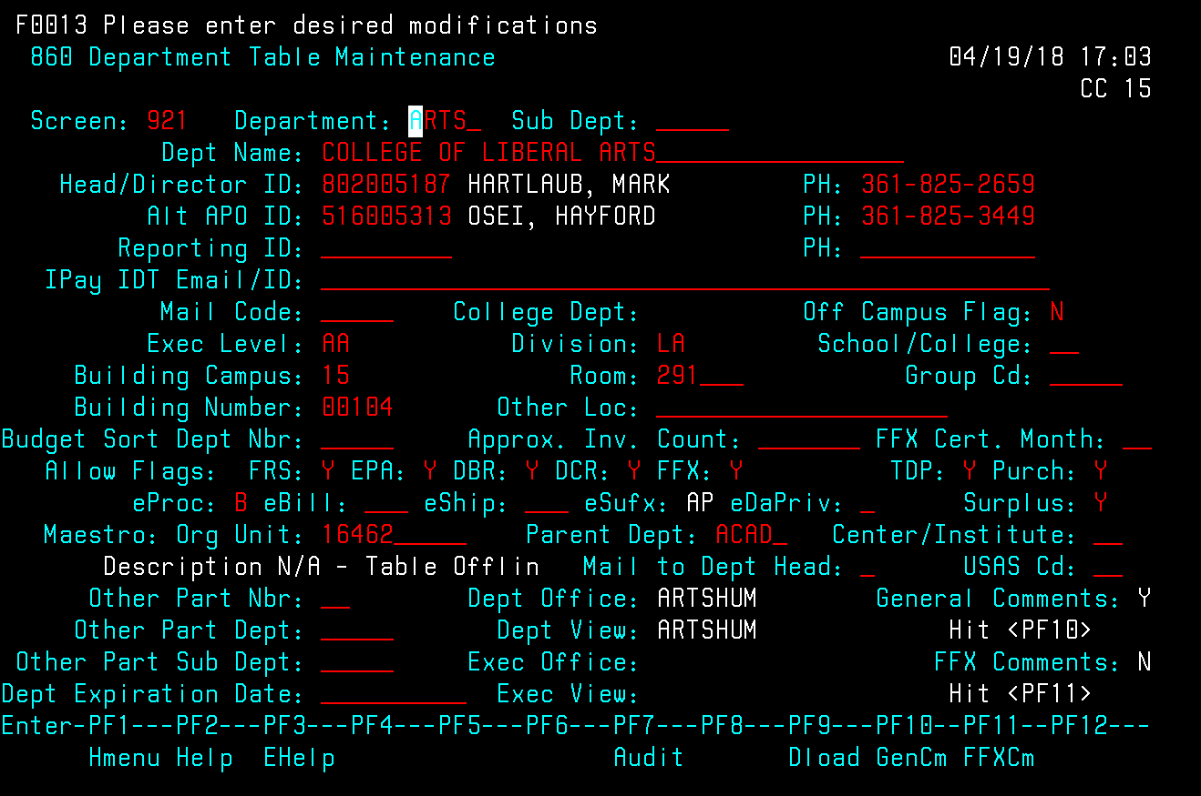
Screen 860 Dept Table Maintenance
Accounting Resources
Type 921
at Screen:
and hit
enter

Slide 30
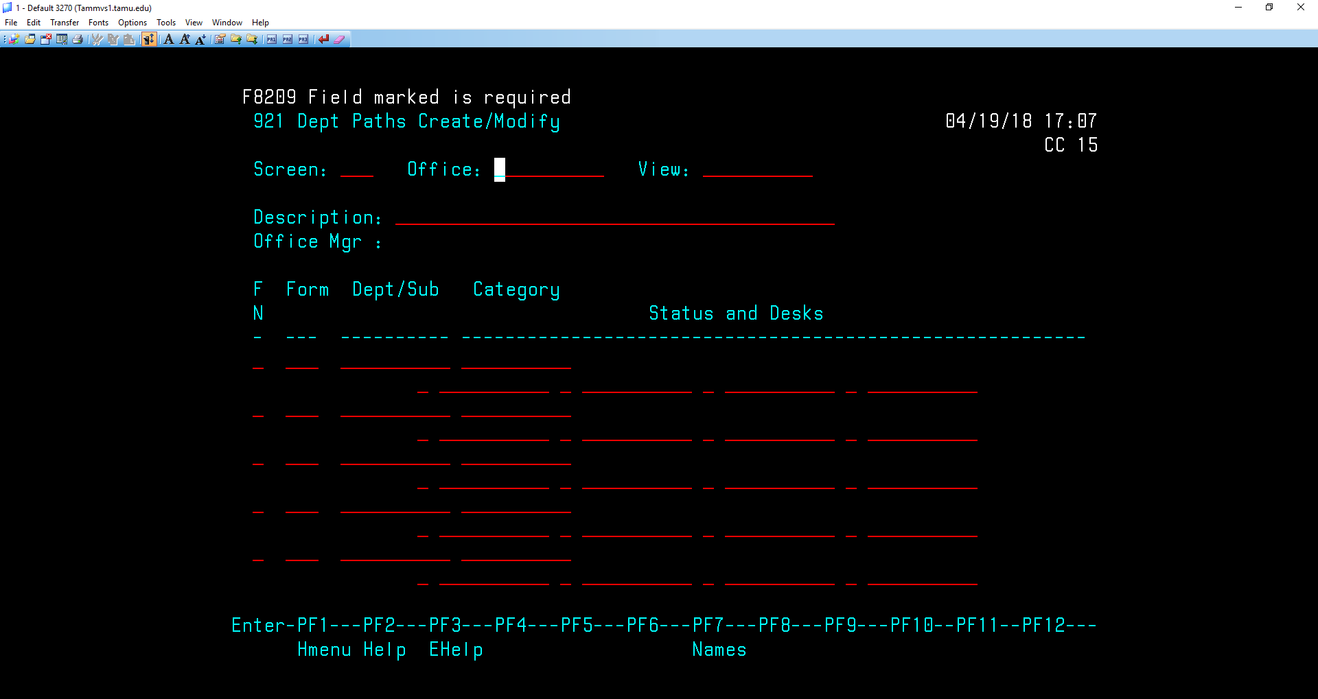

Screen 921Dept Paths Create/Modify
Accounting Resources
On Screen 921 the cursor is at Office
Go back to Edit in the Menu Bar and select paste

Slide 31
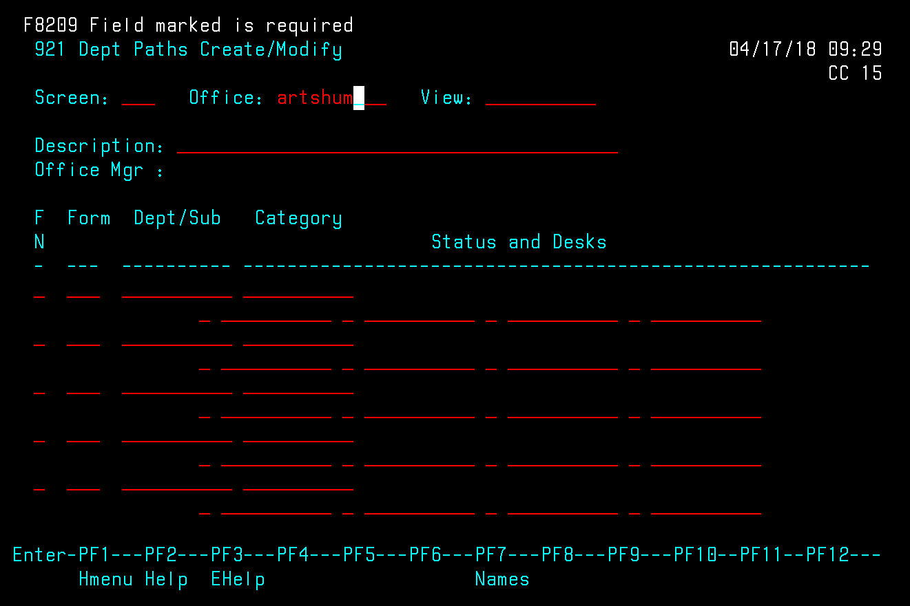
Accounting Resources
Screen 921Dept Paths Create/Modify
The Office name and View name usually are the same so hit enter. Even if names are not the same hit enter.

Slide 32
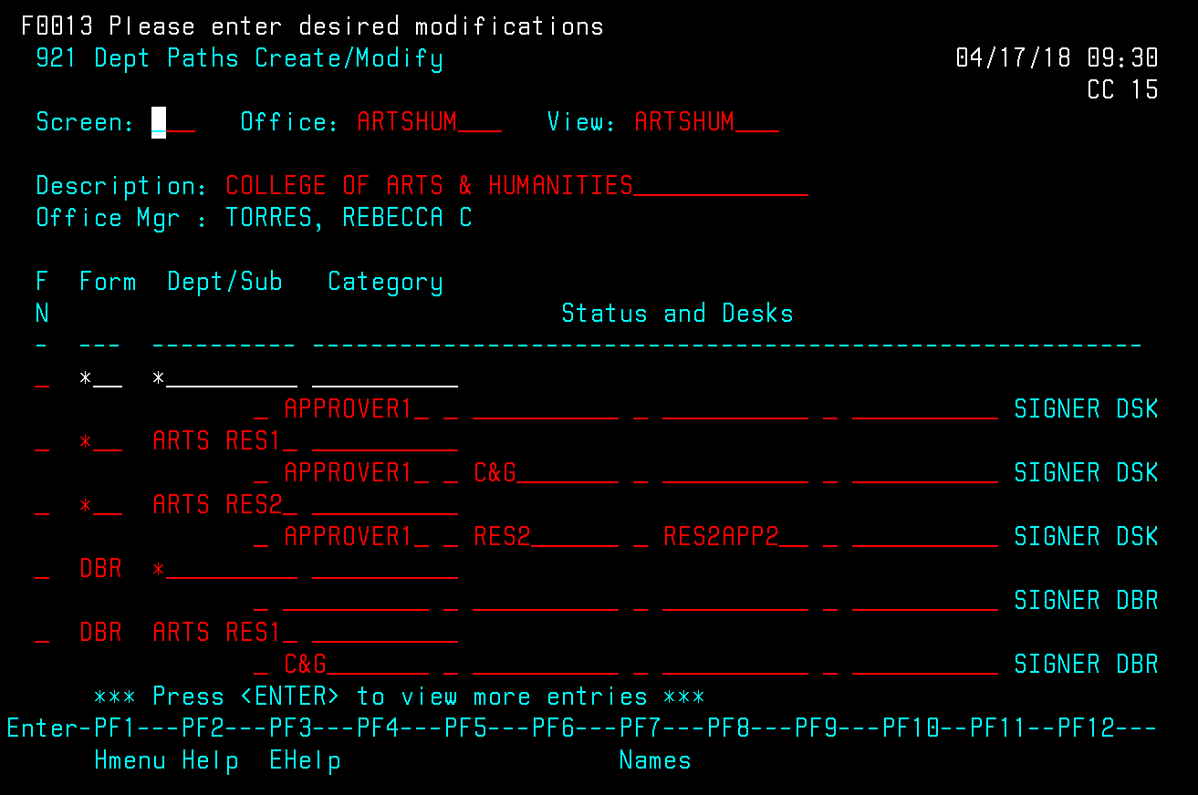
921 Dept Paths
Accounting Resources
* - Purchasing Documents
DBR – Departmental Budget Request
DCR – Departmental Correction Request
DT* – Department Travel
E** - Payroll documents

Slide 33
921 Dept Paths
Accounting Resources
Approver Desks
Not final signers
Stops requested by
department before
the final signer
Desks are created
On screen 922

Slide 34
921 Dept Paths
Accounting Resources
Signer Desks
Final signers
They are the names
Submitted on the
Signatures cards.
Desks are created
On screen 943 by
FAMIS security

Slide 35
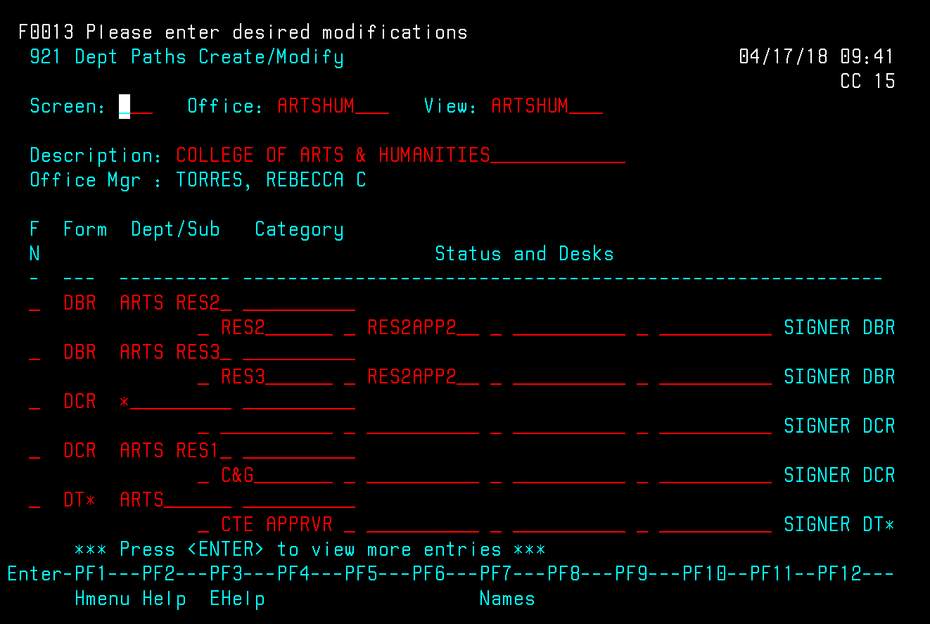
921 Dept Paths
Accounting Resources
To view name
on desk(s)
Place cursor
anywhere on
“CTE APPRVR” or “SIGNER
DT*” and press F7 function key. Can only view one desk at a time.

Slide 36
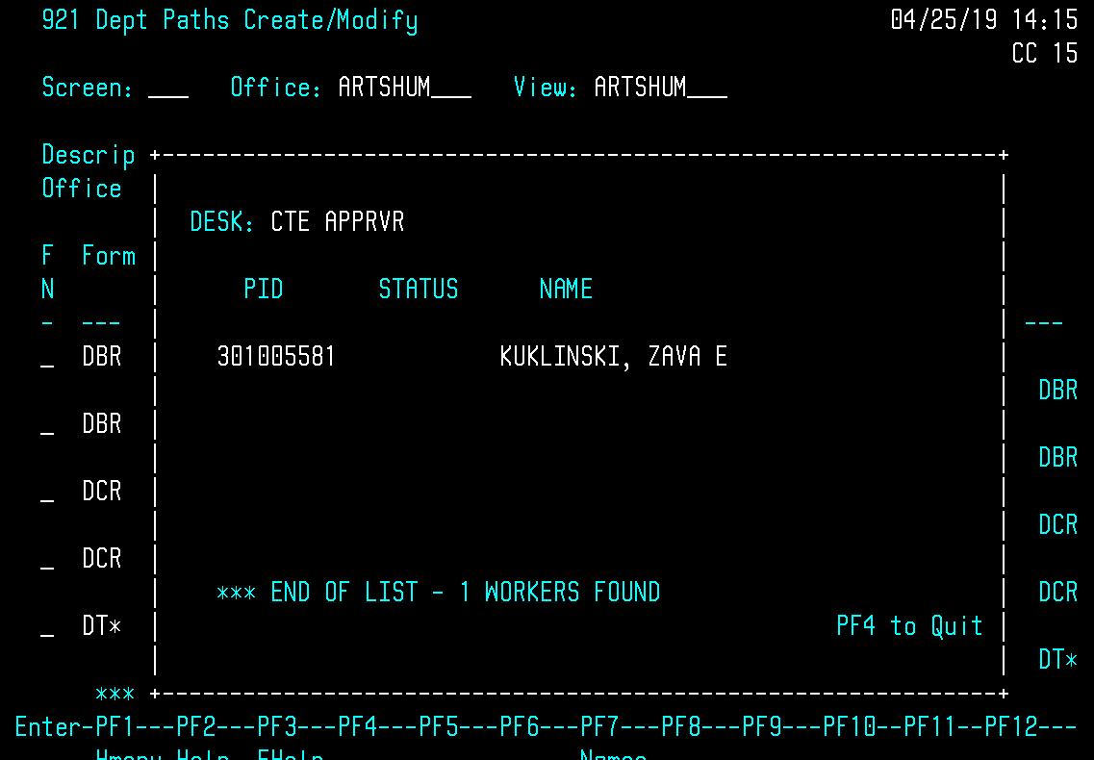
Screen 921Concur Approver Desk
Accounting Resources

Slide 37
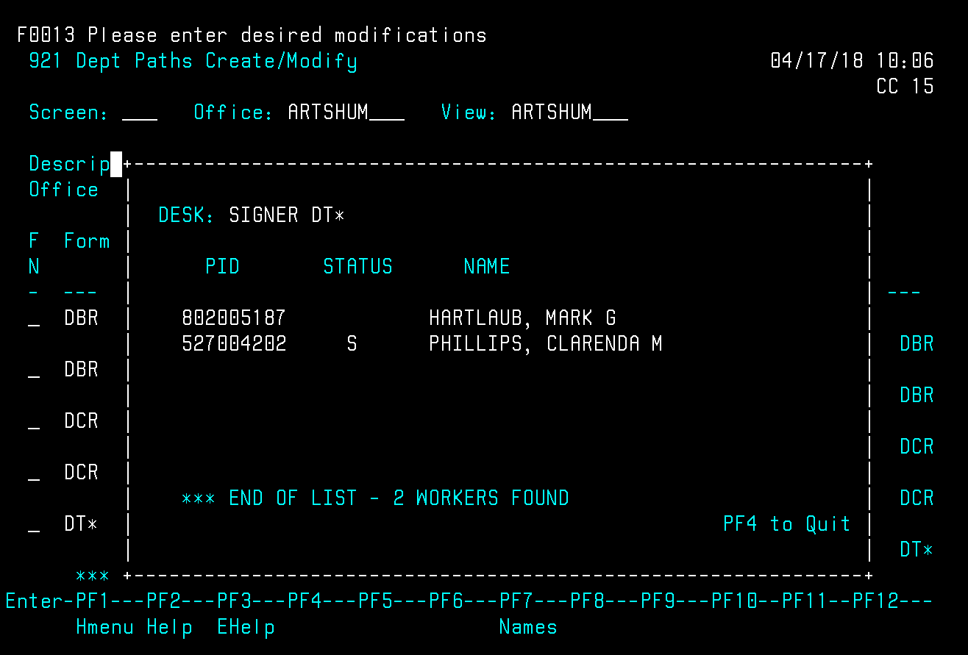
Screen 921 Concur Signer Desk
Accounting Resources
P & S – in case primary approver is not able to approve document the Sub can approve or in case one person leaves the University suddenly the other person can go in and approve. Document can continue on path to signer. To exit press F4 function key.
Minimum of 2 signers. Press F4 function key to exit.

Slide 38
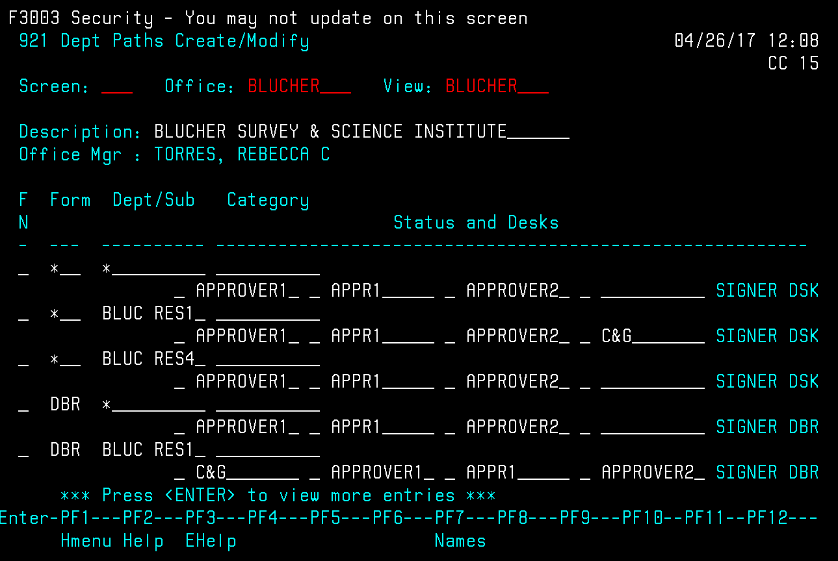
Accounting Resources
Paths can be simple or more in depth – this is page 1 of 3 path screens for this department

Slide 39
FAQ’s
Accounting Resources
http://comptroller.tamucc.edu/AccountingBudget_faq.html
Who do I contact to freeze, delete or drop my account?
Who is my accountant?
I received a check in the mail and I don’t know what its for. What do I do with it?

Slide 40
Questions?
Accounting Resources

