Slide 1
2026 Project Board Rules & Directions CBRSF Regional Fair
Read ALL rules and directions thoroughly before starting.
A virtual project board must be uploaded as a PDF by February 2, 2026, 5:00 p.m. (CST).
In addition to the rules below, all ISEF Display and Safety Rules must be followed.
Students are allowed three 48” x 36” slides.
Model the first two slides after the typical fair board and include all key information: Problem/Question, Hypothesis or Engineering Goal, Background Research, Materials, Procedure, Data, Results, and Conclusion.
Your STEM Wizard Project Title must be displayed on the top as shown in Slide 2.
This is an EXAMPLE project board template for students. Formatting to change colors, text box sizes, move panels, etc. is acceptable. You are not obligated to use this board, but are welcome to use it.
The following statement must be cited directly by photos/images/graphs: “Graphs (tables or picture) were created by (insert student name) using [program/software]; 2026.”. Any images from the internet must be cited in the Bibliography.
Slide 4 must include the STEM Wizard Approved Abstract as well as Form 1C (Regulated Research Institutional/ Industrial Setting Form) and Form 7 (Continuation/ Research Progression Projects Form) if required for your project.
All fonts must be 16pt or larger.
The researcher must have photo releases available upon request if photos include people other than the researcher.
DO NOT include an abstract on slide 2 and/or 3. Only the official abstract from STEM Wizard should be included on slide 4.
DO NOT include any:
        Animations, videos, or a hyperlinked website
        Images and photographs must be relevant to the research
        References to an institution or mentor that supported the work or to any patents pending other than what is displayed on Form 1C on slide 4
        Personal information such as email address, home address, phone number, or social media contacts
  Save a final copy of this template as a PDF. PDF’s are the only accepted version to be submitted.
To access this document, you must download and save it to your computer.

Slide 2

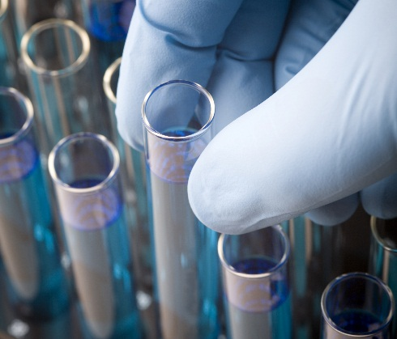
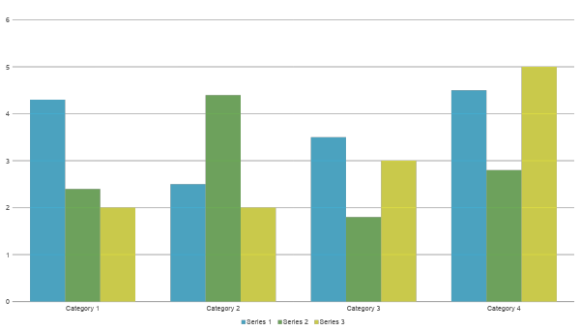
STEM Wizard Project Title
Problem / Question
Materials
Photos
Enter your question here (state the problem).
Quantity (detailed list) | Materials (be specific)
Amount | Item
Amount | Item
Amount | Item
Amount | Item
Amount | Item
Amount | Item
Amount | Item
Hypothesis
Image was created by (insert student name) using (software name); 2026.
Write the hypothesis before beginning the experiment.
Your best educated guess, based on research.
If you are doing an engineering project, this section should be your engineering goal.
Procedure
Numerically list all steps in your procedure.
Step 2
Step 3
Picture were taken by (insert student name); 2026.
Variables
Charts
Controlled variable(s)
Independent variable
Dependent variable
  Remains the same throughout your experiments
  The one variable you purposely change and test
  Measure of change observed because of independent variable
  How you will measure the change
Table/chart was created by (student name) using (software name); 2026.
Background Research
Data / Observations
Graphs
Brief overview of your background research for the project.
Observation 1
Observation 2
Observation 3
Graph was created by (student name) using (software name); 2026.

Slide 3
Extra Slide
This slide is permitted for any additional, relevant data.
Credit all your sources.
Remember, DO NOT include any animations, videos, or hyperlinks.
Results
Works Cited
Results based on experiments
Result 2
Result 3
Include print and electronic sources in alphabetical order
Conclusion
Photo Credit
Brief summary of discoveries based on results
Indicate and explain whether or not the data supports the hypothesis
All photos, images, and graphics were done by the researcher or parent unless otherwise stated.
MANY IMAGES FOUND ON THE WEB ARE COPYRIGHTED. ONLY USE IMAGES FOR WHICH YOU HAVE THE EXPRESS PERMISSION OF THE PHOTOGRAPHER/STOCK IMAGE COMPANY, AND CREDIT THE IMAGE AS REQUIRED BY COPYRIGHT.

Slide 4
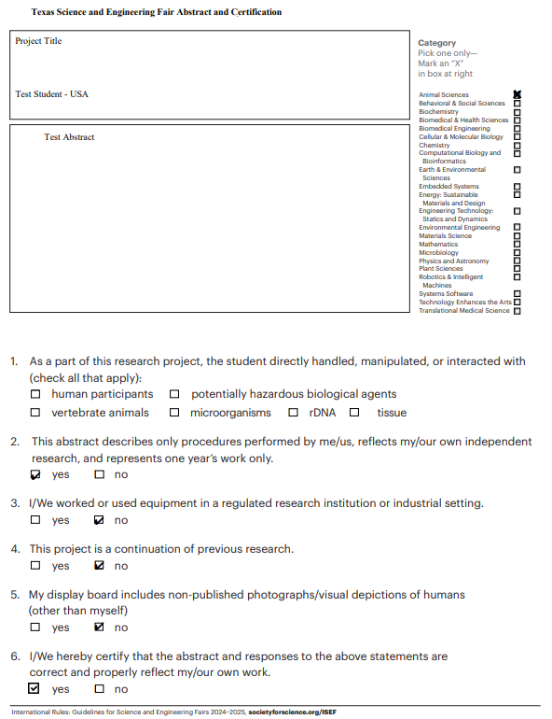
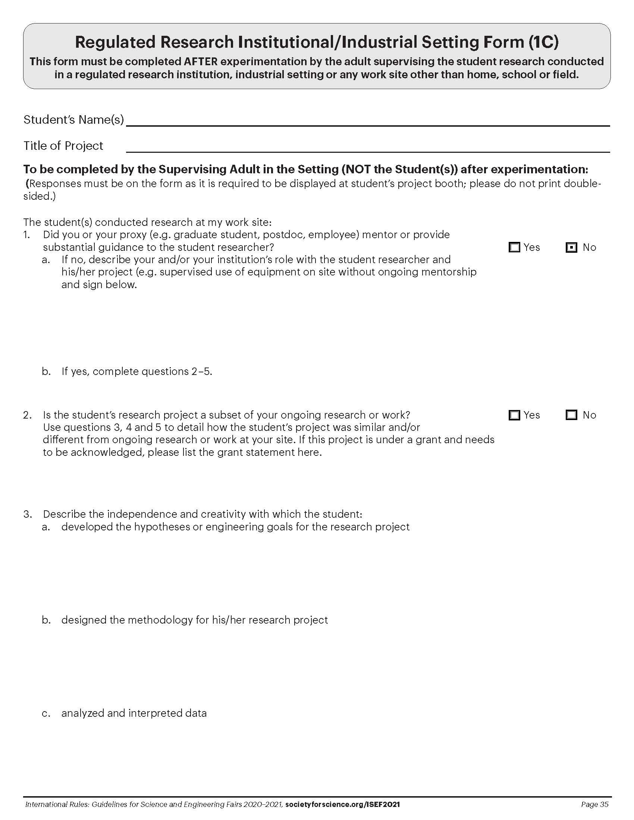
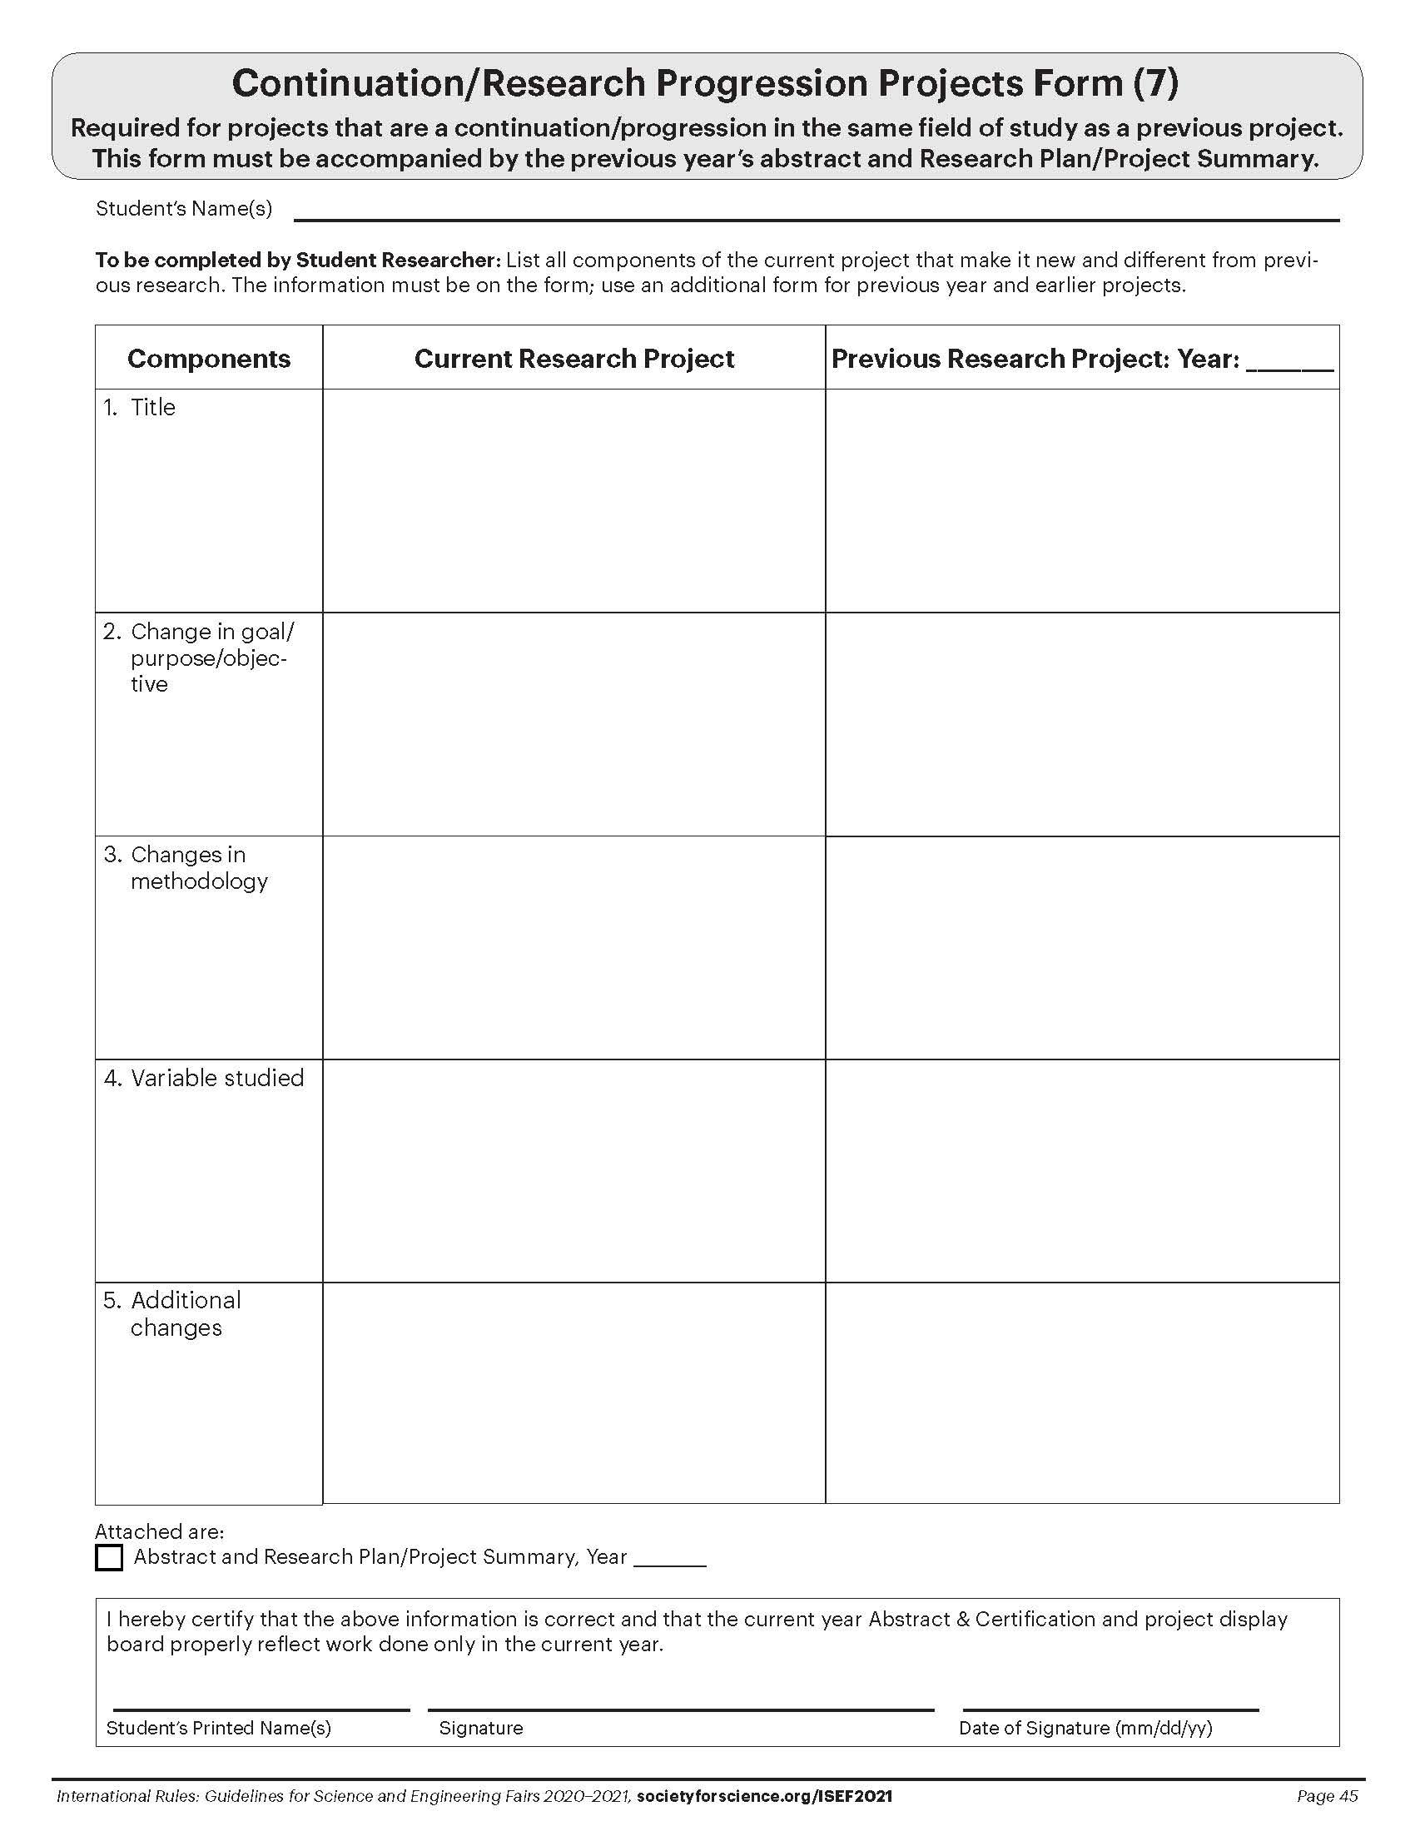
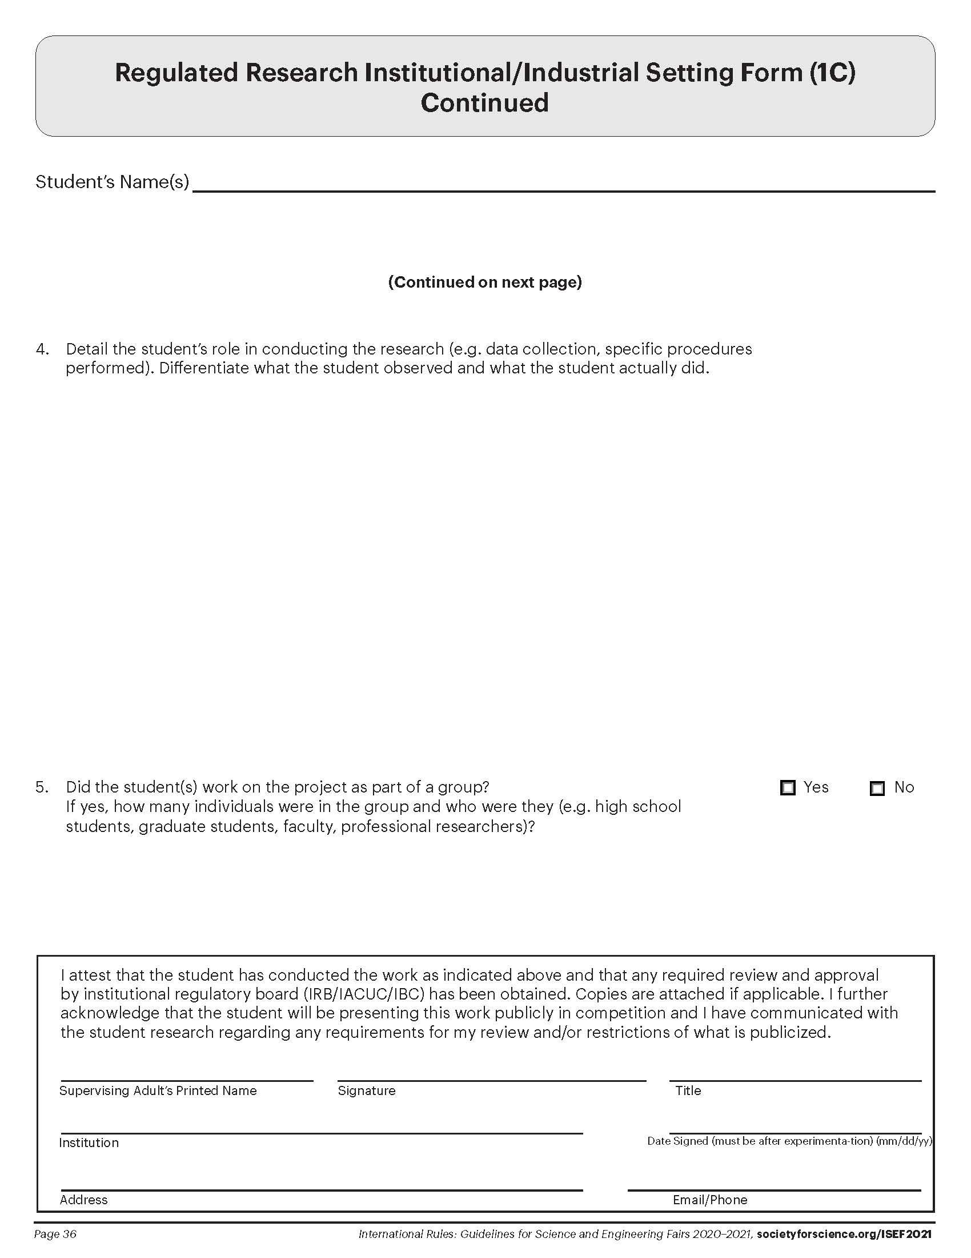
Project Forms
Instructions
Abstract
Form 1C (If Required)
Form 7 (If Required)
ALL Projects must display the Approved Abstract and Form 1C (Regulated Research Institutional/ Industrial Setting Form) and/or Form 7 (Continuation/ Research Progression Projects Form) if required for your project.
These forms are found in the STEM Wizard Files and Forms (look on the left side of screen).
Download the documents as PDFs.
Ensure all forms are clear enough for judges to read.
Example
Replace with Your Approved Abstract from STEM Wizard
Example
Replace with Your Form 1C
from STEM Wizard (If Required)
Example
Replace with Your Form 7
from STEM Wizard (If Required)
Example
Replace with Your Form 1C
from STEM Wizard (If Required)

