Slide 1
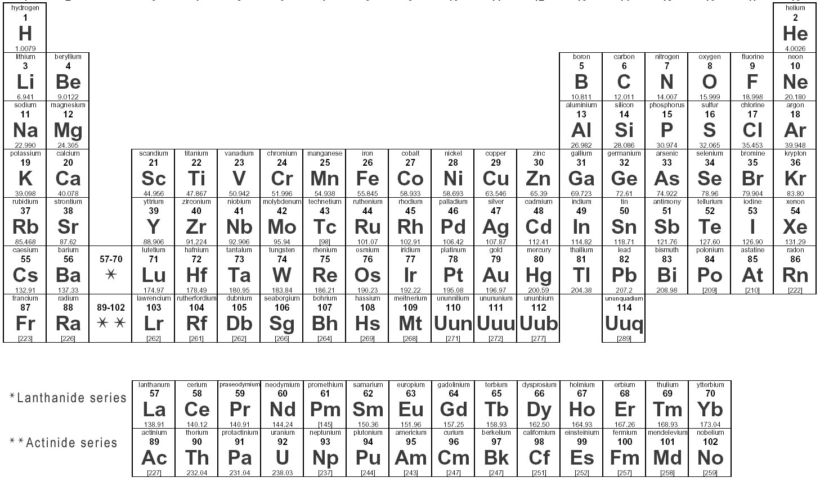
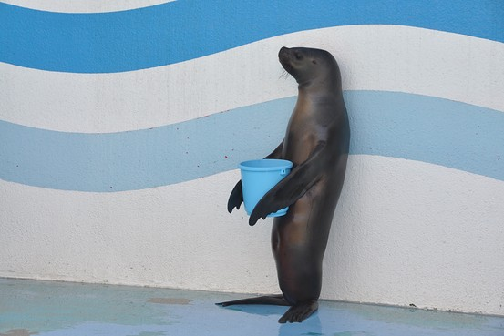
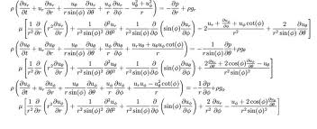
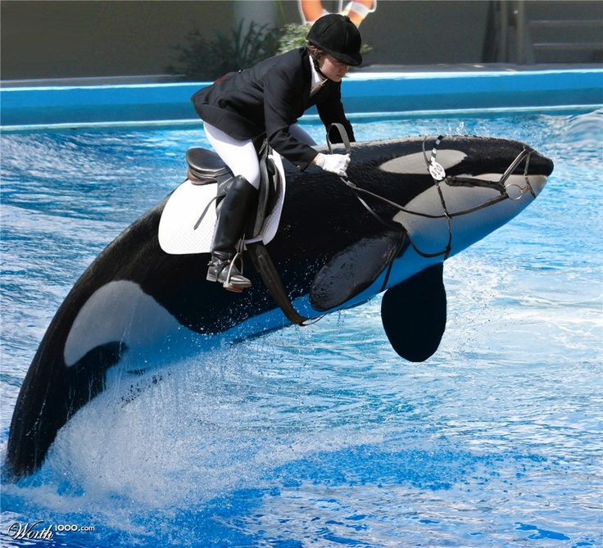

This is where you should put the title of your poster
Mr. Clark Kent, Dr. Pamela Smith, & Dr. Leroy Jenkins
Doctoral Program in Educational Leadership
Texas A&M University-Corpus Christi College of Education and Human Development
Abstract
Methods
Malaria is an infectious disease spread by the female Anopheles mosquito A quick summary of the research A quick summary of the research A quick summary of the research A quick summary of the research A quick summary of the research A quick summary of the research A quick summary of the research A quick summary of the research A quick summary of the research A quick summary of the research A quick summary of the research A quick summary of the research A quick summary of the research A quick summary of the research A quick summary of the research A quick summary
Figure 1. More methods. More methods More methods More methods More methods More methods More methods More methods More methods More methods
Introduction
Blah blah blah is a parasite-induced disease that is a significant medical and economical burden due to the introduction of the research the introduction of the research the introduction stuff introduction stuff introduction stuff introduction stuff introdhttp://education.tamucc.edu/resources/index.htmluction stuff introduction stuff introduction stuff introduction stuff introduction stuff introduction stuff introduction stuff introduction stuff introduction stuff introduction stuff introduction stuff introduction stuff introduction stuff introduction stuff introduction stuff introduction stuff introduction stuff introduction stuff
the in
Results
Conclusion
Reference list goes here Reference list goes here
Reference list goes here
Reference list goes here
Reference list goes here
Reference list goes here
Reference list goes here
Reference list goes here
The protozoan P. falciparum has a very complicated lifecycle consisting of three-stages. More introduction stuff maybe,
the host More introduction stuff maybe, More introduction stuff maybe, More introduction stuff maybe, MFor future research once all genes have been sub-cloned into the pSAT vector they will then be used to transform carrot calli. The transgenic plants will then co-express the gene products in the carrot plants.
the host More introduction stuff maybe, More introduction stuff maybe, More introduction stuff maybe, MFor future research once all genes have been.
References
Blah blah blah is a parasite-induced disease that is a significant medical and economical burden due to the introduction of the research the introduction of the research the introduction stuff introduction stuff introduction stuff introduction stuff introdhttp://education.tamucc.edu/resources/index.htmluction stuff introduction stuff introduction stuff introduction stuff introduction stuff introduction stuff introduction stuff introduction stuff introduction stuff introduction stuff introduction stuff introduction stuff introduction stuff introduction stuff introduction stuff introduction stuff introduction stuff introduction stuff
the in
A description of the methods A description of the methods A description of the methods A description of the methods A description of the methods A description of the methods A description of the methods A description of the methods A description of the methods A description of the methods A description of the methods A description of the methods A description of the methods A description of the methods A description of the methods A description of the methods A description of the methods A description of the methods A description of the methods A description of the methods
The lifecycle proteins that are currently being targeted include MSP-1_19, AMA1, and MSP2, all from the blood stage, Pfs48_45 from the sexual stage, and SSP2 from the liver stage. Wow this is complicated is anyone actually reading this. The main focus of this research, though, is to isolate MSP1_19 and insert it into the pGEM-T easy vector as well as a plant expression referred to as the pSAT vector. For future research once all genes have been sub-cloned into the pSAT vector they will then be used to transform carrot calli. The transgenic plants will then co-express the gene products in the carrot plants.

