Slide 1
RESILIENCE

Slide 2
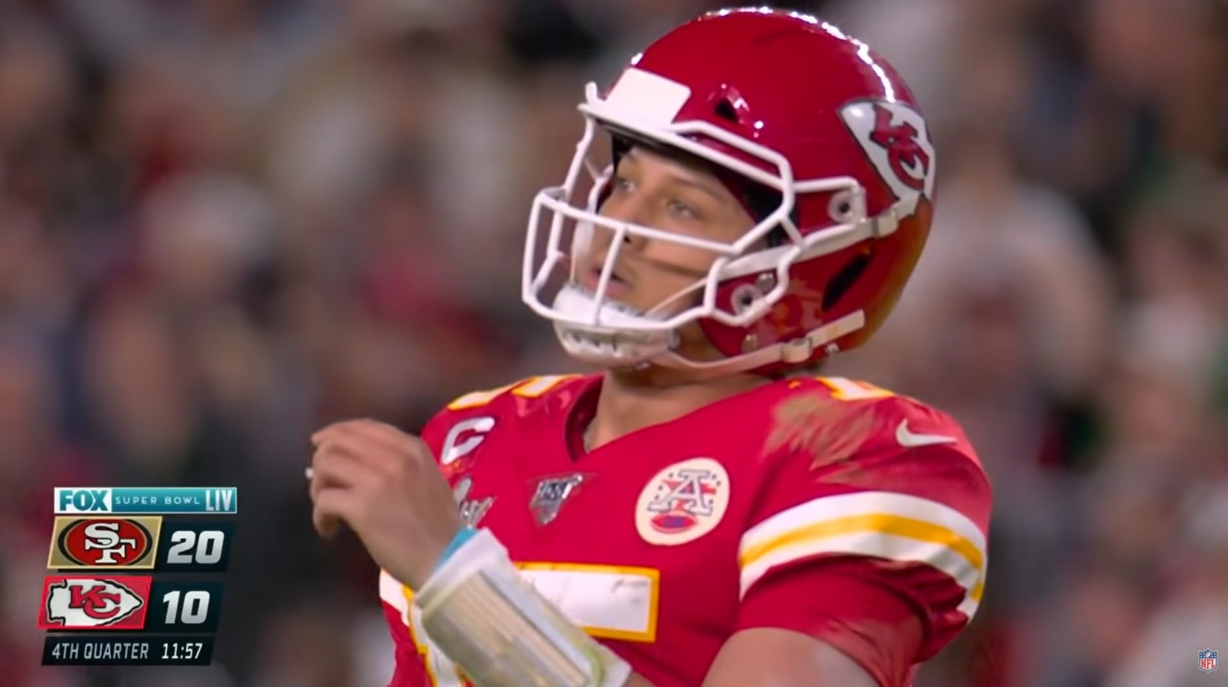

Slide 3
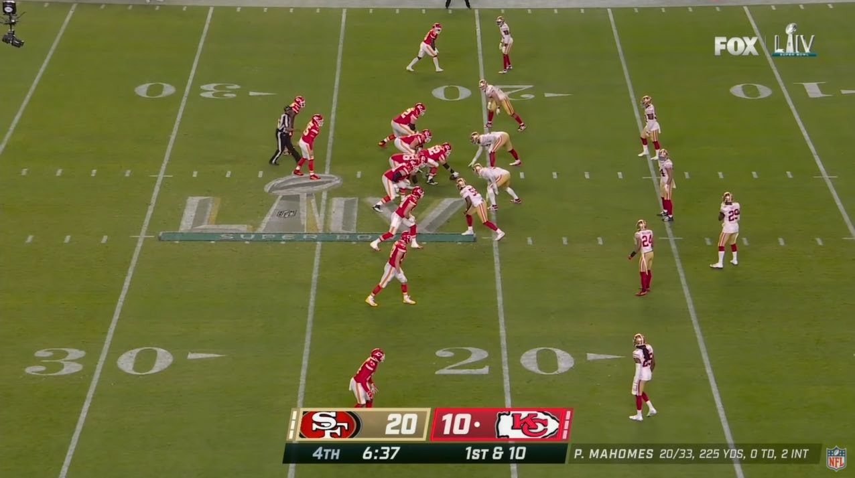

Slide 4
RESILIENCE

Slide 5


Slide 6
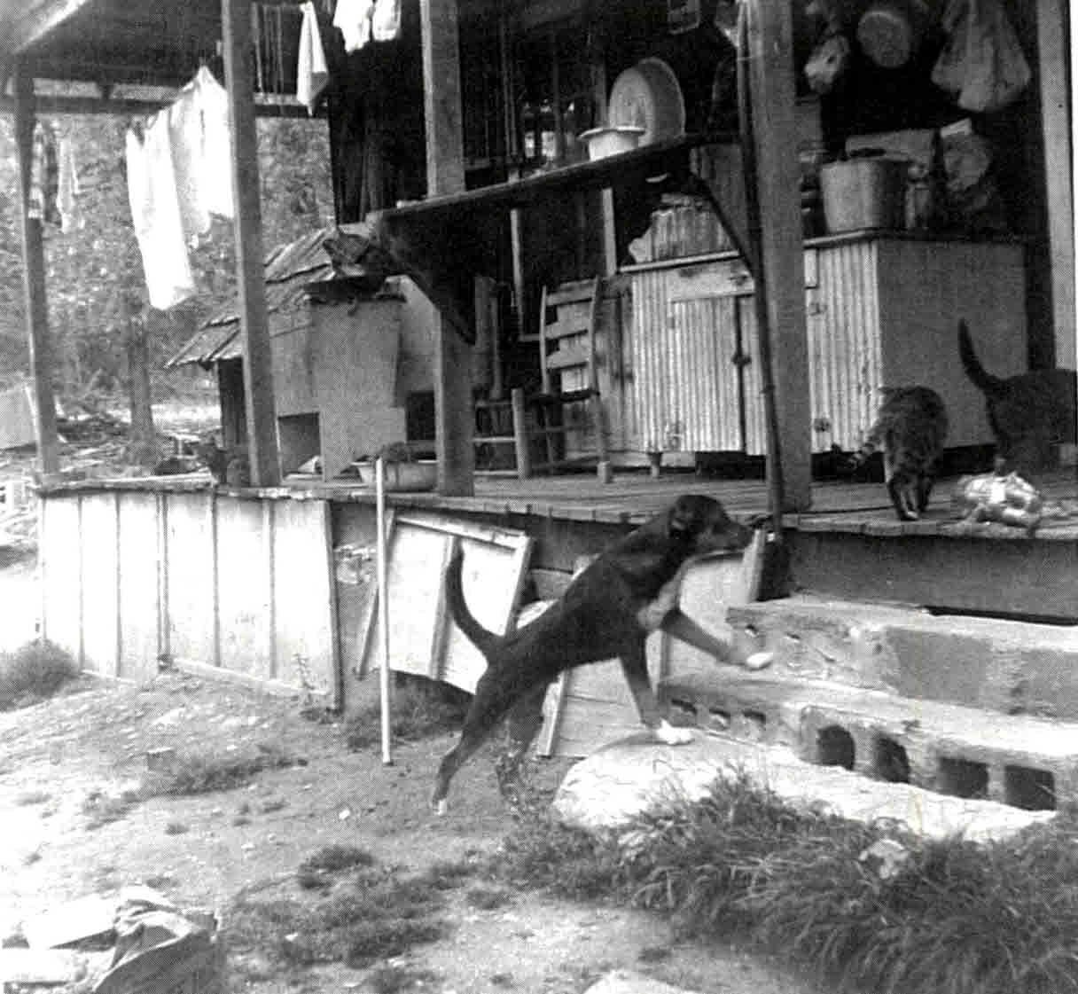
Union County

Slide 7
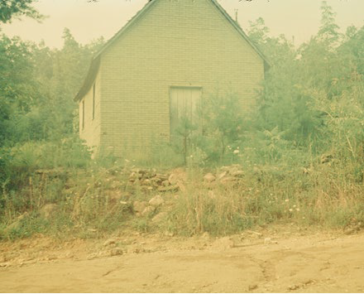
Owltown

Slide 8
RESILIENCE

Slide 9
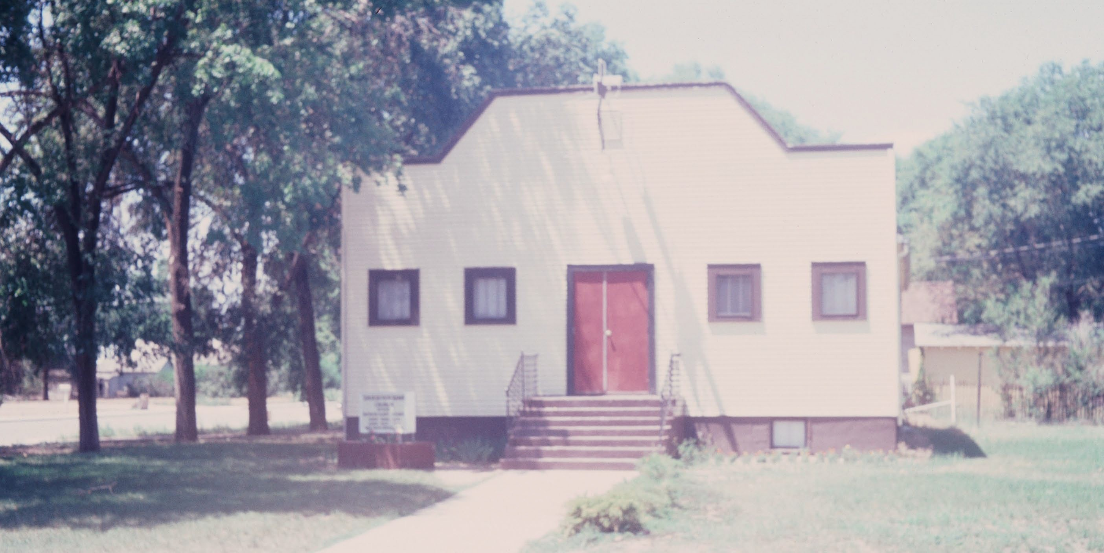

Slide 10
RESILIENCE

Slide 11
Reggie Jackson
-Strike Out King
-2597 Strike Outs
-Won 3 World Series with Oakland A’s
-Won 2 World Series with New York Yankees
-“Mr. October”

Slide 12
Michael Jordan
"I've missed more than 9,000 shots in my career. I've lost almost 300 games. Twenty-six times, I've been trusted to take the game winning shot and missed. I've failed over and over and over again in my life. And that is why I succeed."

Slide 13
RESILIENCE

Slide 14
Things to Remember About Resilient People
Resilient people have these qualities:
They understand “S..t Happens.”
  They understand that the world will definitely bring hardships.
  Everyone will have a bag of rocks to carry. It is how you decide to react to those hardships that will determine your success.
  Overcoming is a process. Every day.
They can choose what to focus on.
  They get out of victim mode and decide what they can actually change to make a difference.
  Never get hung up on trying to change things that cannot be changed.
  Focus!
Are my actions today going to help my cause or hinder my growth?
  Stay away from negative output that really doesn’t help your cause.

Slide 15
Ted Oakley Requests
Appreciate and cherish your family
Work Hard. Hard work will help your success path.
Be grateful for yourself and everyone around you. Write it down daily.
Say a prayer of gratitude and blessings daily.
Give back to the world. Your most uplifting experiences will come from giving back.

Slide 16
RESILIENCE

