Slide 1

TSI Requirements
August 2025

Slide 2

Rule §4.55 (TX Administrative Code, Title 19)
(a) An institution shall assess, by an instrument approved in §4.56 of this subchapter (relating to Texas Success Initiative Assessment Instrument), the academic skills of each entering, non-exempt undergraduate student as defined in §4.53(23) of this subchapter (relating to Definitions) prior to enrollment of the student.
Students must have a complete TSI status in order to be eligible to enroll in courses! TSI Math Status (CR, NCR, Exemption, Waiver) TSI Reading Status (CR, NCR, Exemption, Waiver) TSI Writing Status (CR, NCR, Exemption, Waiver) Students who are MISSING one or more TSI Status are NOT eligible to enroll in ANY courses!

Slide 3
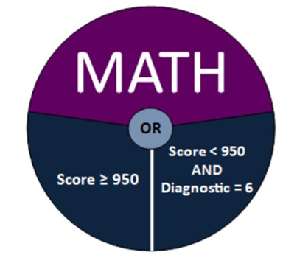
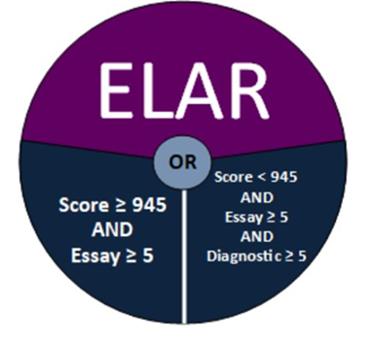
TSI Assessment (TSIA2) Benchmarks
Scores “expire” after 5 years of not being used for placement
TSI Assessment 2 (TSIA2): Beginning January 11, 2021

Slide 4
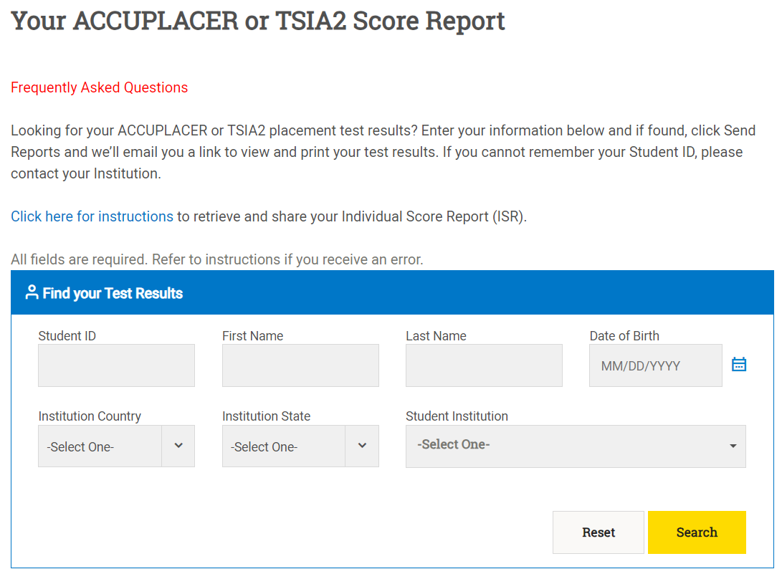

ACCUPLACER
Preferred Submission Method
Students can share TSI scores with TAMU-CC (institution) via ACCUPLACER portal
Alternative Methods
Email score reports to College.Readiness@tamucc.edu
Give our team permission to look up the scores in ACCUPLACER!

Slide 5
TSI Exemptions and Waivers
“…But my high school counselor told me I was exempt!”

Slide 6
TSI Exemptions (Permanent!)
Associates/Baccalaureate degree from an accredited institution​
Transfer/dual credit for college-level math course or ENGL 1301 (or equivalent)
Student has met college readiness standard at another Texas public higher education institution​
Submit COLLEGE transcript to Admissions!

Slide 7
TSI Exemptions (Permanent!)
Associates/Baccalaureate degree from an accredited institution​
Transfer/dual credit for college-level math course or ENGL 1301 (or equivalent)
Student has met college readiness standard at another Texas public higher education institution​
AP/IB exam scores for ENGL/MATH*
SAT: 530 MATH, 480 EBRW
ACT: 22 MATH, 40 ENGL+RDNG
Submit COLLEGE transcript to Admissions!
Submit scores to Admissions! (Early!)

Slide 8


TSI Waivers (Temporary!)
Active duty, has served for at least three years​
Non-degree seeking students​
Completion of a college preparatory course (HB5 Waiver)
  Students MUST report college prep work to our College Readiness team!
  HB5 Waiver expires after one year of enrollment!
Type | Submission Process
CPMATH, CPELA Course | Send official high school transcript showing full credit (with 70+ average) to Admissions!
Texas College Bridge | Submit certificate to TAMU-CC (institution) via GreenLight Locker

Slide 9
College Readiness Requirements
“…But I thought I had to be ‘college ready’ to go to college!”

Slide 10
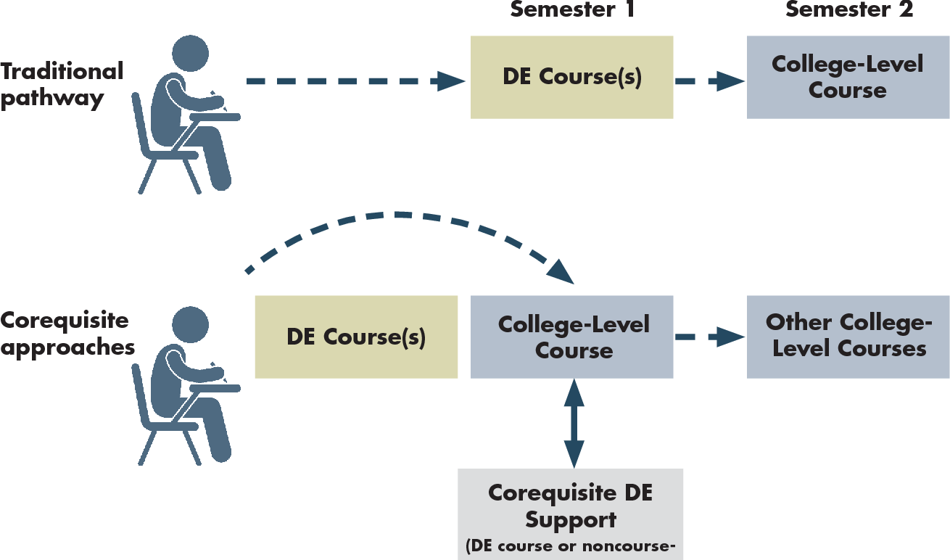
College Readiness Courses
Support Course

Slide 11
College Readiness Courses
Support Course

Slide 12
College Readiness Courses
Reading/Writing (ELAR)
Mathematics
ENGL 1301 + ENGL 0101*
MATH 1314 + MATH 0214*
MATH 1324 + MATH 1024
MATH 1332 + MATH 0099
MATH 1442 + MATH 0242*
PHIL 2303 + MATH 0099
* Credit-bearing courses

Slide 13
College Readiness Team
College.Readiness@tamucc.edu
(361) 825-6793
https://www.tamucc.edu/
academics/planning/

