Slide 1
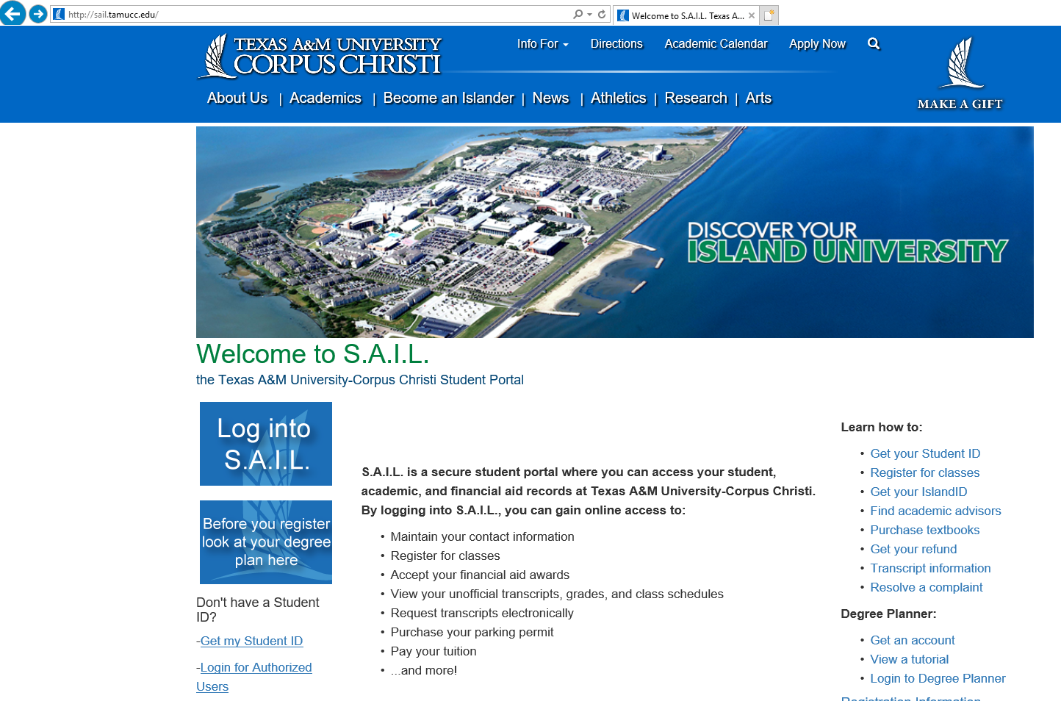
www.sail.tamucc.edu
Start here!

Slide 2
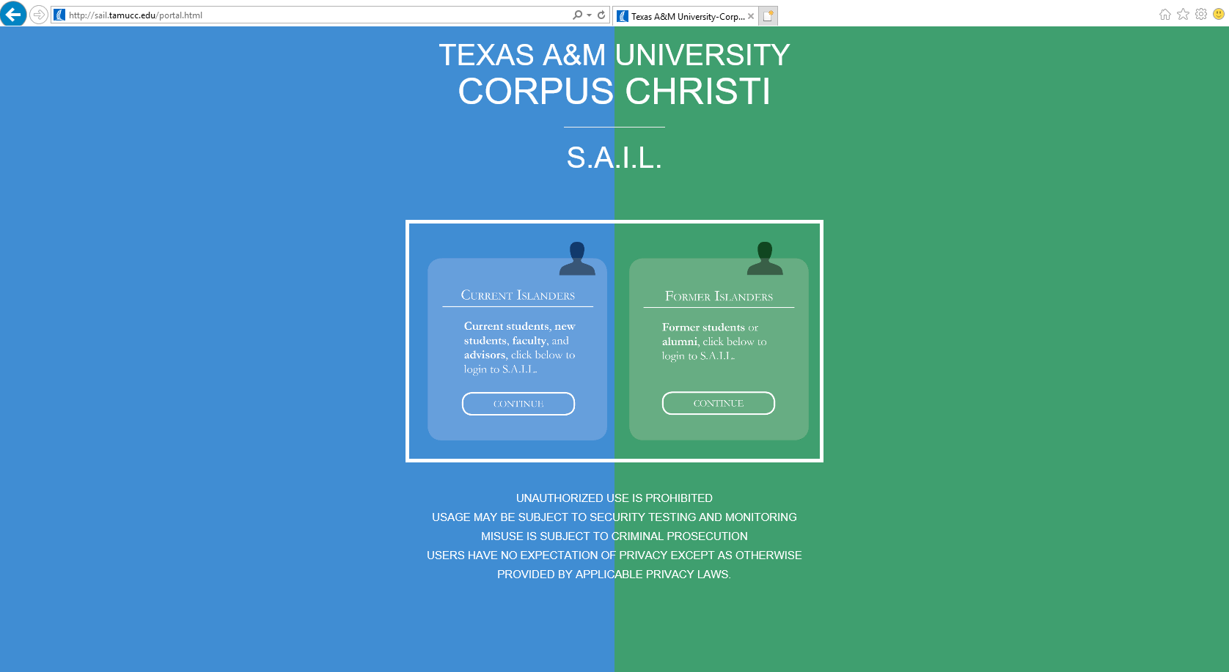
You will be prompted to login using your Island ID and password.

Slide 3
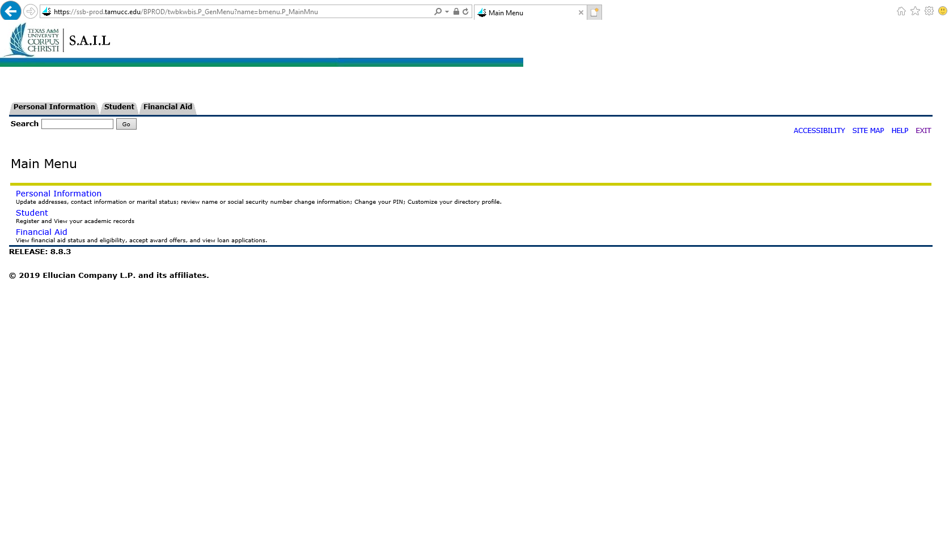

Slide 4
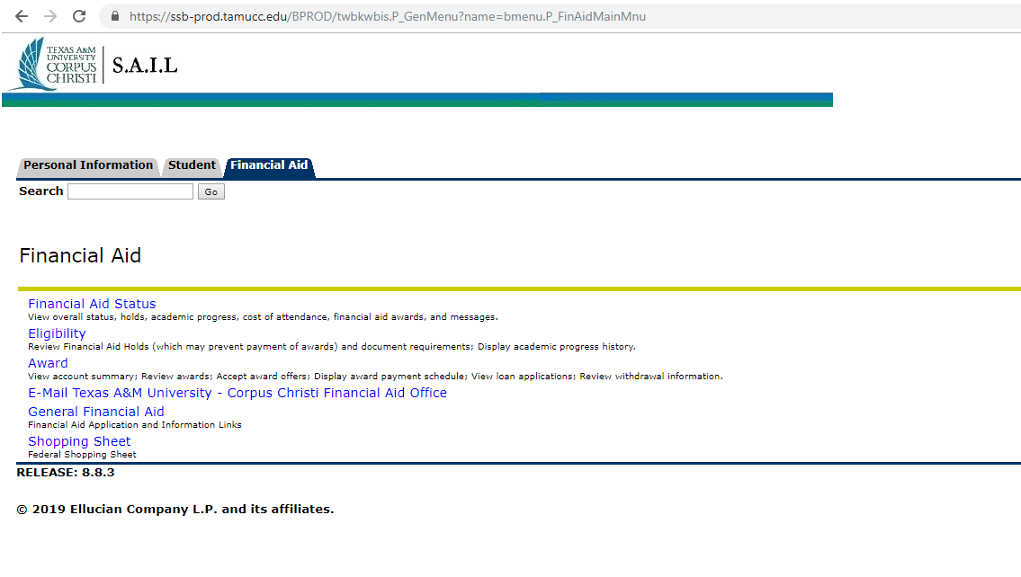

Slide 5
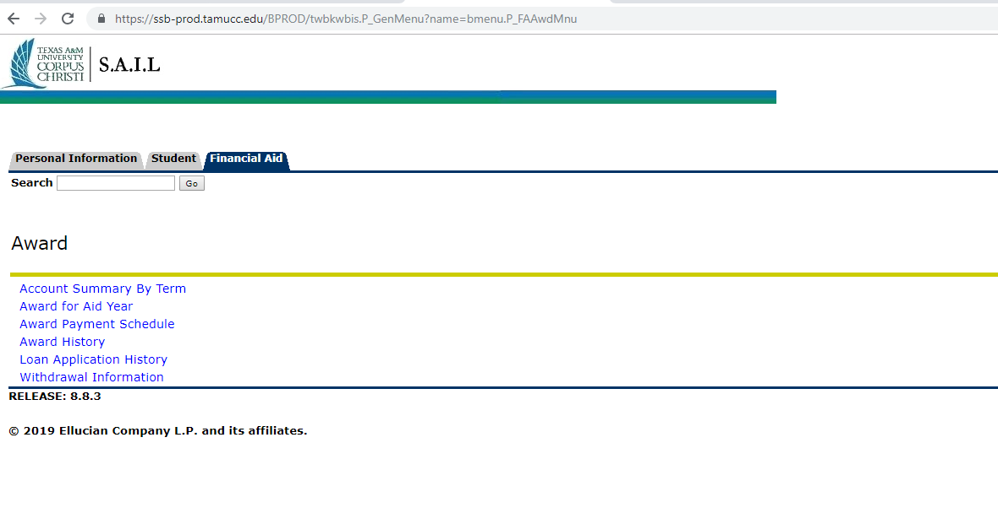

Slide 6
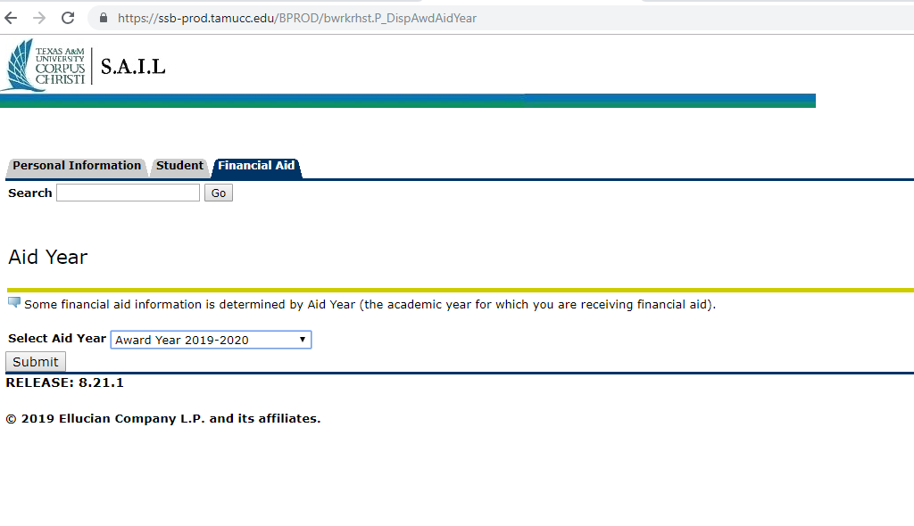
Make sure to select the 2019-2020 aid year

Slide 7
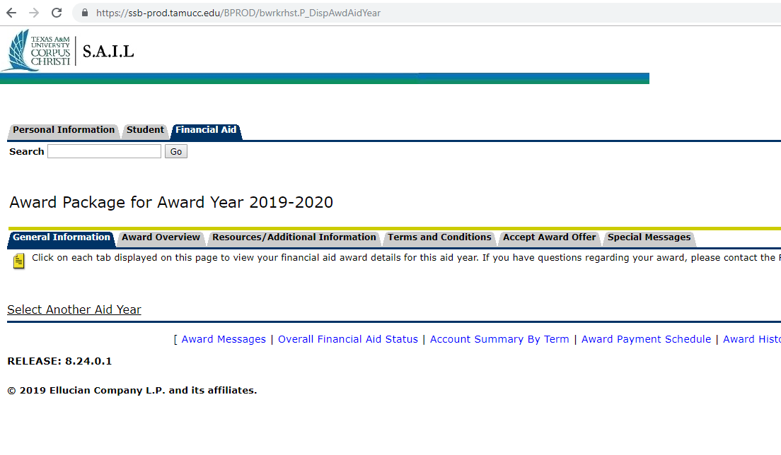

Slide 8
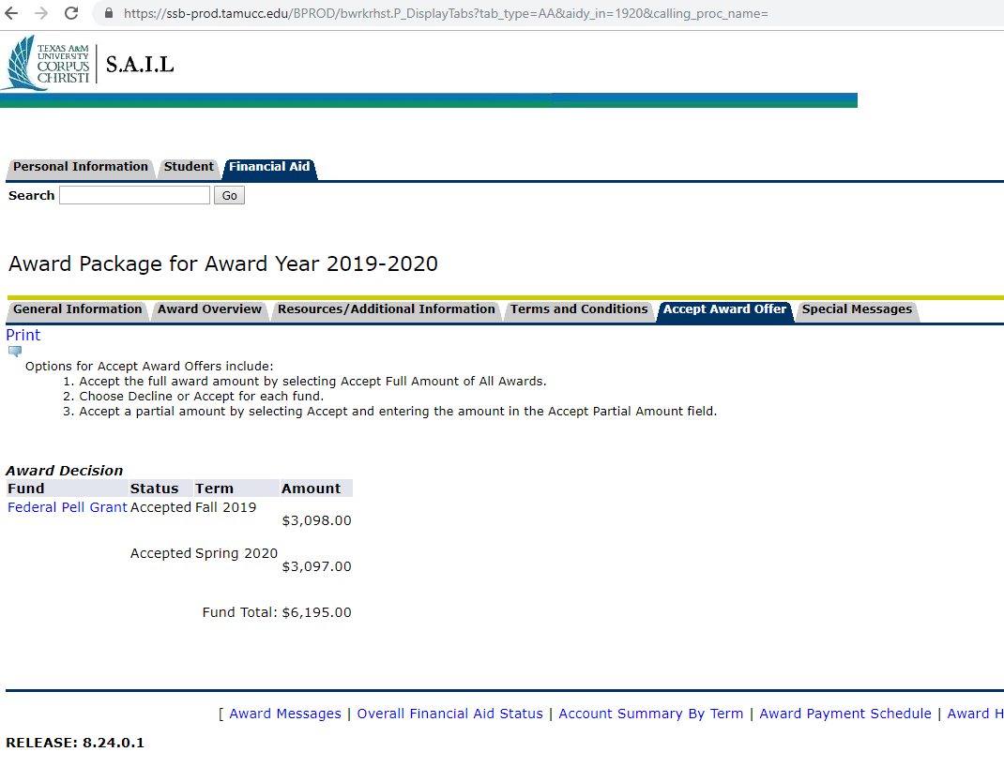
Awards will be listed here with option to Accept or Decline offers

